Slide 1
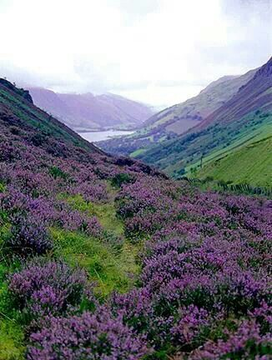

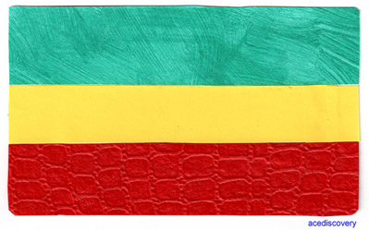
Will Ye Go Lassie Go
Author Sr Maeve O’Brien
Book Launch
21st September 2014, 2pm Sacred Heart Parish Mosman
The National Flags Scotland and Ethiopia
Sr Bridget Harley
2pm Gather in the hall
2.15pm Welcome by Alan Walsh Maser of Ceremony
Welcome to Country Bernie Harrison
Steve Liebmann: The life of Sr Bridget
Sr Maeve O’Brien: Reflections on life in Ethiopia with Sr Bridget
Nataliaja Lambert will sing Will Ye Go Lassie Go (accompanist Bernie Harrison)
Chorus: Will ye go lassie, go? And we’ll all go together
To pluck wild mountain thyme, all around the blooming heather,
Will ye go lassie, go?
Fr Eugene To give the Blessing
2.45pm Afternoon Tea
Books will be available for sale before and after the formal proceedings.
Sr O'Brien and Fr Eugene will be at two tables to sign copies of the book
Cash or cheques $20 per book for one hour
4.30pm Event closes

