Slide 1
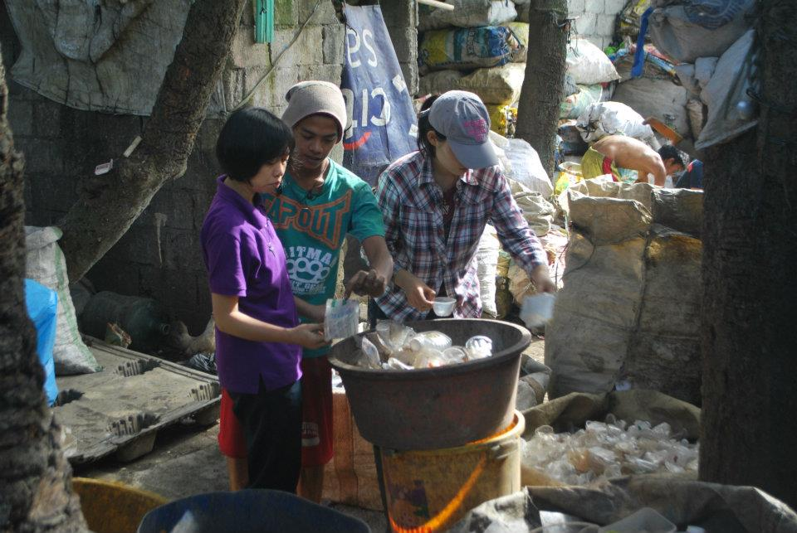
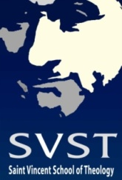
Doing Theology in a garbage dump
The Rough Grounds and Theological Method
Daniel Franklin Pilario C.M.

Slide 2
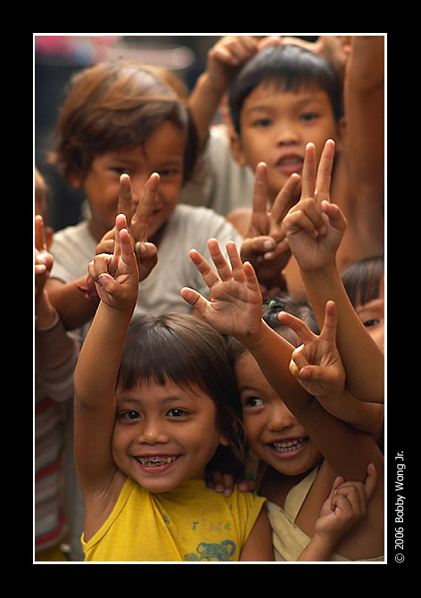
OUTLINE
The Rough Grounds of Payatas
Their Lives as Painful Questions
Closed Churches
Closed Theologies
Reflective Theologizing

Slide 3
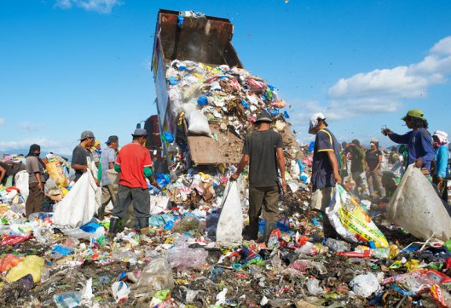
1. THE ROUGH GROUNDS OF PAYATAS

Slide 4
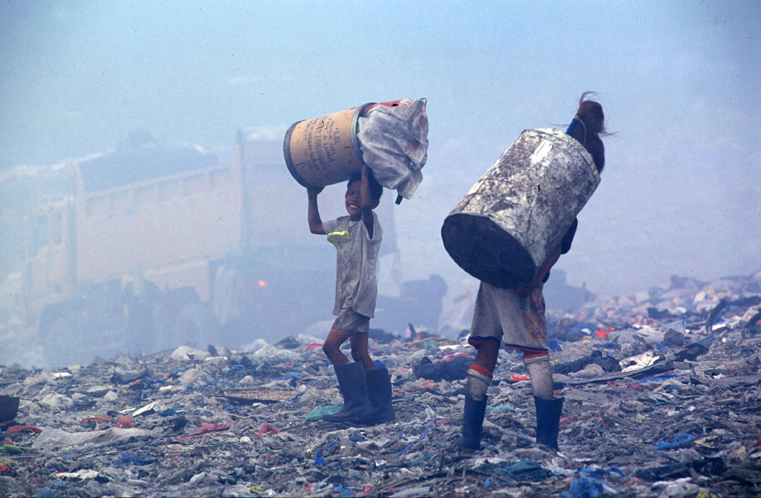

Slide 5
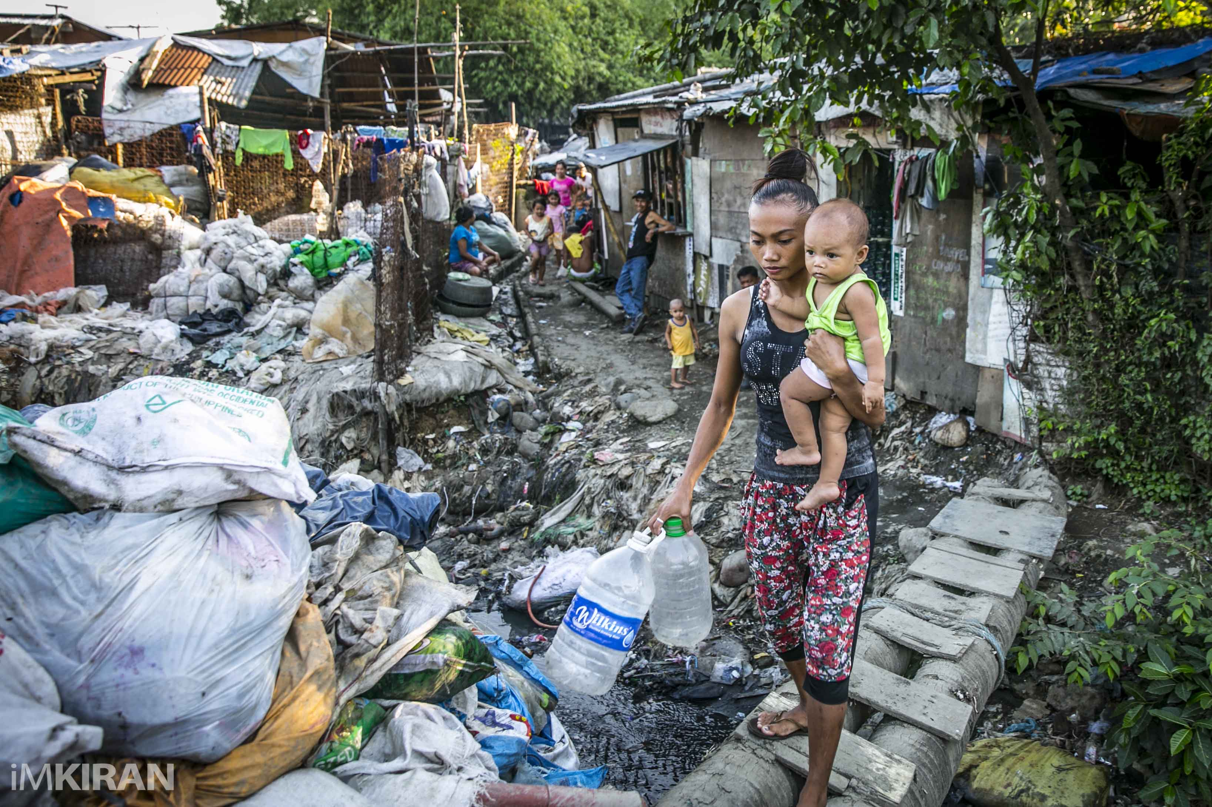

Slide 6
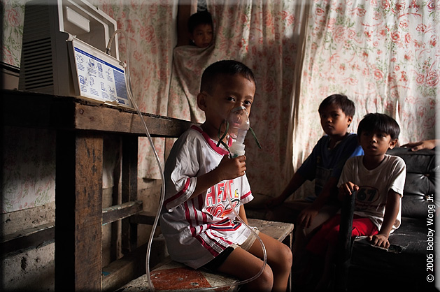
community health services

Slide 7
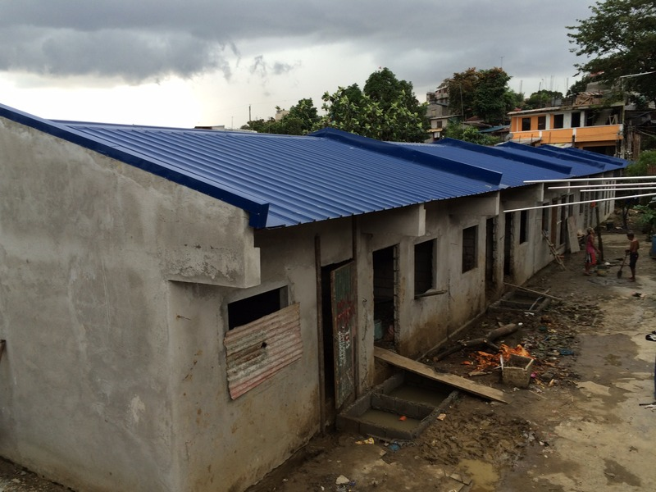
Housing programs, etc.

Slide 8
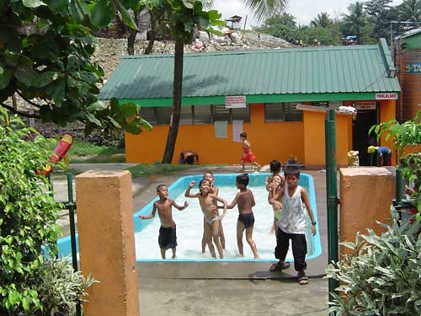

Slide 9
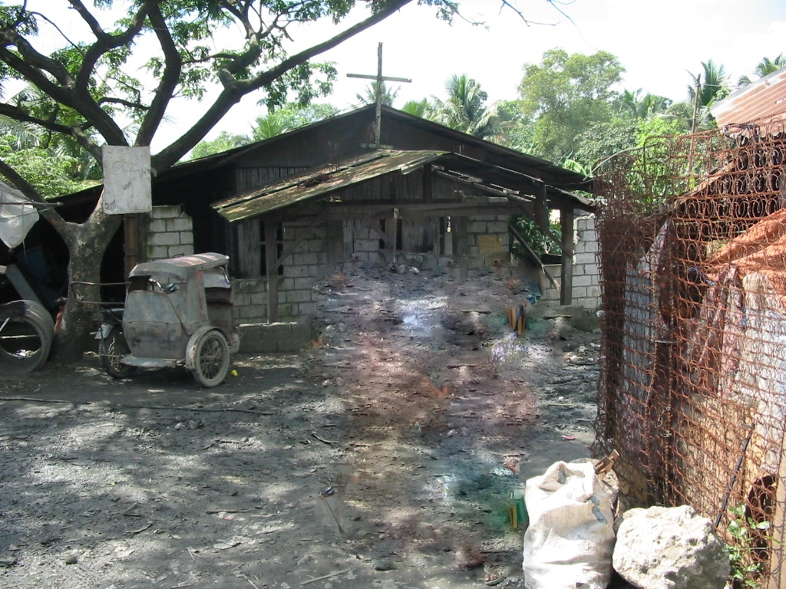

Slide 10
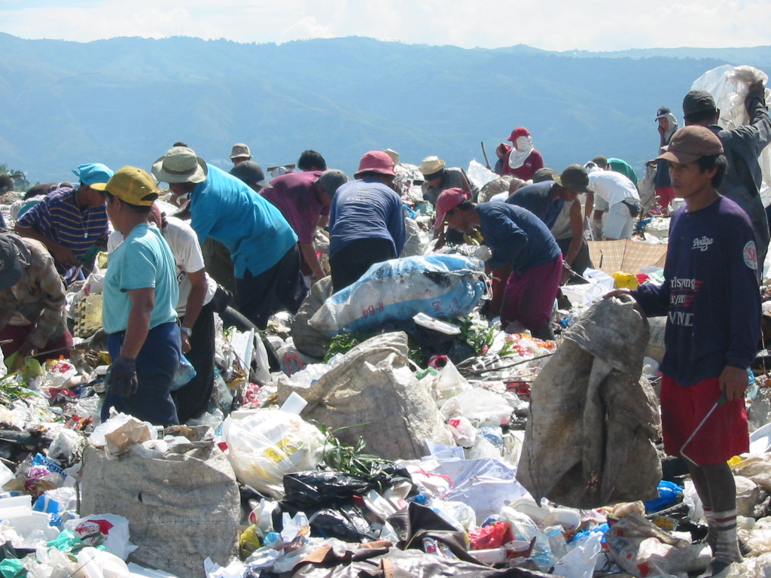
MY QUESTION
How do these rough grounds affect the way I do theology?

Slide 11
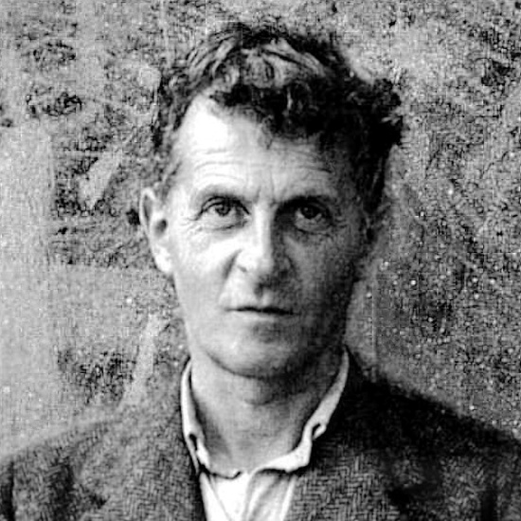
We have got onto slippery ice where there is no friction and so in a certain sense the conditions are ideal, but also just because of that, we are unable to walk. We want to walk, so we need friction. Back to the rough ground!
-Ludwig Wittgenstein
Philosophical Investigations

Slide 12
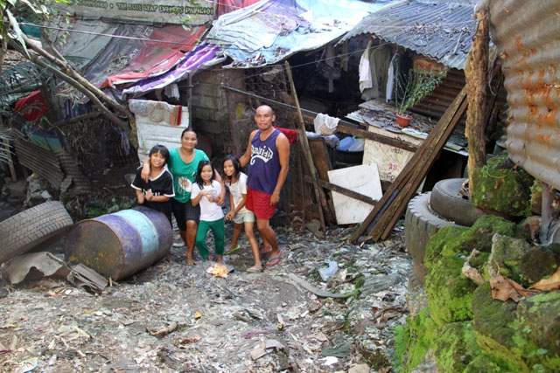
2. THEIR LIVES AS PAINFUL QUESTIONS
A Family in Payatas

Slide 13
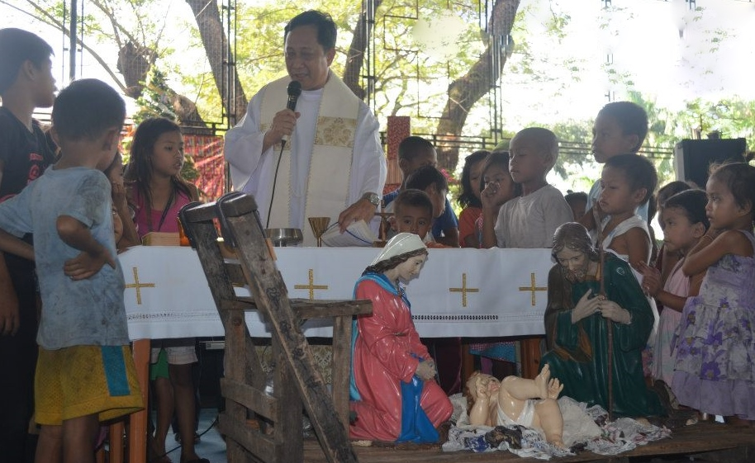
Liturgies on the Ground

Slide 14
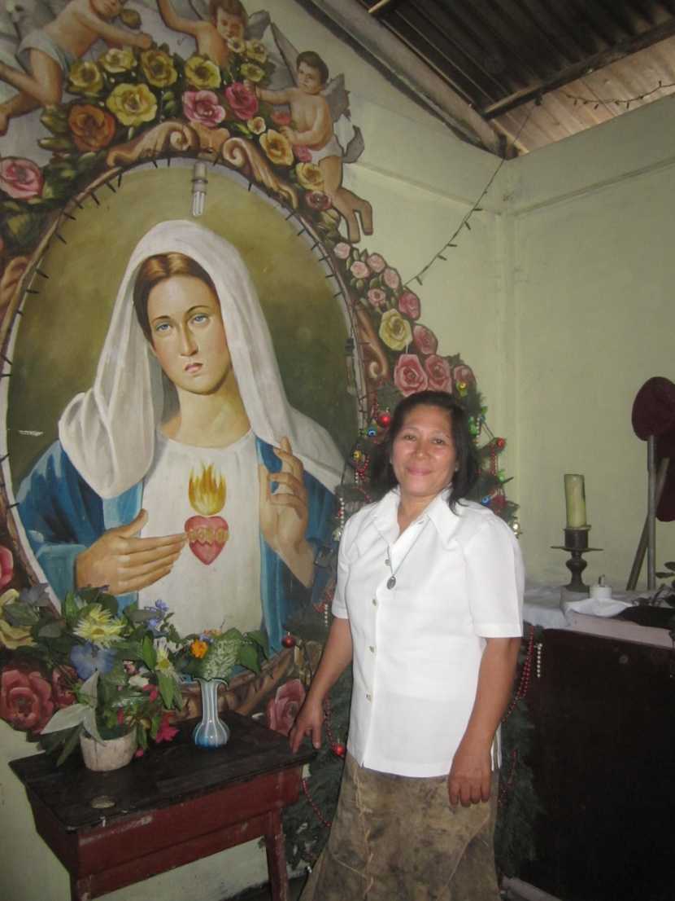
3. CLOSED CHURCHES
“Please do not be too strict.”

Slide 15
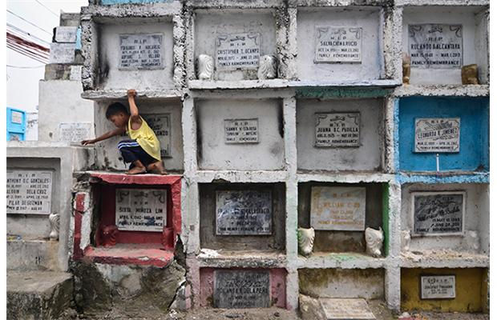
“Can you please leave the church open?”

Slide 16
4. CLOSED THEOLOGIES
It is not only our churches and mentalities which are closed but also the way we do theology.
It is this closed methods that make the Church deaf both to people's voices and to the whispers of the Spirit. In the end, we have a dead church - so closed and so dead that God has decided to move to the cemetery.

Slide 17
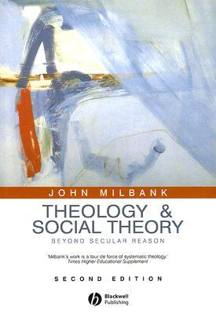
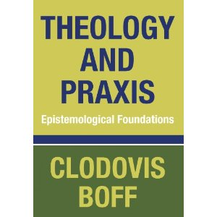
A Closer Look at Two Methods

Slide 18
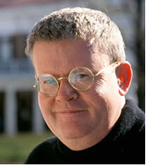
RADICAL ORTHODOXY: John Milbank

Slide 19
IN QUEST OF A STOLEN CROWN
Once upon a time, it was theology that wore the crown, theology that carried out most of the fundamental reading of all other interpretations and all other social formations... It was the master narrative. Stolen by secular reason, and worn as 'social theory', the master-narrative is now sought by its earlier owner.
- Gerard Loughlin

Slide 20
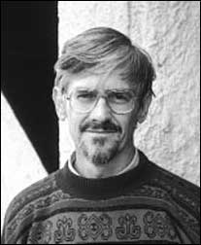
LIBERATION THEOLOGIES: Clodovis Boff
1970s - “Ideologization of the Faith”
1974 – International Theological Commission studies liberation theology (ITC)
1984 – Instructions on Certain Aspects of the Theology of Liberation (CDF)

Slide 21
See-Judge-Act Process
SEE - What is our situation?
JUDGE - What does God tell us about our situation?
ACT - What do we need to do to transform our situation?
Socio-Analytic Mediation
Hermeneutic Mediation
Pastoral Mediation

Slide 22
‘PRACTICE’ IN ALTHUSSER
By practice in general I shall mean any process of transformation of a determinate given raw material into a determinate product, a transformation effected by a determinate human labour, using determinate means of production.
In any practice thus conceived, the determinant moment is neither the raw material nor the product but the practice in the narrow sense; the moment of the labour of transformation itself.
- Louis Althusser, Reading Capital

Slide 23
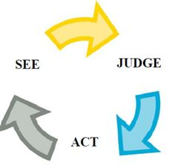
BOFF’S THEOLOGICAL METHOD
“raw materials”
“content of the faith”
“pastoral practice”

Slide 24
convergence
Milbank and Boff - theologians who find themselves in opposite sides of ideological spectrum - in fact possess a common weakness.
Both enthrone the "theologian" as the ultimate arbiter of theological meaning at the expense of voices from the ground.

Slide 25
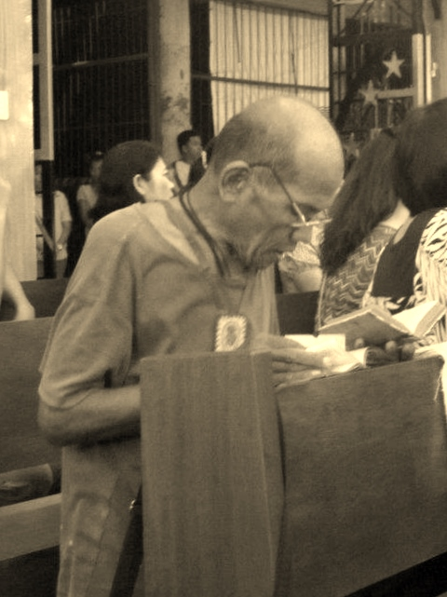
5. REFLEXIVE THEOLOGIZING

Slide 26
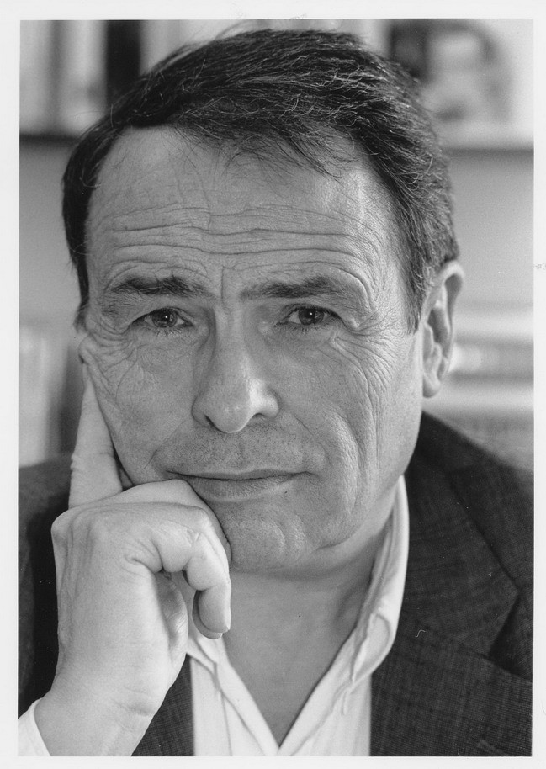
SCIENCE VS. PRACTICE
Science has a time which is not that of practice. For the analyst, time disappears: not only because the analyst cannot have any uncertainty as to what can happen, but also because he has time to totalize, that is, to overcome the effects of time.
Pierre Bourdieu, The Logic of Practice

Slide 27
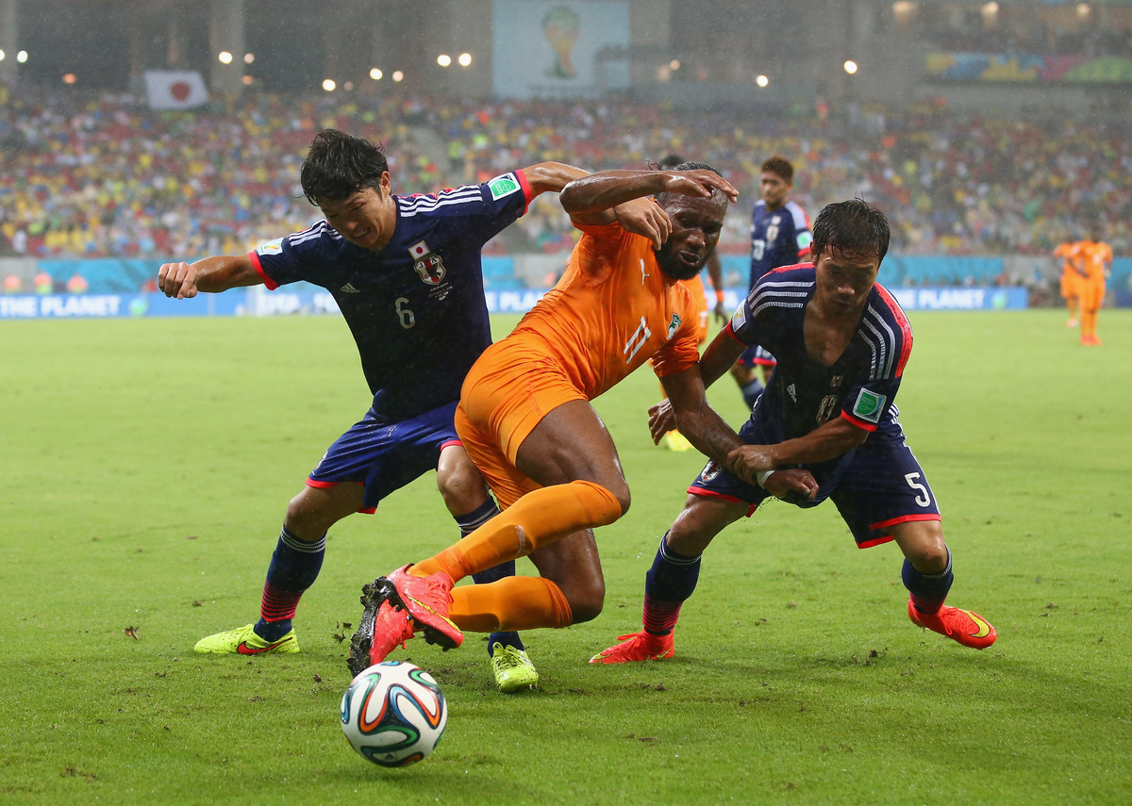
The Feel for the Game

Slide 28
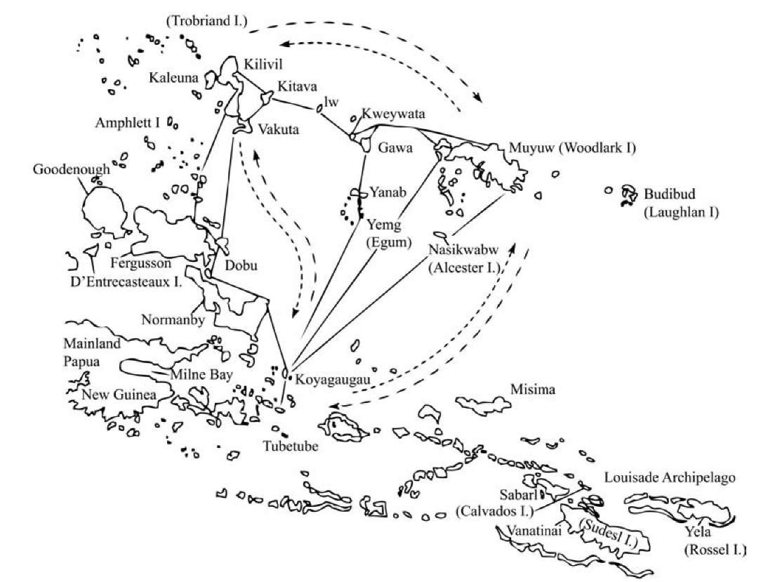
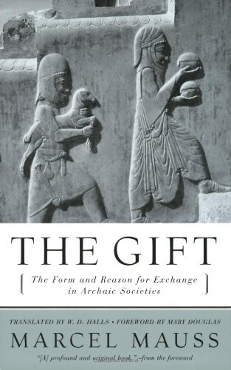
Cycles of Reciprocity

Slide 29
THE POLITICS OF GIFT-GIVING
GIFT
RETURN-GIFT
The time between the gift and the return-gift determines the character of the gift-exchange.

Slide 30
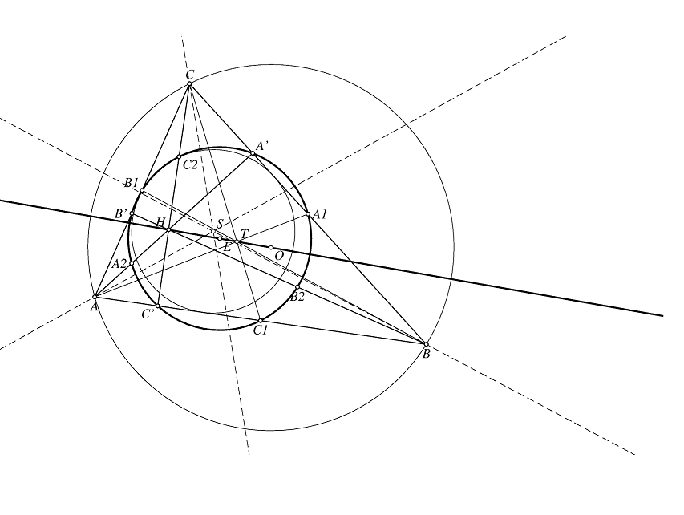
MATHEMATICS AND REALITY
“As far as the laws of mathematics refer to reality, they are not certain; and as far as they are certain, they do not refer to reality.”
Albert Einstein
(Prussian Academy of Sciences 1921)

Slide 31
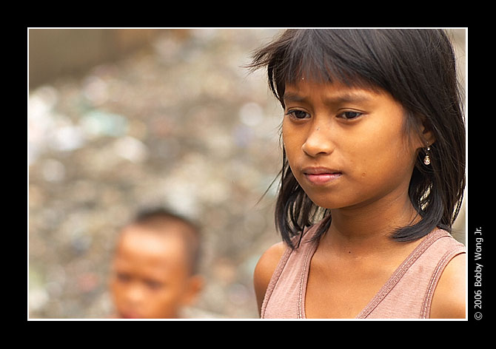
What are the implications to theology?
Theological Reflexivity
The Role of Praxis in Theological Method

Slide 32
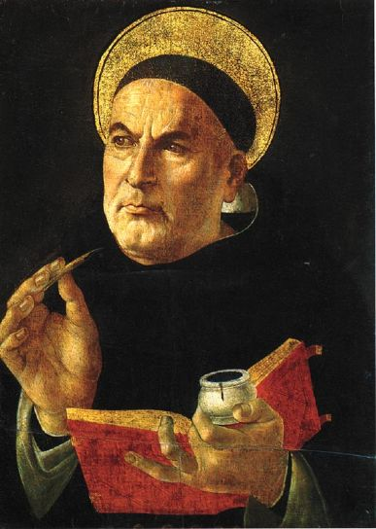
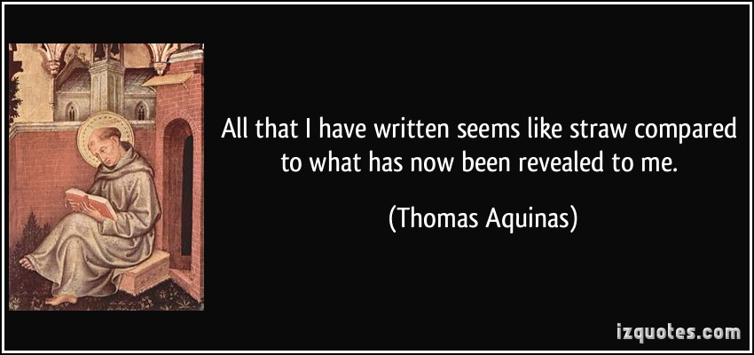
THOMAS AQUINAS

Slide 33
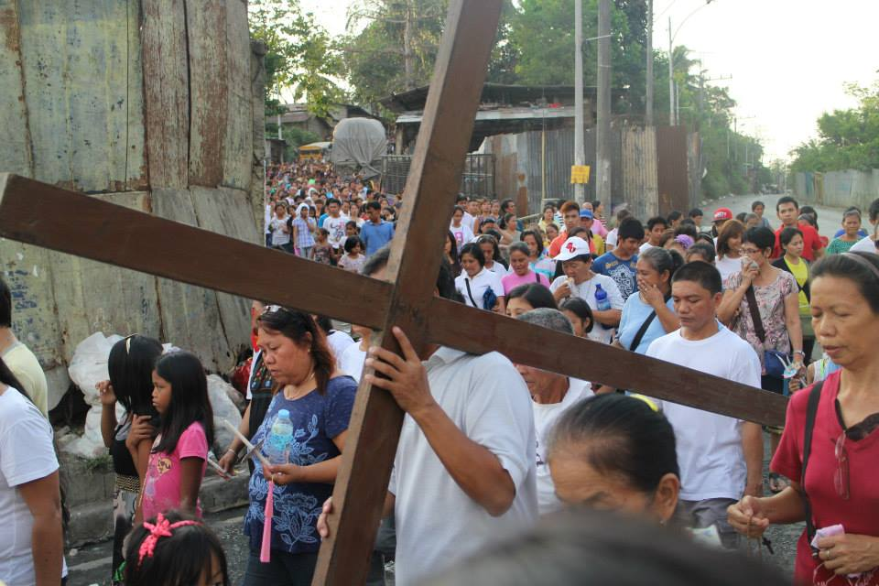
THE ROLE OF PRAXIS IN THEOLOGICAL METHOD
The voices, sentiments, reflections and praxis from the rough grounds are necessary to develop, change, modify or subvert the way we have formulated our doctrines, dogmas and beliefs.

Slide 34
Sensus Fidei (2014)
Problems arise when the majority of the faithful remain indifferent to doctrinal or moral decisions taken by the Magisterium... This lack of reception may indicate a weakness of lack of faith on the part of the people of God...
But in some cases it may indicate that certain decisions have been taken by those in authority without due consideration of the experience of the faithful, or without sufficient consultation of the faithful by the Magisterium. (123)

Slide 35
BY WAY OF CONCLUSION
Payatas Dumpsite – December 18, 2011

