Slide 1
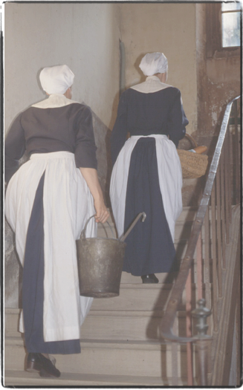
Origins of the Company of the
Daughters of Charity
The hand of God in a series of events that opened the way to a new type of religious congregation

Slide 2
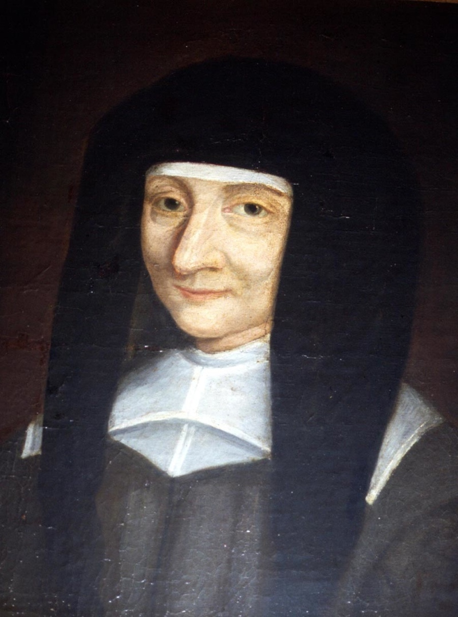
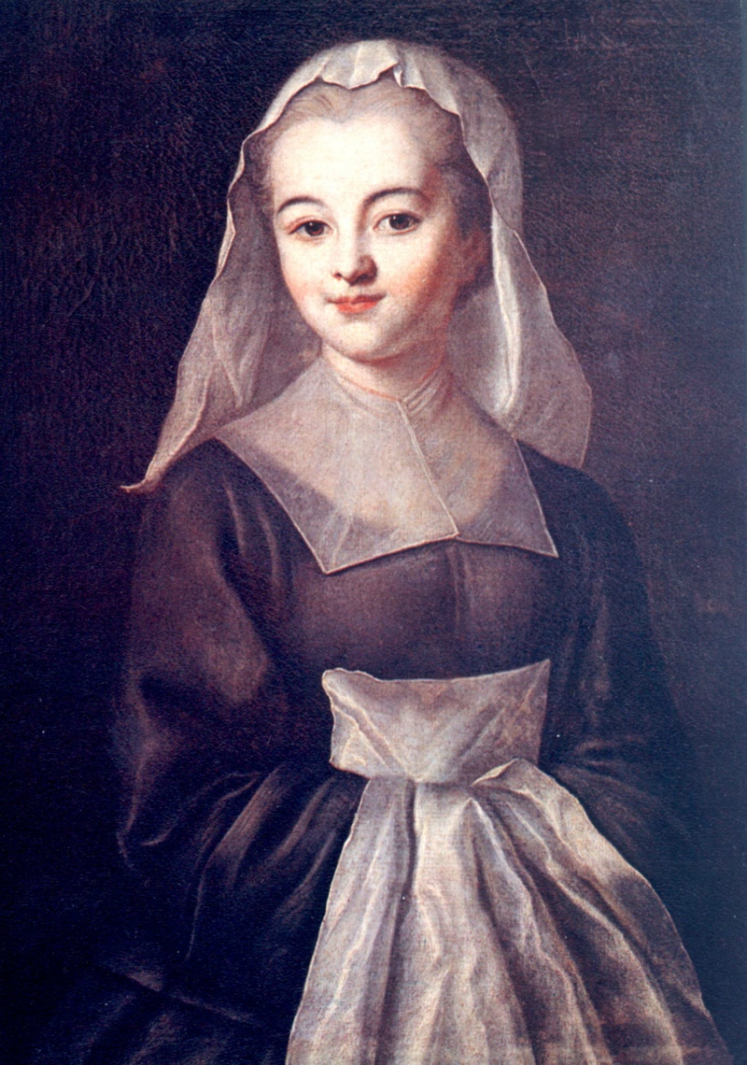
The Company of the Daughters of Charity was born quietly, in the manner of the things of God.
The Spirit of God breathed into the hearts of three persons: Vincent de Paul, Louise de Marillac and Marguerite Naseau.

Slide 3
Vincent de Paul discovered material and spiritual misery in the countryside of France.
In 1617, he brought together the ladies of the bourgeoisie to support those who were poor, both materially and spiritually, in order to help them move toward well-being and regain their self assurance. They formed groups which he called “Confraternities of Charity.”

Slide 4
Louise de Marillac, who had always been aware of those in difficulty around her, visited poor persons even before meeting Vincent de Paul.
Attentive to the needs of the most humble, and with an open heart of faith, she visited the first “Confraternities of Charity” at the request of Vincent de Paul.

Slide 5
Vincent and Louise realized that the direct service of poor persons was not easy for the ladies of nobility or of the bourgeoisie.
It was difficult to overcome the tension between the ideal of service, and the barriers of social class. The noble women took meals, distributed clothing and gave care and comfort. They visited the slums dressed in beautiful dresses next to people they considered to be peasants. The families of the ladies were not always favorable to these works.

Slide 6
Marguerite Naseau met Vincent de Paul during one of his Missions of Evangelization.
Her only intention was to serve God.
Marguerite was a 34 year old woman from the countryside in Suresnes, who had taught herself to read, and worked in her village with other young girls teaching children to read. In 1630 she met up with Vincent and Louise in Paris. They suggested that she help the Ladies of the Confraternities.

Slide 7
Louise had the idea that young women, like Marguerite, could assure the concrete, daily service of the poorest people.
Vincent was happy that the simple country girls could come to the aid of those in need. But the idea of creating two distinct groups from different social classes, with the Ladies on one side and the “humble country girls” on the other didn’t seem appropriate. After three years of reflection, their ideas came together.

Slide 8
These three stories, three vocations intersected and joined together to serve those who are poor.
The experiences of Vincent, Louise, and Marguerite in the Confraternities opened the way to a new creation: the Company of the Daughters of Charity was born on November 29, 1633.

Slide 9
The Daughters of Charity differed from other religious congregations of that era
This is because they were to encounter the poor, to see them in their homes. They maintained the necessary mobility and availability and lived among those whom they served.

Slide 10
In the words of Saint Vincent, they were to have:
for monastery only the houses of the sick, for cell a hired room, for chapel the parish church, for cloister the streets of the city, for enclosure obedience, for grill the fear of God, for veil holy modesty,
and continual confidence in
Divine Providence…

Slide 11
They went everywhere, and anyone in need was the object of their care.
The first Daughters of Charity took care of the sick poor in their homes. Later, they cared for the sick in hospitals, educated young girls in schools, cared for the foundlings. They took care of the galley convicts, wounded soldiers, the elderly and the insane, the marginalized.
Detail: Science and Charity by Pablo Picasso, 1897

Slide 12
The sending on mission of the Sisters throughout the whole world is at the heart of the vocation of the Daughters of Charity.
The Company quickly became international. Poland was the first step for the Company to become international. The Company is now widespread throughout the whole world and tries to respond with creativity and courage to the appeals of the Church and of the poor, while respecting cultures.

Slide 13
Annual vows of the Daughters of Charity
They make four vows: service of those who are poor, chastity, poverty and obedience. The vows are annual, not perpetual.

Slide 14
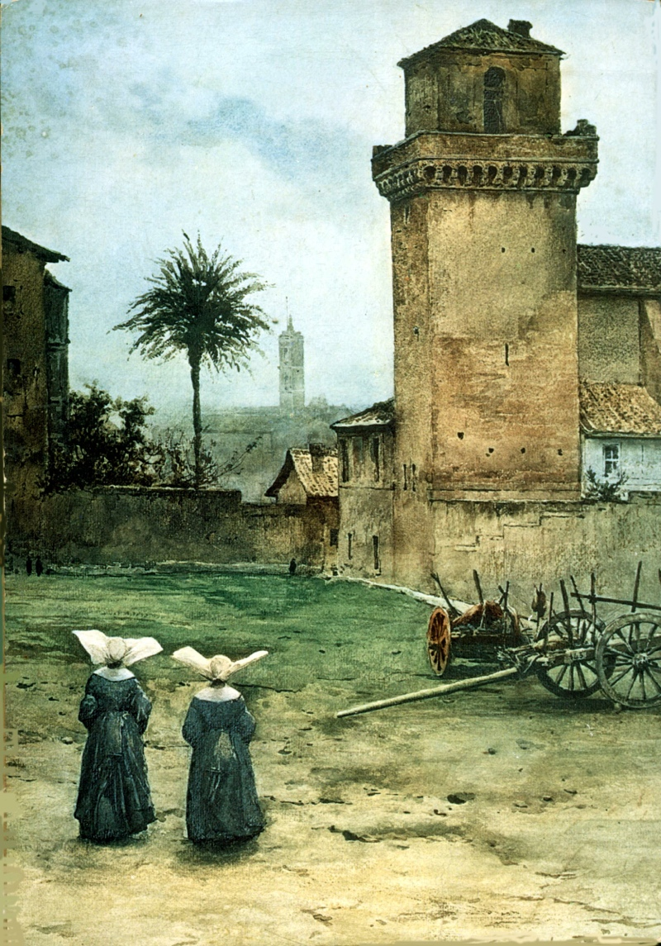
Source:
http://filles-de-la-charite.org/history/origin-of-the-company

