Slide 1
The first American Lady of Charity was a 23-year-old wife and mother named Catherine Harkins.

Slide 2
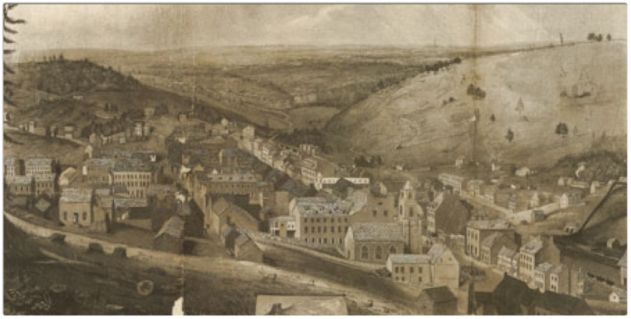
Once again, we see how apparently ordinary circumstances were the indications of God’s Providence. Catherine Harkins was born in the Cove of Cork, Ireland. She was educated at St. Ann’s School in Pottsville, Pennsylvania, at that time conducted by Mother Seton’s Sisters from Emmitsburg, Maryland. From the Sisters, she certainly learned about St. Vincent de Paul and his works of charity towards the poor, whom he always referred to as “Our Lords and Masters”.
View of Pottsville, PA

Slide 3
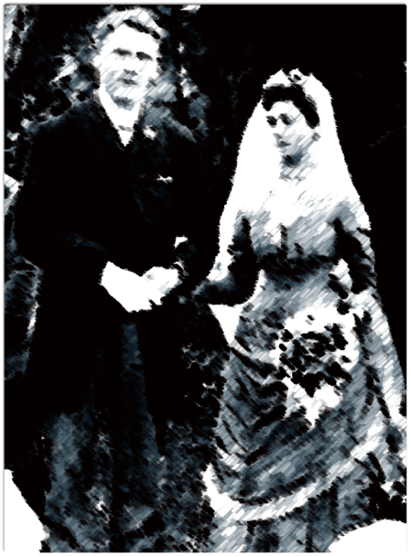
After her marriage to Captain Hugh Harkins, a Mississippi steamboat owner, in 1853, she and her husband settled in St. Louis in 1857, residing in St. Vincent de Paul parish.
Artist’s impression

Slide 4
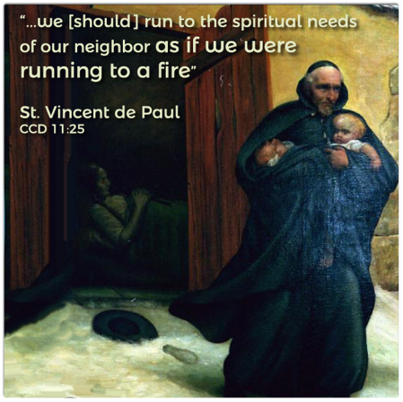
Shortly after the move to St. Louis, Mrs. Harkins had a dream of St. Vincent walking through snow-covered streets and gathering neglected children under his cloak. He spoke to her and directed her to help the poor also. Three times, the dream was repeated, so Catherine decided to mention it in confession. The confessor, probably Father Peter O’Neill, CM, told her to pray for enlightenment, that he would offer Mass for this same intention, and that she should come back to the same confessional on the next day.

Slide 5
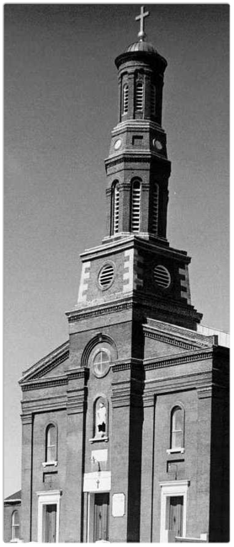
She did as directed, but found that the confessor of the previous day had been missioned to New Orleans. In his place was Father Urban Gagnepain, CM, who listened to her story with interest, promised to offer Mass for guidance, and asked her to continue her prayers. Later, he advised her to gather together some assistants to form a society to care for the poor, adding that:
“If the work is not from God, it will not progress.”

Slide 6
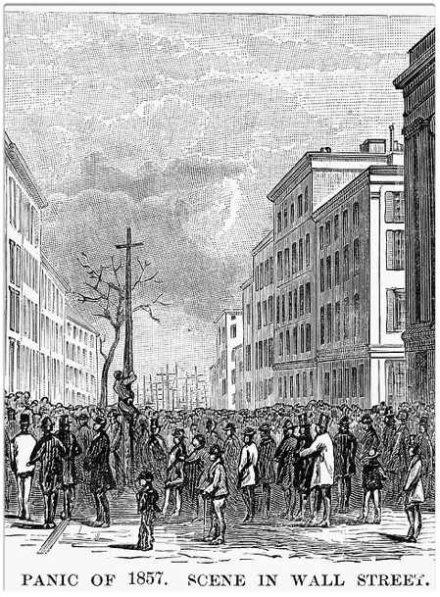
This Association was formed on December 8, 1857, and called the Association of the Ladies of Charity. It consisted, at the beginning, of 12 members. Mrs. Catherine Harkins was the first President. Providentially, this association was founded at the same time of the Panic of 1857 causing a depression which was to continue until the beginning of the Civil War. There were many hungry poor in those days, and so, the Ladies of Charity found many unfortunates to be the beneficiaries of their charitable services.

Slide 7
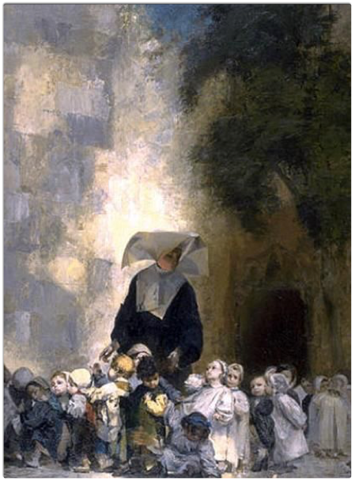
When in 1859, Archbishop Peter Richard Kenrick asked the Daughters of Charity to staff the House of the Guardian Angel for orphan girls, the Ladies of Charity immediately began to aid and assist them in their work. In that same year of 1859, Father Gagnepain was missioned to New Orleans. In a letter to Catherine Harkins in January, 1860, he tells of founding the Ladies of Charity at St. Joseph parish in New Orleans with 22 members in the founding group.

Slide 8
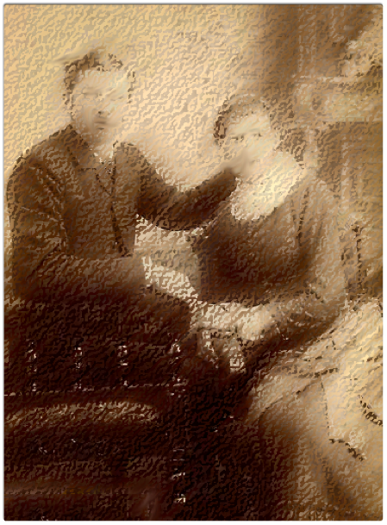
Later, Catherine as wife and mother was widowed and remarried to Mr. Elmer Drake in 1884. She continued to work with the Daughters of Charity in St. Louis. Twice widowed, she raised three children, was a grandmother with
18 grandchildren and great grandmother having 4 great grandchildren, yet she maintained a zeal in serving her neighbor.
Her children were Hugh C., Urban V., and Marie Victorine Harkins.
Artist’s impression

Slide 9
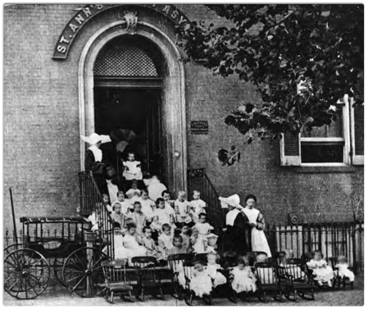
Catherine collaborated with Vincentian priests and Daughters of Charity in establishing the Ladies of Charity in the United States and became the founding president. She launched its early social ministry outreach projects in collaboration with the Vincentian Family.
As a widow who became a leader in charity, Catherine had a keen interest in the education of young children and social supports for orphans, the elderly and needy families living at the brink of poverty, especially the most vulnerable like widows with young children.

Slide 10
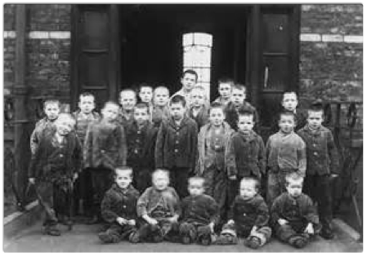
Catherine was especially concerned about educational opportunities for orphans and neglected youngsters, and involved herself in promoting healthy child development for underprivileged children living in the city.

Slide 11
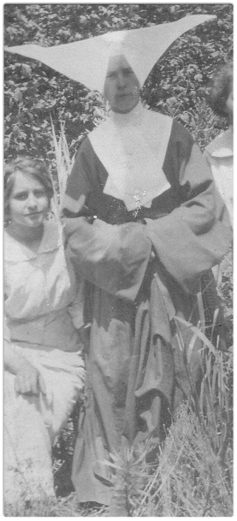
Later, death claimed many members of the original founding group, so that in 1893, a reorganization of the Ladies of Charity was necessary. Fr. Stephen Paul Hueber, CM, undertook this work of reanimating the society. As years passed, the meetings of the Ladies of Charity in St. Louis transferred to the newly reorganized Guardian Angel Settlement House administered by the Daughters of Charity. With this change, the Ladies of Charity spread throughout St. Louis and the county with a membership of more than 1200 members.

Slide 12
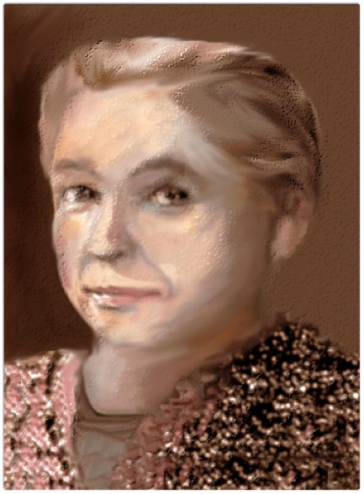
Interestingly enough, the granddaughter of Mrs. Catherine Harkins, held the office of President of the Ladies of Charity for 19 years. Fr. Martin Hanley, CM and Father Francis Moser, CM served in turn as spiritual directors with the Ladies of Charity assisting the Daughters of Charity in their work. In the DePaul archives, there is correspondence between Catherine Harkins and her granddaughter, Marie Harkins, regarding their charity work within the Association. Catherine Harkins died in 1911.
Artist’s impression of Catherine Harkins
(based on newspaper obituary photo)

Slide 13
text prepared by Sister Frances Ryan, DC, LCUSA Spiritual Moderator, DePaul University
References:
Betty Ann McNeil, DC (2000) Paper presented to the Ladies of Charity of the
United States, “Vincentian Women of Faith and Mission’ – September 19 – 2000
ALCUS Annual Meeting, St. Louis, Missouri, USA. pp:1-11
http://famvin.org/wiki/Vincentian_Women_of_Faith_and_Mission
Obituary: Catherine Harkins Drake, 1911- DePaul University Special Collections,
Ladies of Charity (LCUSA-AIC archives)
John Zimmerman, CM, (1982). ‘Homily for the One Hundred Twenty-Fifth
Anniversary of Service to the Poor by the Ladies of Charity’ (unpublished)
St. Vincent DePaul Church, St. Louis, Missouri, November 27, 1982-DePaul
University: Ladies of Charity Archives (LCUSA)- pp.1-8.

