Slide 1
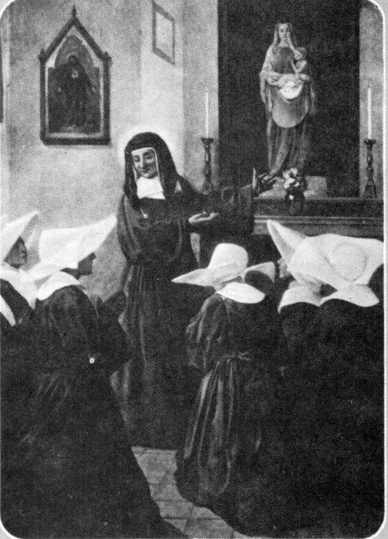
spirituality of
St. Louise de MariLlac
meditations on the infant Christ, and Mary, His mother

Slide 2
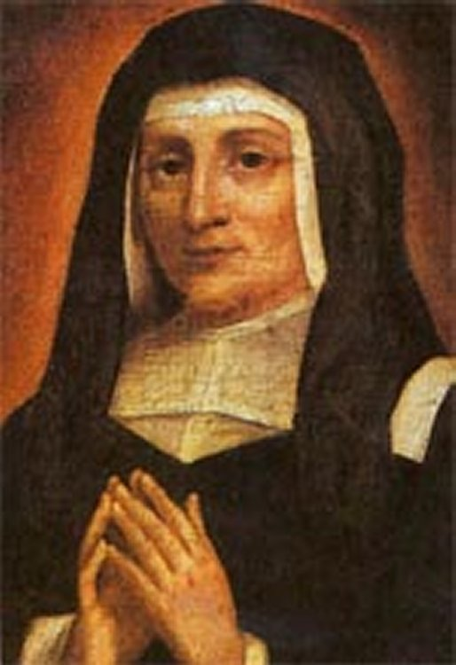
Mystery of the Incarnate Word
Louise's prayers and meditations followed the rhythm of the liturgical year. At each season she entered into what Andre Dodin called "this mysterious adventure of the Incarnate Word.”*
*Andre Dodin, CM., Saint Vincent de Paul et la Charité (Paris: 1960),69.

Slide 3
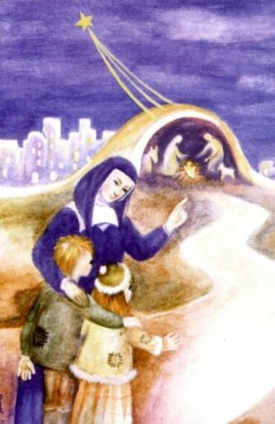
the lessons of the crib
During her Advent retreats she reflected on the birth of Christ and the lessons of the crib.
On one such occasion she wrote, “Our Lord, born in poverty and obscurity, teaches me the purity of His love which He does not manifest to His creatures. He is satisfied simply to do whatever is necessary for them. Thus, I must learn to remain hidden in God, desiring to serve Him without seeking recognition from others ... content that He sees what I am striving to become.”*
*"Retreat," A.8, SWLM, 718.

Slide 4
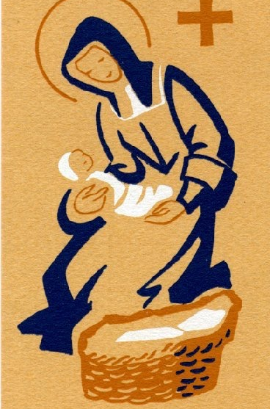
the example of Jesus in His infancy
Love, simplicity, humility - virtues which would later be presented as the fundamental virtues of the Daughters of Charity. The Christmas before her death, she would once again remind the Sisters of the wisdom contained in this mystery. She told them, "You will learn from Jesus, my dear Sisters, to practice solid virtue, as He did in His holy humanity, as soon as He came down upon earth. It is from the example of Jesus in His infancy that you will obtain all that you need to become true Christians and perfect Daughters of Charity.”*
*Louise de Marillac to Genevieve Doinel and Marie-Marthe, 28 December 1659, L. 647, SWLM, 666.

Slide 5
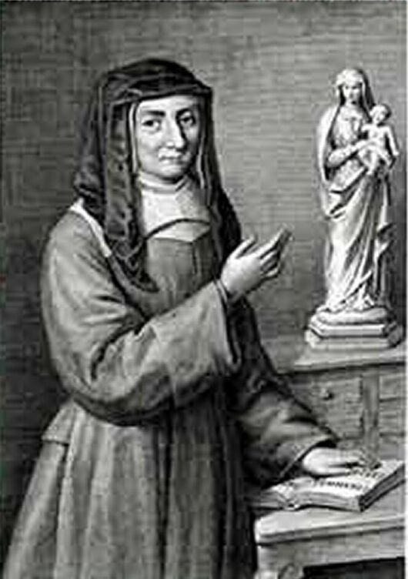
Mary, Mother of God
Meditation on the Incarnate Word led Louise de Marillac quite naturally to Mary, his mother, to whom she would consecrate the "Little Company," and whom she would designate in her “Spiritual Testament" as its "only Mother.”*
*”Spiritual Testament," undated, SWLM, 835.

Slide 6
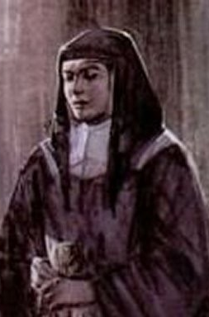
christmas joy
The contemplation of the intimate union of Mary with her son moved Louise to desire to attain profound union with her God. On Christmas day, while praying before the crib, her heart overflowed with joy and she exclaimed, "Most Holy Virgin, you know the emotions of my heart today at the thought of your Divine Son in the Crib and how great this mystery seemed to me ... O holy time of grace! Why are our souls not in a continuous state of joy and happiness? Why does this time not suffice to fill our lives with love for so good a God?”*
*”To the Virgin Mary," A.14B, SWLM, 774.

Slide 7
Mary, for Louise
We find Mary here as we will always find her in Louise de Marillac's writings, as the Mother of God, intimately united to her son in the accomplishment of the divine plan.*
*See Elizabeth Charpy, D.C., Un chemin de sainteté: Louise de Marillac, (Paris: 1989),201-19.

Slide 8
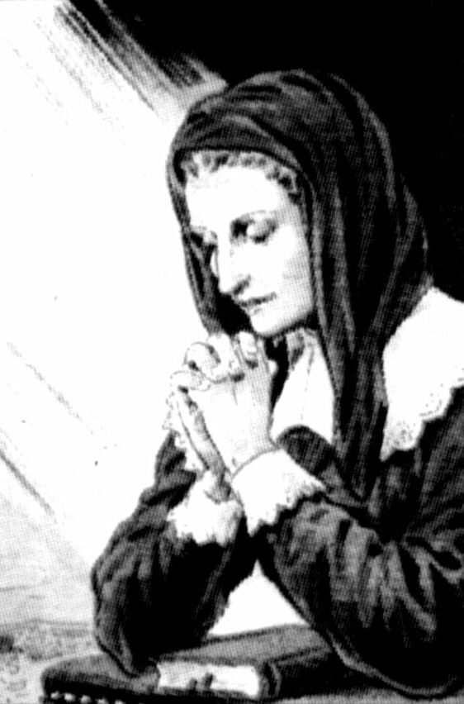
mary immaculate
Louise's reflections on the role of Mary in the redemption caused her to see, well before any definition of the dogma, the importance of the Immaculate Conception. She wrote, "Most Holy Virgin [I wish] to glorify God for the choice He made of you to be the Mother of His Son. Because of this divine action, your conception was immaculate since the Father applied to you the anticipated merits of the death of Jesus Christ.”*
*”Oblation to the Blessed Virgin, (c. 1626)" A.4. SWLM, 695.

Slide 9
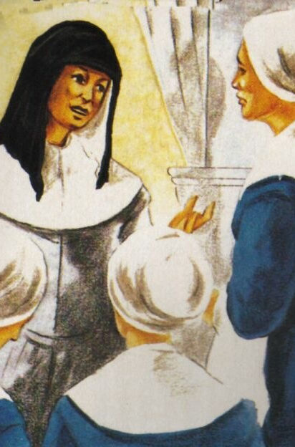
Turn daily to the Blessed Virgin
Every aspect of Mary's life became a subject of prayer for Louise.
She wished her spiritual daughters to turn daily to the Blessed Virgin.
She asked them to recite the rosary while meditating on a single mystery and hailing Mary as "Daughter of the Father, Mother of the Son and Spouse of the Holy Spirit.”*
*Louise de Marillac to Vincent de Paul, March 1646, L.303B, ibid., 140.

Slide 10
Source
Vincentian Heritage Journal, Volume 12 | Issue 2, Article 5.
The Spirituality of Louise de Marillac: Moved by the Spirit to Charity by Louise Sullivan D.C., pp.162-164
presentation by

