Slide 1
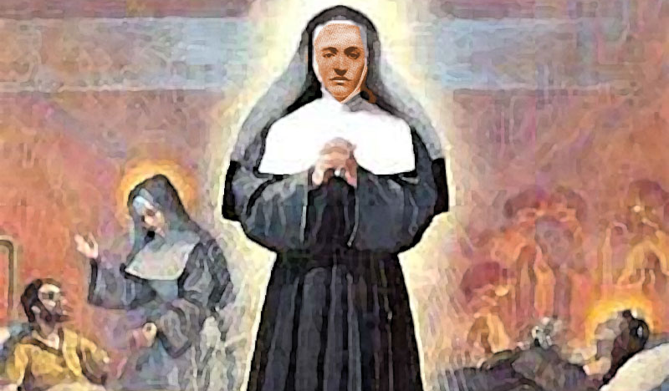
Saint Agostina Pietrantoni
Text
Responding in faith to each situation in her life

Slide 2
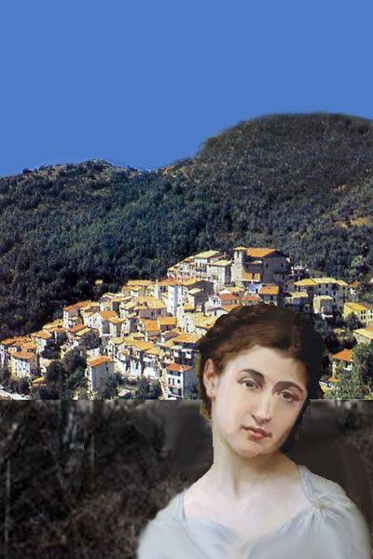
Saint Agostina’s Childhood
...all with a cheerful disposition, without complaint.
Born Livia Pietrantoni in the little village of Pozzaglia Sabina, Italy. She:
started working at age seven to help the family's income
tended cattle
helped with her younger brothers and sisters (she was one of eleven children)
made shoes
worked on olive harvests
for four years helped to build a road for little pay
helped her mother because her father was very ill with arthritis...

Slide 3
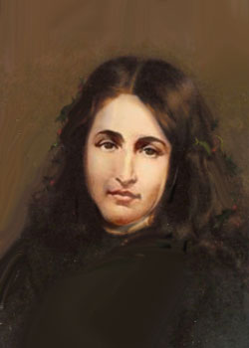
No hope for her young suitors
The budding Saint was pretty and had suitors. One of the young men attempted to propose to her.
Livia took out a holy card with Jesus’ image and said:
"Here is the One I will marry."

Slide 4
Sister Agostina
Refusing offers of marriage, and, believing she had a vocation to religious life, Livia travelled to Rome with an uncle at the age of 22, with the aim of entering a religious order. She was turned away, but a few months later was accepted into the Sisters of Charity of Saint Joan Antida Thouret and took the name of Agostina.
Some had suggested that she sought religious life to escape hard work.
To them she is said to have replied, "I wish to choose a Congregation in which there is work both day and night."

Slide 5
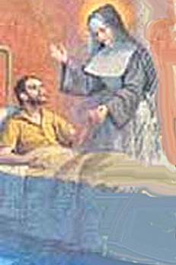
At the Hospital of Santo Spirito
Sister Agostina was sent to Santo Spirito (Holy Spirit) Hospital, which had served the sick for seven hundred years. The hospital had become far too secularized over the years. The Capuchins had been forced to leave; crucifixes and other religous articles were removed from the wards and banned.
One of the rules imposed on the sisters was a ban on mentioning so much as the name of God to their patients!
This did not deter Sr. Agostina because she did not need words to tell others about God; her actions were so imbued with the love of God and neighbor that her patients grasped everything she was teaching them.

Slide 6
Tuberculosis
While working in the tuberculosis ward, Sister contracted the disease. She received Viaticum and then recovered, miraculously.
She did not give up...
She requested to work with tubercular patients since she was already infected.

Slide 7
Life in the Tuberculosis Ward
This ward held a number of unruly men, some of them convicts. They blasphemed and sputtered vulgarities.
She never failed to be patient and cheerful. Her consolation and inspiration during this time was Our Lady. She had a great devotion to the Mother of God, her favorite prayer was the Rosary. In her charming, silent way, she would write letters to the Blessed Virgin and place them behind a picture by way of a mailbox. One of these contained the following: "Most Holy Lady, convert that wretched man whose obstinate heart I am not able to change and I promise to do two or three extra night duties in your honor."

Slide 8
Worker for the Kingdom
Sister Agostina, given the chance, chose work over rest. The night before she died, she said: "We will lie down for such a long time after death that it is worthwhile to keep standing while we are alive. Let us work now; one day we will rest."

Slide 9
Her last day on earth
One of the men who had been sent from a prison, a Giuseppe Romanelli, had a mother and sister who visited him. Our Saint was very kind to them. He was so troublesome in the ward that he was sent away; thereafter he wrote threatening notes. On November 13, 1894, Sister Agostina and another patient were going down the stairs of the ward, only to find themselves face to face with this four times condemned man. Romanelli wielded a knife and stabbed her several times. The patient hollered for help, but by the time it came St. Agostina was on the floor dying. She was 30 years old.

Slide 10
Forgiveness, repentance
She was taken to a bed, no longer able to speak. Her superior asked her if she forgave the murderer, who had escaped. She nodded, Yes. She was smiling. She was saying, “Blessed Mother, help me.” A few moments later she died.
Two days later her funeral was held, on the same day that her killer was arrested. He was sentenced to life although the Saint's family asked for mercy. He repented, received the Last Sacraments, then died in prison a year later.

Slide 11
Sources:
Ann Ball in MODERN SAINTS, BOOK ONE, Tan Books, with Nihil Obstat and Imprimatur
http://semperaltius.com/agostina.htm
Vincentian Encyclopedia
http://famvin.org/wiki/Agostina_Pietrantoni

