Slide 1
St. Vincent’s First Foundation: the Ladies of Charity
by Colette Padberg and Sister Daniel Hannefin, D.C.

Slide 2
The year 1617 was a turning point in the life of St. Vincent de Paul, paving the way for two of his foundations of charity.
In both of these, a woman played a decisive role.

Slide 3
Origin of Missions
Francoise-Marguerite de Silly, Madame de Gondi, was deeply moved when a dying man told her he would have been damned if Fr. Vincent had not urged him to make a general confession. She asked Vincent to preach to all the people at Folleville about general confessions. This sermon, given January 25, 1617, was so effective that Vincent later referred to that day as "the first mission." It was Madame de Gondi who provided the financial support that made possible the foundation of the Congregation of the Mission eight years later.

Slide 4
Origin of Confraternities
In August of 1617 Vincent turned away from the De Gondi household to become parish priest of Châtillon·les-Dombes. After his first sermon there, Françoise Bachet, wife of the lord of the manor of La Chassaigne, and her friend Charlotte de Brie renounced worldly amusements and resolved to devote their time to good works. It was Bachet who, a few weeks later, discovered a family so ill that none could care for the others, and reported their needs to Vincent as he was vesting for Sunday Mass. His heartfelt sermon on charity led to an afternoon meeting in her home, followed by such a spontaneous outpouring of charity that the family was overwhelmed with food and visitors that day.

Slide 5
Vincent realized that it is not enough for charity to be generous and personal; it must also be organized.
On Wednesday, August 23, he called a meeting of the women. They agreed to form an association in which each would take her turn in serving the sick poor corporally and spiritually. The turns were to begin the next day, in this order: Françoise Bachet, Charlotte de Brie, Philiberte Mulger, Benoîte Prost, Denise Beynier, one of the daughters of Lady Perra, Lady Colette, and Mlle. de Chassaigne (Florence Gomard).

Slide 6
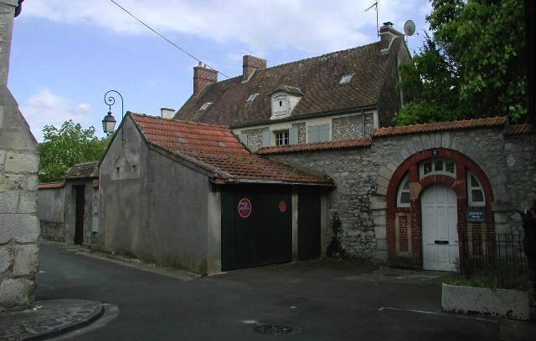
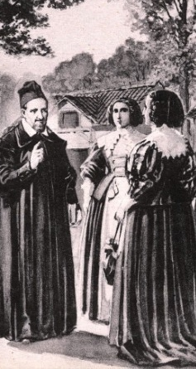
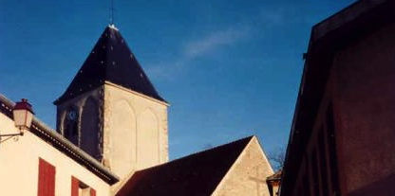
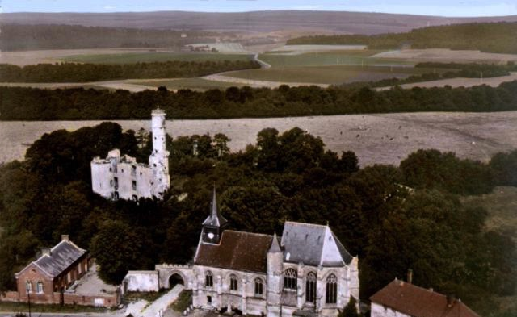
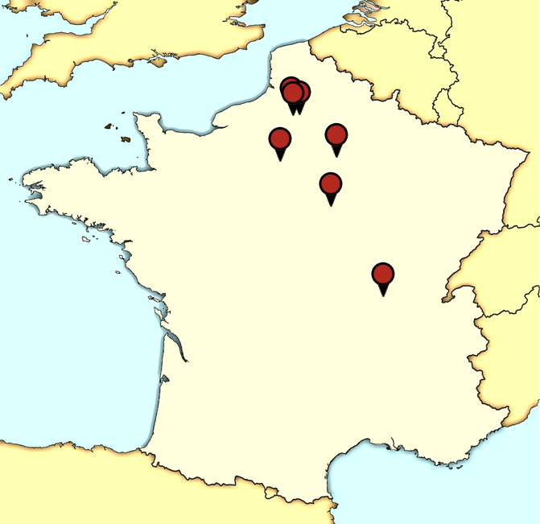
The pattern for the renewal of the Church in the countryside was set: a mission, leading up to the establishment of a Confraternity of Charity, which would continue to build Christian community in the parish.
During the next years Vincent established Charities in every village where he gave missions: Villepreux, Montmirail, Folleville, Paillart, Séréviller, Joigny, Mâcon.
Later he would direct his priests to establish and supervise Charities wherever they preached so that the fruits of the mission would endure.
Villepreux
Montmirail
Folleville
Joigny
Macon

Slide 7
Rules of the Charities varied from place to place, with some modifications and improvements, but the essentials were the same as at Châtillon:
The "servants of the poor" were to be twenty virtuous women, married or single, with the consent of their families. They met one Sunday a month, visited and cared for the sick poor by turns, were faithful to prayer and the sacraments. Jesus Himself was their Patron— their Model in charity and the One they served in the person of the poor. There were three officers: the prioress, who admitted and dismissed the sick poor; the wardrobe keeper, who cared for and lent the movable goods of the Confraternity, such as furniture, bedding, and linens; and the treasurer, who paid bills and kept records, assisted by a man known as procurator.

Slide 8
Did you know?
At Folleville, Paillart and Séréviller there was also a Charity for men. While the women cared for the sick and prisoners, the men helped those who were destitute and trained poor boys in a trade. At Joigny and Montmirail the men and women were combined into one group, but there were problems there which caused Vincent to abandon the idea of mixed Charities.
The men's groups seem to have died out by the time of the French Revolution.

Slide 9
The registers of the Confraternity contained: copies of the regulations, the formal act of establishment, a list of members with dates of reception and death, audits of accounts, lists of those helped, and the history of the confraternity.
Expenses of the Charities included nourishment for the sick, medicines, linen, furniture, Mass stipends, payments to doctors or nurses. Sources of income were gifts, bequests, alms-boxes in churches and inns and taverns, begging in church and from door to door. In some places cows and sheep were kept to provide wool, milk and meat. Sometimes magistrates assigned certain fines or taxes to the Charity for the care of the poor.

Slide 10
By 1629 the Charities were so numerous that help in supervising them was needed. Vincent sent Louise de Marillac in the wake of the Missioners, with instructions how to establish, visit and organize the Charities. Traveling at her own expense in the most frugal ways, she visited Charities in the diocese of Paris, Beauvais, Senlis, Meaux, Soissons, Chalons and Chartres. She instructed and inspired the ladies, recruited and trained new members, taught the children, visited the poor in their homes, nursed the sick, trained schoolmistresses, and gave the example of all that a servant of the poor should be. Through these visits she completed the work of organization that Vincent had begun.

Slide 11
The first Charity in Paris was in the parish of Saint-Sauveur in 1629. The following year Louise organized one in her own parish of Saint Nicholas-du-Chardonnet and was chosen to lead it. Four more parishes followed in 1631; soon after, almost every parish in Paris and the suburbs had its own Confraternity of Charity.

Slide 12
The ladies in some of these parishes were not accustomed to cooking and doing their own work; but still Vincent insisted on personal service to the poor. It was to help in these parish Confraternities that the first Daughters of Charity were formed. Members of the Charities were still being referred to as "the Sisters" at this time; the girls were to be the servants of the Charity, doing the harder work to which the ladies of Paris were not accustomed or suited.

Slide 13
On November 29, 1633, Louise de Marillac took some of these girls into her home for deeper spiritual formation in the service of the poor, and the third of Vincent’s organizations of charity was begun, also with a woman’s collaboration. The triangle of service was complete:
Confraternities of Charity, 1617;
Priests and Brothers of the Mission, 1625;
Daughters of Charity, 1633.

Slide 14
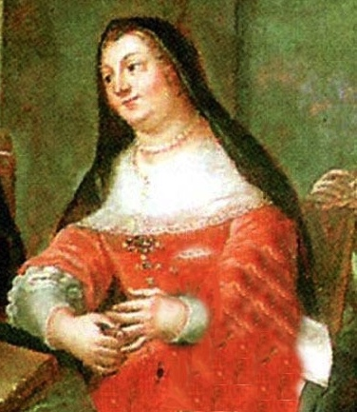
The Ladies of Charity of the Hôtel Dieu
Up to this time, all of the Confraternities of Charity were parochial— drawing members from one parish and serving the poor of that parish, under the direction of the pastor. But in 1634 Genevieve Fayette, Madame Goussault, who had been active in the Charity of her own parish and also in visiting those of the countryside, approached Vincent to suggest a new kind of Confraternity. She had been visiting the sick of the Hôtel Dieu and was appalled at the neglect of their spiritual needs. (The Hôtel Dieu was a large, overcrowded hospital where patients were often assigned four to a bed.)

Slide 15
Vincent did not want to interfere in what was the apostolate of the Canons of Notre Dame. But the determined Madame Goussault took her observations to the Archbishop of Paris, who responded by ordering Vincent to establish a Charity for the Hôtel Dieu. Vincent accepted the command as God's Will and called a meeting at the home of Mme. Goussault early in 1634. The ladies present decided to undertake the work.
Describing the meeting and its results to Louise, Vincent added, "They will need you and the girls."

Slide 16
"Of all the Confraternities of Charity," Coste says, "that of the Hôtel-Dieu was, without question, the most important both from the social position of its members, the extent of its field of action, and the amount of aid received and distributed." The association drew its members from all over Paris. Although it included members of the titled nobility, even queens and princesses, as well as the wives of merchants and artisans, much of the real leadership stemmed from the families of magistrates and members of Parlement. Mme. Goussault, its president until her death in 1639, was the widow of the President of the Chambre des Comptes (Tax Court).

Slide 17
Besides the spiritual ministry to patients at the Hôtel Dieu (to which they gained entry by serving them a daily meal), this group (which came to be known as “Ladies of Charity") took on the care of the foundlings, the galley slaves, the refugees from the war-torn provinces of France, and missions in Barbary and Madagascar. The work of the Association spread to Italy in 1634 and to Poland in 1652.
It continued to expand in France until the Revolution, in which many of its aristocratic members were guillotined.

Slide 18
In a reorganization after the Revolution, brought to fulfillment under Fr. Etienne in 1840, the term “Association of Ladies of Charity” designated parish Charities as well as metropolitan groups.
At this time Sister Rosalie Rendu initiated the Louisettes, a junior group for young girls. (It was she also who aided Frederic Ozanam in founding the St. Vincent de Paul Society, which again brought laymen together for charity in the Vincentian spirit.)
Image: pinterest.com/dofcharity

Slide 19
The International Association of Charities (AIC)
By 1938 there were Ladies of Charity in France, England, Belgium, Poland, Ireland, Spain, Portugal, Switzerland, Italy, Greece, Romania, Hungary, Yugoslavia, Denmark, Turkey, Iran, Syria, Egypt, Palestine, Algeria, India, China, the Philippines, the United States, Mexico, Peru, Ecuador, Brazil, Panama, Costa Rica, EI Salvador, Guatemala, Chile, Venezuela, Uruguay, and British Guiana. The Ladies of Charity numbered 450,000 in the world, with an additional 15,000 Junior Ladies of Charity.
The first International Congress of Ladies of Charity was held in Paris in 1930, and an international bulletin was inaugurated to form closer bonds of unity between national associations and the canonical center. The second congress was held in Budapest in 1935. The third, scheduled for Warsaw in 1940, was cancelled because of the war. After the war, congresses resumed: Paris in 1953, Brussels in 1958.
Photo: The Encyclopedia of Alabama http://www.encyclopediaofalabama.org/article/m-5351
Courtesy of The Doy Leale McCall Rare Book and Manuscript Library. Photograph by Erik Overbey.

Slide 20
Three representatives of the International Association were invited by Fr. James Richardson, C.M., Superior General, to attend the Assembly of the Congregation of the Mission to explain the situation of the Charities throughout the world. The delegates were asked to set up statutes for the International Association. In 1971 the Vincentians handed over the direction of the Association to the presidents, on all levels, but retained the role of spiritual advisers. In October of 1971, delegates from twenty-two countries met to vote on the statutes, elect an Executive Board and an International President.
The name AIC was adopted, and the international secretariate transferred from Paris to Brussels. Subsequent meetings in Rome (1973), Brussels (1975) and Mexico (1976) studied the questions of poverty and volunteerism, and paved the way for the AIC Declaration, promulgated in 1977.
Image: AIC International Facebook page

Slide 21
In 1980 the AIC Basic Document, "Against All Forms of Poverty - Acting Together" was published. It was a response to the call of the Church for self-study and realization as a means of renewal. It collected into one document the awareness of the needs of the suffering, oppressed poor; the challenge of the Gospel; the calls of Vatican II; the prophetic intuition of St. Vincent de Paul; and the concerns and action of members of the AlC, individually and collectively, in response to these needs, challenges and calls. For members of the Association it was a basis for action and reflection, a call and inspiration to live their commitment, and a sign of the unity of the Associations throughout the world.

Slide 22
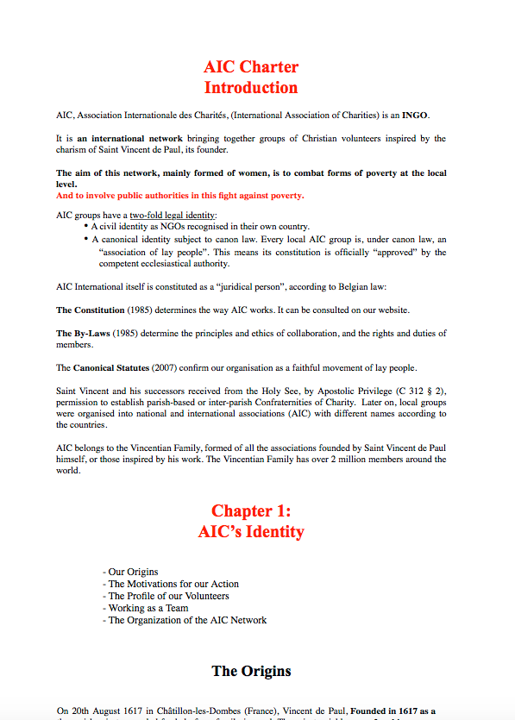
In preparation for the 400th anniversary of the International Association of Charities (AIC), a new document, the AIC Charter, was written to replace the Basic Document.
The Charter is based on “what drives the AIC”.

Slide 23
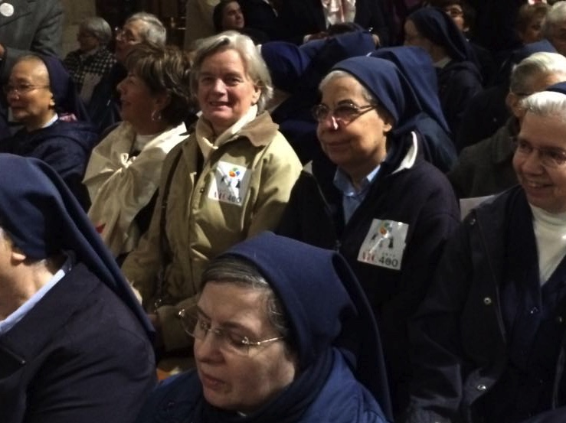
The AIC collaborates with many organizations on all levels, but there is a special bond with members of St. Vincent's other two foundations: the Vincentian Priests and the Daughters of Charity.
In many countries Vincentians serve as spiritual advisers, and Daughters of Charity as moderators, on the national and local levels, wherever this relationship is feasible.
Images: AIC International Facebook page

Slide 24
You see a great deal of distress that you are unable to relieve. God sees it also. Bear the pains of the poor together with them, doing all you can to give them whatever help you can, and remain in peace.
–St. Louise de Marillac

Slide 25
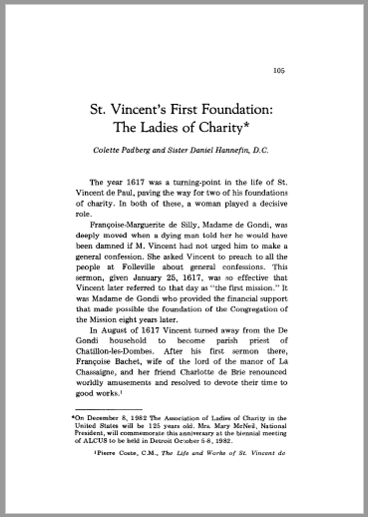
Source:
Padberg, Collette and Hannefin, Daniel D.C. (1982) "Saint Vincent’s First Foundation: The Ladies of Charity," Vincentian Heritage Journal: Vol. 3: Iss. 1, Article 3.
Available at: http://via.library.depaul.edu/vhj/vol3/iss1/3

Slide 26
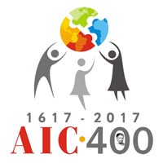
aic-international.org
presentation
by

