Slide 1
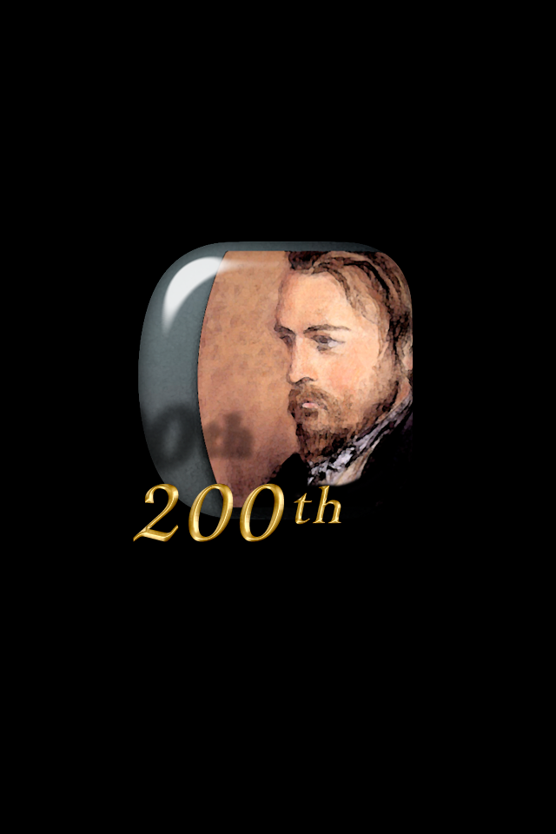
Frederic Ozanam:
Social Justice Vision
+ Personal Action

Slide 2
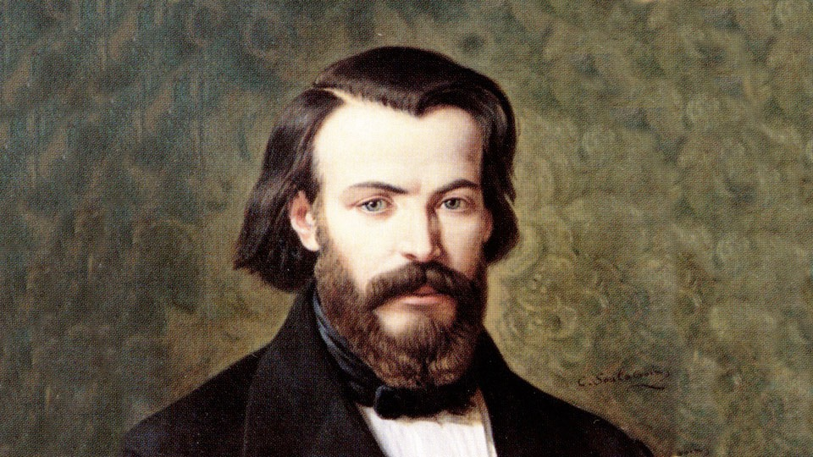
Frederic Ozanam’s life was a dramatic fusion of intellectual achievement
Social Justice Vision

Slide 3
and direct, personal action
Social Justice Vision
Personal Action

Slide 4
to alleviate the poverty of the least amongst us.
Social Justice Vision
Personal Action

Slide 5
Social Justice Vision
Ozanam was an earnest advocate of Catholic democracy. He viewed that the Church should adapt itself to the changed political conditions resulting from the French Revolution.

Slide 6
Social Justice Vision
The prevalent notion was that the Catholic Church had done far more to enslave than to elevate the human mind.

Slide 7
Social Justice Vision
In his years as a student at the University of Paris at the Sorbonne, professors were using their academic positions as a platform for their rationalist ideas against the Church.

Slide 8
Social Justice Vision
Confronted by that situation, Frederic was impelled to a battle for the truth. His faith demanded a militant attitude. He knew how to valiantly defend the fundamental Truths of the Faith.

Slide 9
Social Justice Vision
First, in his writings he dwelt upon important contributions of historical Christianity, and the Catholic Church from the time of Christ through the Middle Ages.

Slide 10
Social Justice Vision
Second, a grand master of speech, Frederic eloquently presented the Catholic Church as a paradigm for the restoration of society in his time.

Slide 11
Social Justice Vision
He fearlessly championed workers’ rights, including the right to join labor unions.

Slide 12
Social Justice Vision
While a law professor at Lyon, Ozanam developed his central thesis of the “salaire naturel”— the natural wage, a concept that became the precursor to the living wage movement.

Slide 13
Social Justice Vision
The working man, he believed, was by nature entitled, at a minimum, to a wage sufficient to provide for the necessities of life, the education of his children, and for the support of his old age.

Slide 14
Social Justice Vision
Ozanam’s writing laid the groundwork for Catholic social-justice teaching, helping set the stage for the great encyclicals on the rights of workers, starting with Pope Leo XIII’s Rerum Novarum (On Labor) in 1891.

Slide 15
Social Justice Vision
His aim was to be a missionary of the faith in the world of science; his dream was to bring about the renewal of society under the guidance of the Catholic Church.

Slide 16
Social Justice Vision
Ozanam said:
“We have two lives:
one to look for the Truth and defend it, and the other to practice it.”

Slide 17
Social Justice Vision
He well merits being proclaimed today (in this Year of Faith) “the patron of all apologists.” The combination of his intellectual clarity and his testimony to charity make him an axis for the new evangelization.

Slide 18
Reflect
What comments would you make on Ozanam’s social justice vision? Have you changed any ideas you used to have on these subjects? What examples would you show others to help them understand the issues?

Slide 19
Intellectual Achievement
Personal Action
Ozanam was that rarest of intellectuals: one who served—directly, personally, throughout his entire adult life—the immediate needs of the poor.

Slide 20
Intellectual Achievement
Personal Action
He did not defer social action until after he was professionally established...

Slide 21
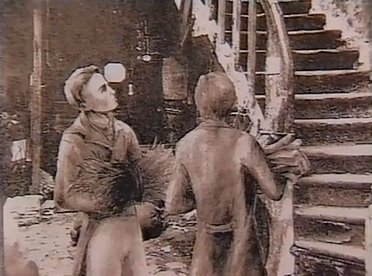
Intellectual Achievement
Personal Action
Rather, he saw the cold misery of the poor in Paris as a twenty-year-old student, and he carried wood and coal to them in their tenement slums.

Slide 22
Intellectual Achievement
Personal Action
As a twenty-year-old law student, in 1833, he founded the St. Vincent de Paul Society; it soon became the largest Catholic charity in the world.

Slide 23
Intellectual Achievement
Personal Action
He founded it not by drafting sophisticated corporate charters and negotiating favorable tax arrangements but, rather, by direct personal witness.

Slide 24
Intellectual Achievement
Personal Action
Committed to do more than talk about faith, Frederic and his small group met weekly to contribute to a secret collection and then visit the poor in their homes.

Slide 25
Intellectual Achievement
Personal Action
They developed their method of service under the guidance of Sister (now Blessed) Rosalie Rendu, D.C., who was prominent in her service in the slums of Paris.

Slide 26
Intellectual Achievement
Personal Action
The poor were not an abstraction; they were, and are, his brothers in Christ.

Slide 27
Intellectual Achievement
Personal Action
Unlike many liberal French Catholics (to say nothing of conservative royalists), he did not fear and loathe the poor; he literally embraced them.

Slide 28
Intellectual Achievement
Personal Action
He wrote: "The beloved daughter of the faith is charity, and without it faith has no reason to exist."

Slide 29
Intellectual Achievement
Personal Action
“Do we remain inert in the middle of a world that suffers and moans?”

Slide 30
Reflect
Which of my beliefs do I live out well, and which not so well?

Slide 31
Ozanam was always an activist in his soul. When he was just 18, in January 1831, he wrote:
I will be delighted if some friends gather around me! Then, if we join our efforts, we could create something together, and others would join us, and perhaps one day all society will join under this protective shade: Catholicism, full of youth and strength, will rise up suddenly upon the world.

Slide 32
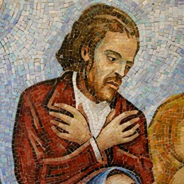
At a time when the Catholic Church was on the defensive and under assault, especially in France, Ozanam was unfailingly optimistic, affirmative, and progressive.

Slide 33
Perhaps there was considerable utopianism and naiveté in much of Ozanam’s worldview, in believing that private charity could significantly ameliorate deeply embedded structural poverty. Nevertheless, he firmly believed that the widespread practice of direct, personal, individual charity to individual poor was the best hope for avoiding social disaster.

Slide 34
Sources:
Verheyde, Christian (2013-04-02). 15 Days of Prayer with Blessed Frédéric Ozanam. New City Press.
Antoine Frederic Ozanam: Building the Good Society by David L. Gregory
Wikipedia: Frederic Ozanam
Frederic Ozanam, Grand Apologist of the Faith in the 19th Century by Father Teodoro Barquín, C.M.

