Slide 1
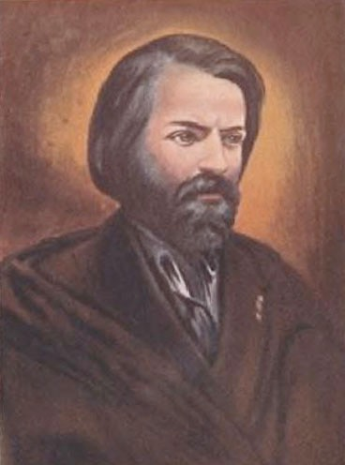
The two most outstanding traits
in Frederic Ozanam's character

Slide 2
1
The genuine sympathy which Ozanam felt for other humans

Slide 3
something much more than mere humanitarianism...

Slide 4
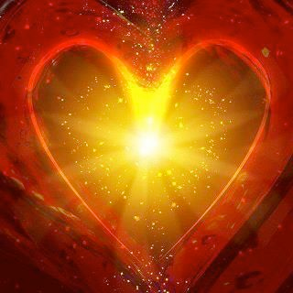
for him, the whole created universe revolved around the central pivot of Divine Love.

Slide 5
It was an impulse of pure unselfish love that first caused God to call the world into being.

Slide 6
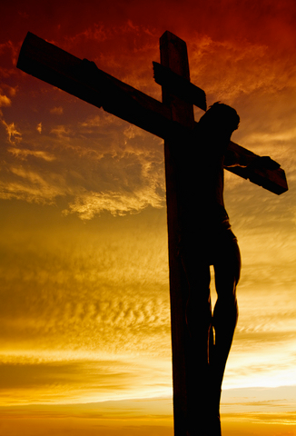
It was by a stupendous act of love again that God redeemed the world.

Slide 7
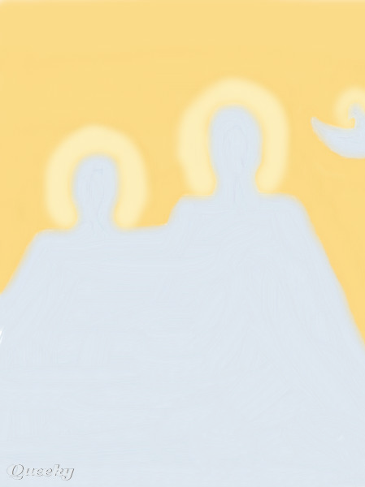
The mystery of the Holy Trinity constitutes the highest expression of Love--
a boundless Love existing from all eternity between the three persons in the God-head.

Slide 8
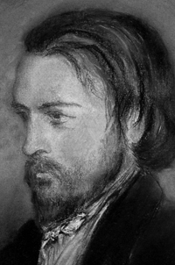
Ozanam had long meditated on these fundamental truths until they had penetrated into the very marrow of his bones.

Slide 9
He radiated a glow of love
and sympathy
on all around him.

Slide 10
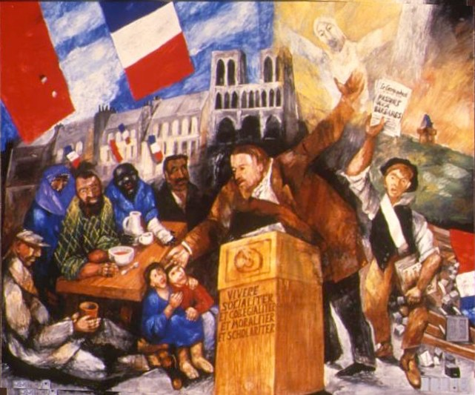
As a champion of faith he extended this spirit of love, even towards his opponents.

Slide 11
Many whose minds were closed
to the force of his reasoning
were touched
by his ready gift of sympathy.

Slide 12
Others in their turn have caught from Ozanam
a reflected ray
of the Light of the Love of God.

Slide 13
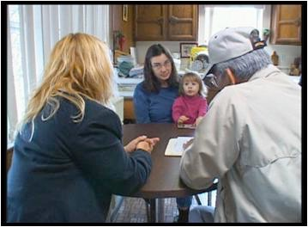
For Ozanam lit a lamp of charity:
the St. Vincent de Paul Society
in this world…

Slide 14
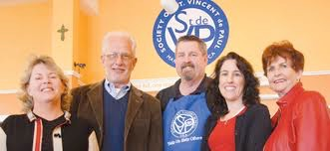
the flame of which has shone with brilliancy ever since.

Slide 15
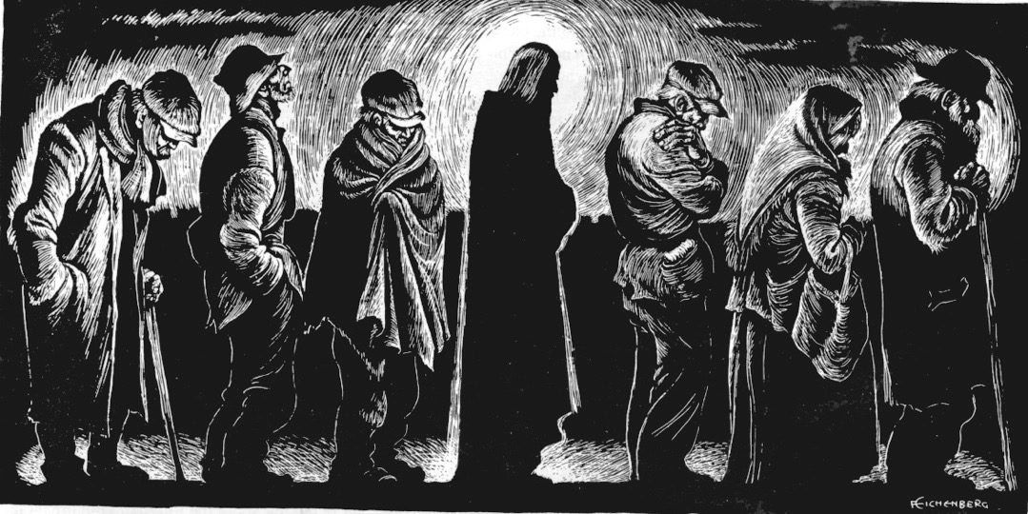
Year by year it has gathered fresh strength and continued to light up
the dark places of the world.

Slide 16
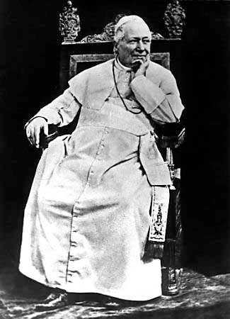
Shortly after Ozanam's death,
Pope Pius IX addressed a delegation of four hundred members of the Society
who had been sent to Rome:

Slide 17
"My children, you are crusaders of Christ in a world which will listen no longer to sermons, nor heed the words of the priests. But it will still hearken to the voice of charity...

Slide 18
...Go forth and conquer the world
by means of your love for the poor."

Slide 19
Reflect:
When you have gone to see a sick person who is tired and lonely, or to visit a family in financial trouble, did they actually console and strengthen you? How?

Slide 20
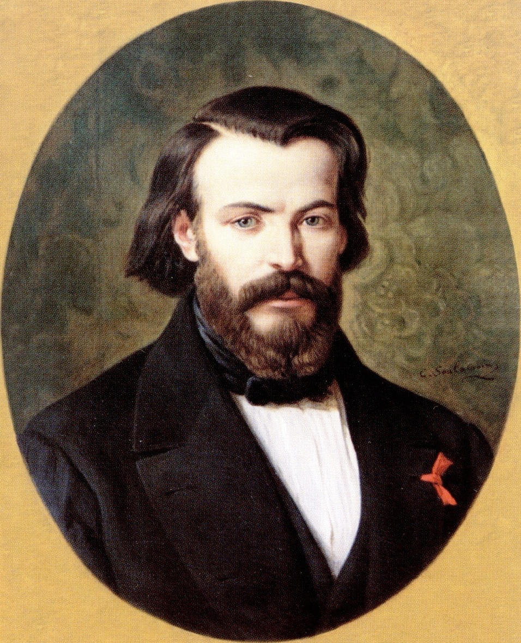
Frederic Ozanam steadfastly refused to ever allow himself to be elected president of the Society. He never used the Society as a means of personal aggrandizement.

Slide 21
2
This brings us to the second distinguishing trait in his character-- his humility, modesty, and spirit of self-effacement.

Slide 22
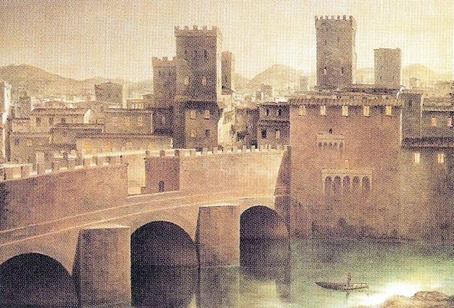
To illustrate this,
let us take an example from the frequent visits that Ozanam made to Tuscany.

Slide 23
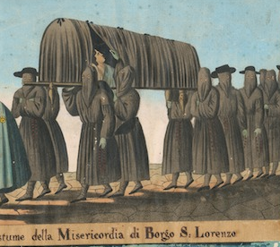
How often must Ozanam have seen the black-hooded figures of the “Misericordie"
(the medieval burial confraternities) passing along the streets of Pisa, Florence, or Siena.

Slide 24
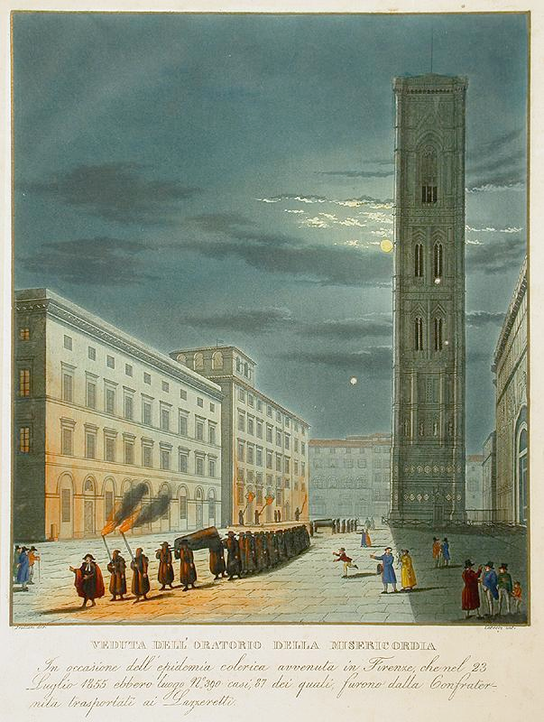
A group of men hasten by. They are carrying a coffin of some poor person to the church to receive the last blessing, or perhaps it is some poor sick woman whom they are taking to the nearest hospital.

Slide 25
But who are they?
Who is carrying that coffin?

Slide 26
Passers-by are at a loss to tell, for the bearers are completely hidden from sight by their long black flowing robes.

Slide 27
It may be that they are men of rank and station, small shopkeepers or rough workmen-- that is all that can be known about them.
For their faces are completely concealed from view by their hoods.

Slide 28
The crowd hanging around the pavement in the street sees no more than that:
the charitable act itself,
not the person who performs it.

Slide 29
The flame of charity and zeal
which burned in Ozanam's heart
was of the same pure quality as that of the honest burghers of the Tuscan republics, enabling them to perform their duties without attracting attention
to their own persons.

Slide 30
Precisely on account of these two traits in Ozanam's character-- his charity and humility--
his name endures in our minds today.

Slide 31
For, whatever far-reaching changes the future may have in store for the world, sympathy for others
and singleness of purpose
will always be understood and appreciated by all honest-minded people.

Slide 32
Reflect:
What did you learn about yourself as you read this story?
Do you have a sense of being part of Frederic Ozanam’s legacy?

Slide 33
Source:
Frederic Ozanam
by Rev. Henry Louis Hughes

