Slide 1
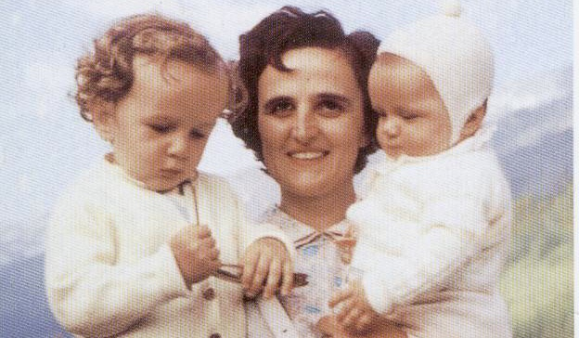
St. Gianna Beretta Molla
Heroic mother and doctor

Slide 2
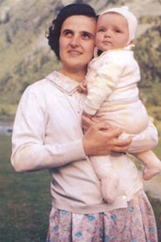
The canonization of Saint Gianna is the first of its kind. Many mothers have been beatified for their heroic virtues, but they entered religious life after becoming widowed. In St. Gianna’s case, the very condition of her being a spouse and mother is exalted and highlighted.
St. Gianna is the first canonized woman physician:
a professional who was also a “working mom”.

Slide 3
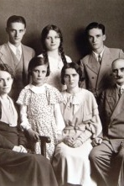
Gianna, born on October 4, 1922, was the tenth of thirteen children born to Maria and Albert Beretta (five of whom died at an early age). They made sure that each of their children studied a profession, so that they would serve the community and be living examples of Christian life:
  Two, including Gianna, became doctors
  One was a civil engineer
  Two became priests and one a Sister
  Two were missionaries, one to Brazil and one to India
Her parents considered the education of their children, the molding of their souls, as a divine undertaking.

Slide 4
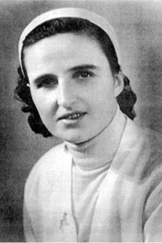
Gianna had just graduated from high school and considered becoming a medical missionary in Brazil when her parents died. While waiting for her missionary calling, she began studying medicine in Milan. It was often impossible to attend classes because of the constant wartime bombing. Everything was in a state of confusion, but Gianna endured the tragedy of war with her deep faith in God. If she could not perform heroic deeds as the soldiers did, she would strive to do whatever task was set before her as well as she could.
When weary, she went to church. When she was tired and felt she couldn’t go on, she would revive herself
with a little meditation, speaking to Jesus.

Slide 5
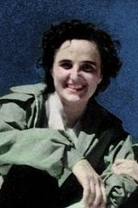
While attending university, Gianna became a leader in Catholic Action. All of her free time was devoted to apostolic work. She planned conferences, retreats, and excursions for the younger girls. Although wartime made this mission very difficult, Gianna persevered and worked untiringly for the good of souls who more than ever needed spiritual strength.
Many of the individuals she was involved with or served testified that they rediscovered their faith in God through Gianna’s example.

Slide 6
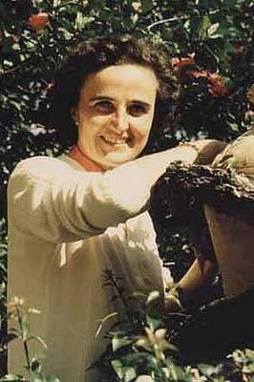
Gianna’s entire life was enriched by her charitable actions: whether with Catholic Action, with the St. Vincent De Paul Society, or with her patients.
Taking some of the younger members with her, Gianna would visit the poor and sick in their homes, bringing them food and medicine and attending to the housekeeping.
Charity was an essential and dominant element
in St. Gianna’s life.

Slide 7
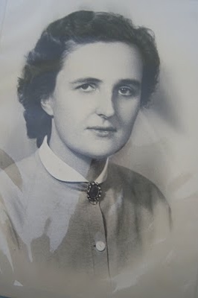
Gianna believed that the medical profession was like no other; she had very clear ideas about the purpose and sanctity of her vocation.
During poor economic times, often patients would pay her with eggs or chickens and Gianna herself would give them money for food or medicine.
“'He who visits a sick person, helps me,' Jesus said... Just as the priest can touch Jesus, so do we touch Jesus in the bodies of our patients... We have opportunities to do good that the priest doesn't have... Catholic doctors are so necessary!”

Slide 8
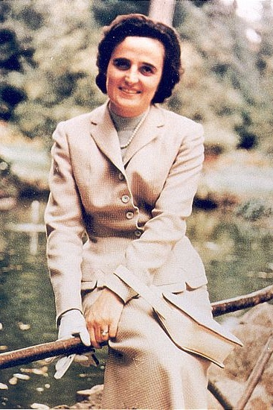
Gianna had always wished to become a lay missionary. She wanted to join her brother Alberto, a missionary in Brazil and offer her medical services, which were badly needed. However, obstacle after obstacle prevented her from carrying out her wish. Instead of losing heart, she intensified her prayer in order to know God’s will better. Through spiritual direction, she finally understood that she was being called by God to form a family, and she directed her thoughts to the married state, secure in the knowledge that this was God’s will for her.
Gianna spent many years in uncertainty of the choice of her state in life. She suffered much because she was really convinced of her vocation as a lay missionary.

Slide 9
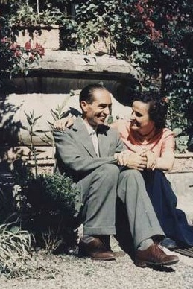
Gianna had a deep passion for motherhood and wanted to have many children. Two weeks before their wedding, Gianna wrote this to her future husband, Pietro:
“With God’s help and blessing we will do our best to make our new family a little Cenacle where Jesus reigns over all our affections, desires, and actions… There are only a few days to go and I feel moved at the thought of approaching and receiving the ‘Sacrament of Love’.”
“We will become collaborators with God in His creation and so we will be able to give Him children that love and serve Him".

Slide 10
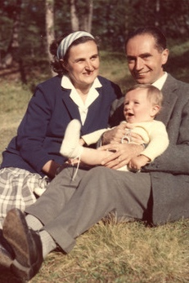
Just a little over a year after their marriage, Pietro and Gianna joyfully welcomed their first son. Pierluigi was born on November 19, 1956 in their home.
On December 11, 1957, Maria Zita (Mariolina) was welcomed into the world.
July 15, 1959 brought the third Molla child, Laura, into the world.
To thank God after the birth of each child, she took money from her savings to give to the missions... an amount equal to six months of a worker’s salary.

Slide 11
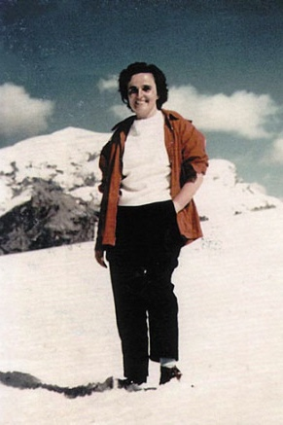
Gianna was a happy person who felt loved and understood throughout her entire life.
Her work did not impede her from engaging in her favorite sports, skiing and mountain climbing. She felt nowhere closer to God than at the summit of a large mountain covered with snow. She enjoyed fashion, the symphony, and took in the opera at Milan's La Scala. She painted, and played sports.
Gianna lived her life with exuberant joy. She was able to accept and appreciate the Lord’s gifts, life’s gifts, without abusing them, without ever letting them dominate her.

Slide 12
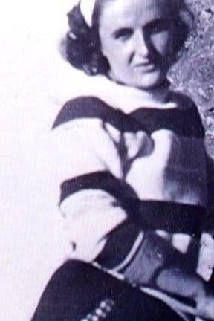
One of Gianna’s school companions wrote:
“Gianna had a faith so catching that all those who met her, after a short time, felt attracted to the Church, in whose life we desired to participate with deeper religiosity.”

Slide 13
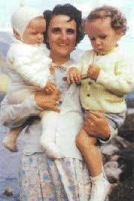
Gianna and Pietro adored each other and their rapidly growing family, but they began to experience some stress. Gianna cared for the children and continued with her medical practice.
Others were continually amazed that she found time for everything and everyone involved in her life; she was never idle. She was a wonderful cook and loved to entertain peers, friends and family on the weekends.
She successfully juggled her responsibilities:
mother, wife, homemaker, doctor.

Slide 14
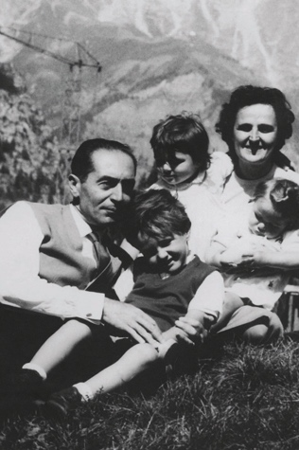
Pietro, who felt an enormous burden with the concerns and responsibilities of his own work and family, needed a retreat from daily pressures. He would spend time alone in the mountains. Although Gianna understood and accepted his needs, she was sad to see him leave. She decided that she would not bother him with any family matters while he was away. But she missed his warm embrace and the strength and support of his presence.
Her love for Pietro continued to grow stronger and she felt her love for him was connected to her love for God.

Slide 15
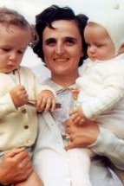
Gianna paid particular attention to the children’s spiritual training. Each evening the children would reflect on their actions that day, and talk about whether Jesus would have been happy about some of the events.
Although they were very young, she would say prayers with them and talk to them about the love of Jesus.

Slide 16
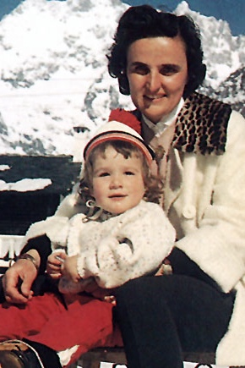
In September 1961, towards the end of the second month of her fourth pregnancy, she had developed a fibroma in her uterus. Surgery was required. Some of her colleagues advised her to terminate the pregnancy, A typical therapy offered in Gianna's day for a woman with uterine cancer or a tumor of uncertain type would have been hysterectomy.
Yes, I have prayed so much in these days. With faith and hope I have entrusted myself to the Lord... I trust in God, yes; but now it is up to me to fulfill my duty as a mother. I renew to the Lord the offer of my life... If you must decide between me and the child, do not hesitate: choose the child--I insist on it. Save the baby."

Slide 17
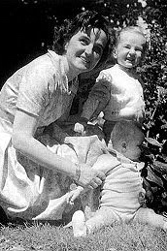
Conscious of the risk that her continued pregnancy brought, still she pleaded with the surgeon to save the life of the child she was carrying. She entrusted herself to prayer and Providence.
She worried that the baby in her womb might be born in pain, and she asked God to prevent that.

Slide 18
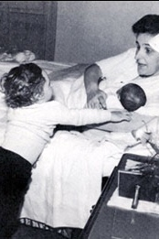
Gianna never considered the possibility of abortion.
On the morning of 21 April 1962, Gianna Emanuela was born.
She freely chose, with great generosity on her part, to proceed with a higher risk pregnancy for the benefit of her child.

Slide 19
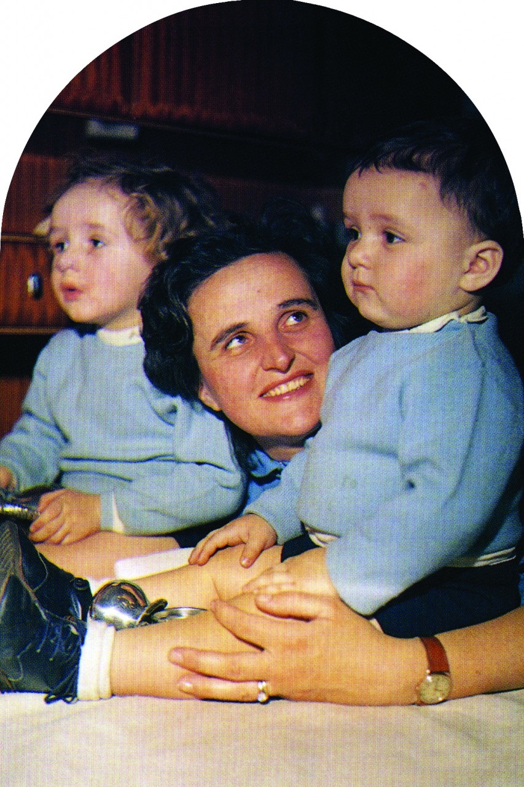
During the night between Tuesday and Wednesday after Easter, her condition sharply worsened. Wednesday morning it took a temporary turn for the better and she told me “Pietro, I was on the other side already and if I could tell you what I saw! One day I will. But since we were too happy with our wonderful children, full of health and grace, with all of heaven’s blessings, they sent me back here, to suffer more, because it is not right to knock at the Lord’s door without having suffered greatly.” Gianna’s faith in God and in his Providence gave her the courage to make the choice of love that cost her life.
This was her testament, of joy and suffering, of devotion and faith in God.

Slide 20
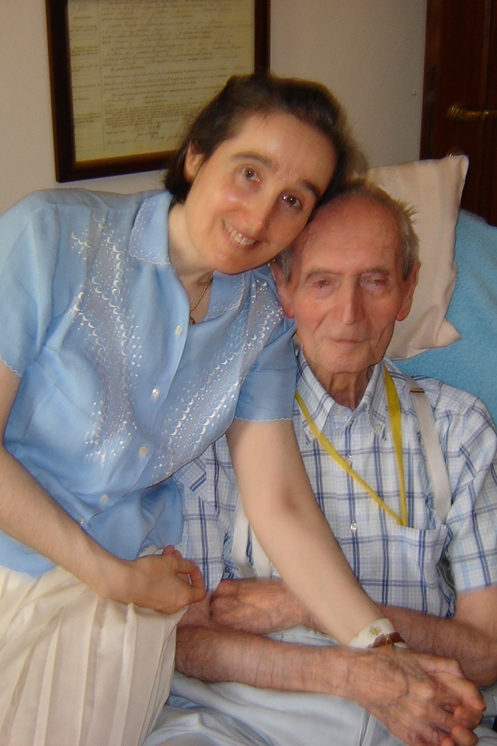
Pietro Molla on his 95th birthday, with daughter Gianna
Pietro Molla remembers the days of intense suffering resulting in his wife’s death: “Many times I relive them almost as if they were the present. I still see Gianna when, on Easter morning in 1962, in the maternity ward of the Monza hospital, she took the child in her arms with great effort, she kissed her and looked at her with a sadness and an anguish that to me are the proof of her awareness that she would soon orphan her.”
At the funeral, Dr. Jolanda Botti, a pediatrician, stated: "I believe that the memory of Gianna will be a seed that will bear fruit. We cannot think that God has taken away from this world such a noble and dear lady, without a very great motive that we cannot understand now."

Slide 21
Source: http://www.saintgianna.org

