Slide 1
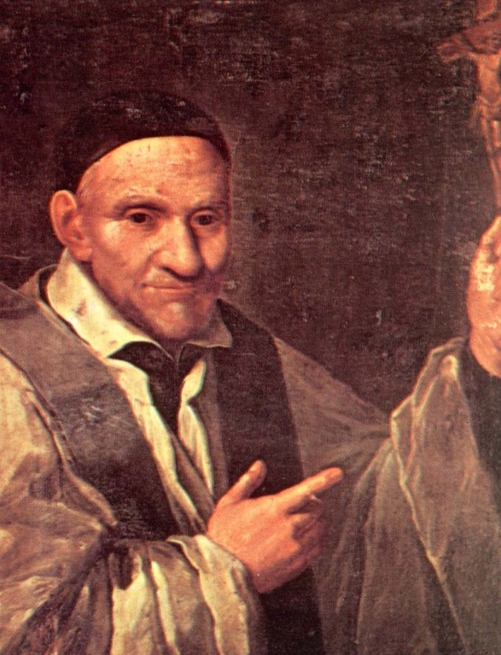
The Virtue of
Mortification

Slide 2
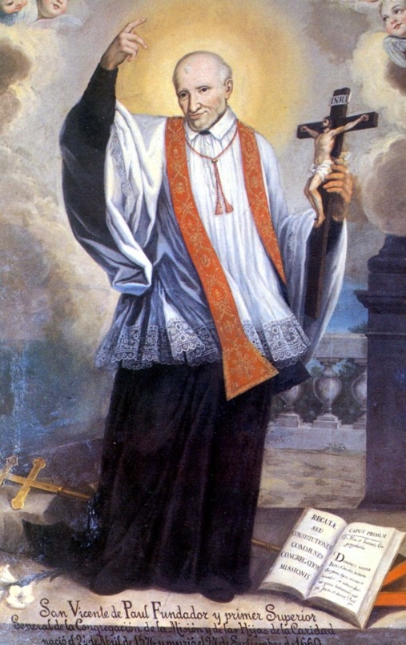
Mortification is renouncing immediate gratification, for the sake of more important goals.

Slide 3
We live in an age where the challenge of the virtue of mortification is ever increasing. Mortification stands against our constant, unrestrained pursuit of material goods and comfort. It stands against seeking only what pleases me in the here and now.

Slide 4
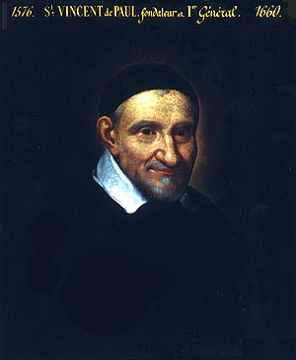
St. Vincent de Paul, ahead of his time, recognized mortification as a powerful tool to sanctity. He insisted on the necessity of mortification, and we count it as one of his five great Vincentian Virtues.

Slide 5
Mortification does not mean not having the basic comfort which is a natural and inalienable right of individuals. It does mean that we are people of self-discipline-- people of restraint-- who are living witnesses to Gospel teaching.

Slide 6
St. Paul puts it succinctly:
“I am allowed to do everything, but not everything is good for me. I am allowed to do anything but I am not going to let anything make me its slave.” (1 Cor 6:12)
The virtue of mortification is the solution to this human dilemma. Mortification says to us that not every passion needs to be expressed.

Slide 7
Mortification says to me: Be free from the comfort of home, in order to experience the “discomfort” of the mission.
It says: Be free from the sweet-scented and highly connected wealthy people, in order to experience the often repulsive body odor of the poor, the sick, the prisoners and the patients of HIV/AIDS.

Slide 8
Mortification says to me: Indulging in rich food and drink is not my priority-- today I will set aside time to pray and fast.
Mortification says to me: Sexuality is God’s gift, and it should not be misused.

Slide 9
Mortification says to me: Be free... let go of your natural tendency to “have it all your way”.
Mortification says to me: Choose to fly economy class instead of first class, even though you can afford it, and do so in solidarity with the poor.

Slide 10
Mortification says to me: Give up “perks” or advantages in parish ministry, if you want to build a true participatory Christian community.
Mortification says to me: As a prison chaplain, I will withstand the ungrateful nature of the oppressed prisoners.

Slide 11
Mortification says to me: I can bear the unhygienic nature of the environment of _______.
(Fill in the blank according to your vocation: working in a very difficult country, a home visit, visiting the sick, serving the elderly, encountering a homeless person... etc.)

Slide 12
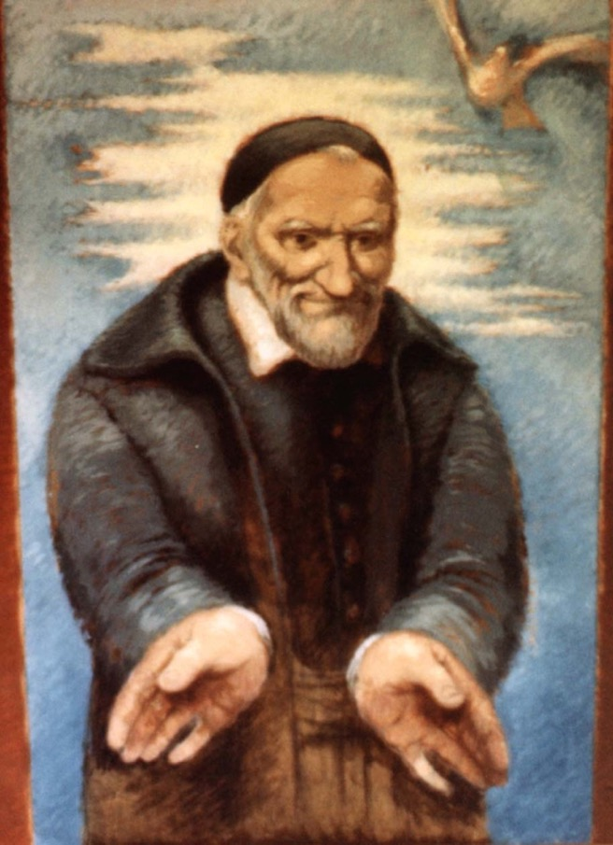
Mortification is all about making choices and the goal for our choices. In the Vincentian context, choices are made in solidarity with and for the poor.

Slide 13
In fact, mortification has charity as its goal. (Lk 21:1-4, The Widow’s Offering):
He looked up and saw rich people putting their gifts into the treasury; he also saw a poor widow put in two small copper coins. He said, ‘Truly I tell you, this poor widow has put in more than all of them; for all of them have contributed out of their abundance, but she out of her poverty has put in all she had to live on.’

Slide 14
Mortification is always for the sake of something or someone else. We give up good things not because we think they are bad. We acknowledge that they are good even as we give them up, because we want something better.

Slide 15
St. Vincent’s teaching on mortification is contained in his correspondence. St. Vincent encouraged acts that involve denial of the senses: sight, smell, touch, taste and hearing; and also of the interior senses: understanding, memory and will.
Common examples would be quiet prayer, and fasting. Another: letting go of a dysfunctional desire to know all things. In Common Rules for his congregation, he even advises: renounce immoderate love for your relatives and parents. (CR II, 9)

Slide 16
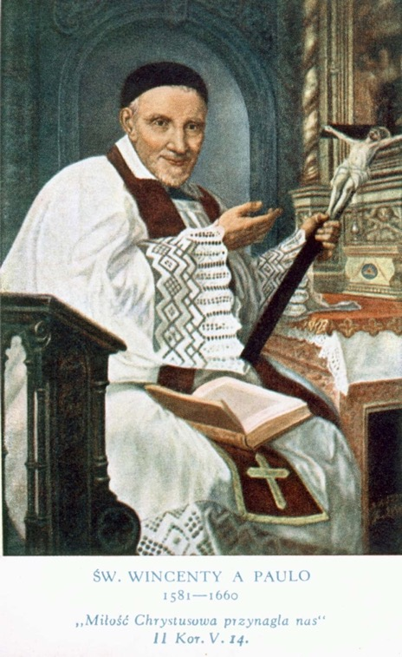
St. Vincent emphasized that the practice of mortification is a discipline aimed at detachment from any things that disrupt one’s healthy relationship with God.

Slide 17
St. Vincent’s idea of mortification is based on Christ’s condition of discipleship: “If anyone wishes to come after me, let him deny himself and take up his cross daily.” (Lk 9:23)
Authentic spirituality is that which is rooted, lived and centered on the person of Jesus. The need to embrace the virtue of mortification lies in the fact that Jesus Himself made it a condition for discipleship.

Slide 18
St. Paul, in similar spirit, adds: “If you live according to the flesh, you will die, but if by the spirit you put to death the deeds of the flesh, you will live.” (Rom 8:13)

Slide 19
What is the reward of mortifying ourselves, after the example of Our Lord? When we are obedient to God, we feel satisfaction, safety in God, and are more able to go out and build a harmonious community of fraternal love. Mortification helps pastoral agents, missionaries, anyone who serves the poor-- to remain firm and undaunted in the face of difficulties. Disobedience to God brings trouble while obedience brings blessing.

Slide 20
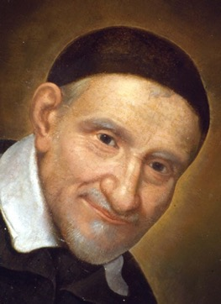
“Gentlemen, let us keep this example before our eyes-- let us never lose sight of the mortification of our Lord, seeing that to follow him we are obligated to mortify ourselves after his example. Let us model our affections upon His, so that His footsteps may be the guide of ours in the way of perfection. The saints are saints because they walked in His footsteps, renounced themselves and mortified themselves in all things.”
(St. Vincent XII, 227)

Slide 21
link to full article
Source: Adapted from
Vincentiana, July-December 2005
The Virtue of Mortification by Michael Ngoka, C.M.
Vice-Visitor of Nigeria
famvin.org

