Slide 1
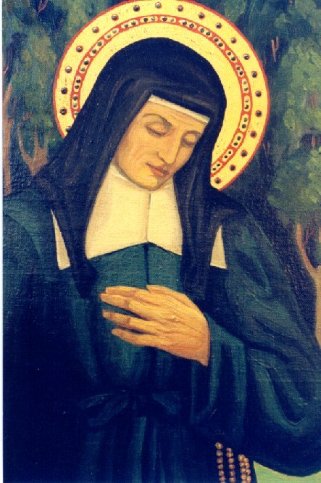
St. Louise - healer, sister, friend
Shared by Sister Nancy Murphy, DC

Slide 2
Realities of 17TH century France
Average Life Span – 35 years(mid-50s, for those who actually made it to adulthood)
War
Plague
Starvation
Abject poverty
No organized social services (no Red Cross, Catholic Charities, etc.)
Sisters lived in monasteries- not able to come to the people

Slide 3
Louise de Marillac and Vincent de Paul – co-founders of the daughters of charity
Each saw in the other a great holiness and sense of mission to serve the needs of the numerous people living in poverty all around them

Slide 4
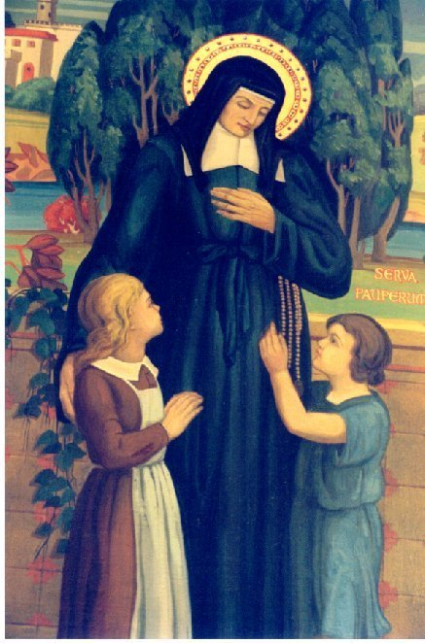
Louise with the needy children
Vincent at the bedside of a sick man

Slide 5
Louise as healer
Louise’s own delicate health (it was her constant reality to be ill)
Numerous illnesses around her
Sick included
those who were poor
the Sisters
their families
Vincent
others

Slide 6
WHAT DID LOUISE KNOW ABOUT ILLNESS AND TREATMENT?
What was the medical knowledge and understanding in 17th century France?

Slide 7
Timeline of medical discoveries
5th Century, B.C.: The Four Humors (Blood, Phlegm, Yellow Bile, Black Bile)
August 12, 1591: St. Louise is born
1634: William Harvey – Blood Circulation (did not enter into common thinking until the 19th Century)
March 15, 1660: St. Louise dies
1665: Robert Hooke – Invention of the Microscope
1678: Anthony Leeuwenhoek – Discovery of Bacteria
1724: Daniel Fahrenheit – Clinical Thermometer
1816: Rene Laennec – Stethoscope
1846: William Morton – Ether
1865: Joseph Lister – Antiseptic
1899: Felix Hoffman – Aspirin

Slide 8
The Four Humors
Blood – Liver
Phlegm – Brain/Lungs
Bile – Gall bladder
Bile - Spleen
Basically, this was the working medical theory of Louise's time– that there were 4 fluids in the body, and they needed to be in balance with each other, or else the person became ill. Two of the major therapies recommended frequently by St. Louise were blood-letting and purgation– both done in order to bring back the balance of the humors in the body and restore health. Remember, they did not know about blood circulating throughout the body or about bacteria and viruses.

Slide 9
Everyday concerns
Problem
Death/dying
Illness/ill
Sick
Suffering
Wounds
Health Issues
Found in Letters
>230
>250
>500
>125
>70
>200

Slide 10
How did Louise address these concerns?
Spiritual Support
Human Support
Material Support
Training of Sisters

Slide 11
Caution with remedies
“…remedies are most effective when used infrequently.”
“…purge patients and let their blood only when necessary.”
…inform the doctor and if he finds it wise…”
“…we have been taught a remedy that we are to try out … then will recommend it to you”

Slide 12
Questionable medical advice
“Purge her…although the best remedy is a cauterization at the back of the head.”
“…for persons our age, blood-letting...full moon; purgatives ...the waning moon.”
“…remedies of cold sponges or bloodletting when the sick are adverse to the sponges.”

Slide 13
How does louise’s example help us in our ministry to those who are poor and ill?

Slide 14
Service of the poor reverence integrity wisdom creativity dedication

Slide 15
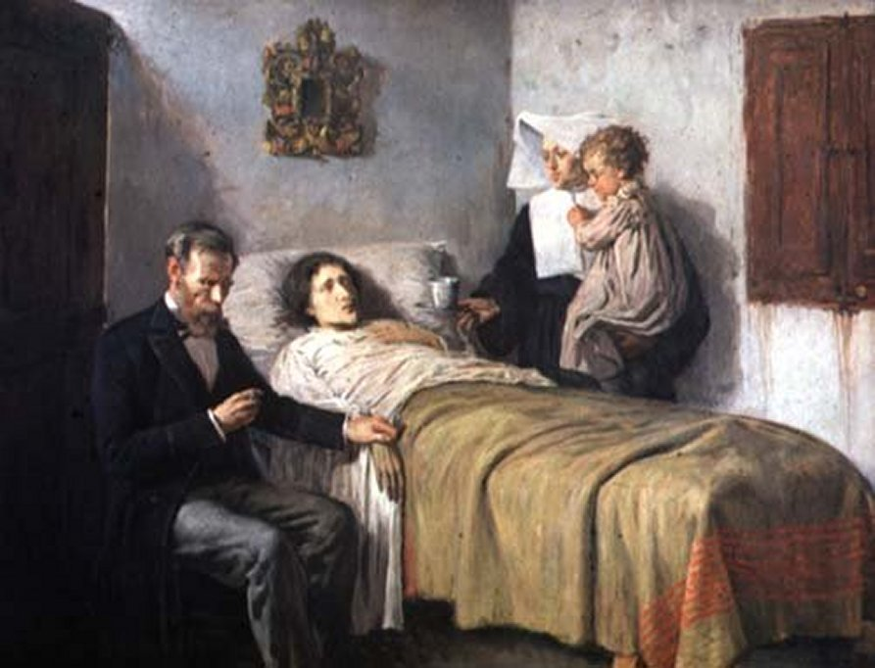
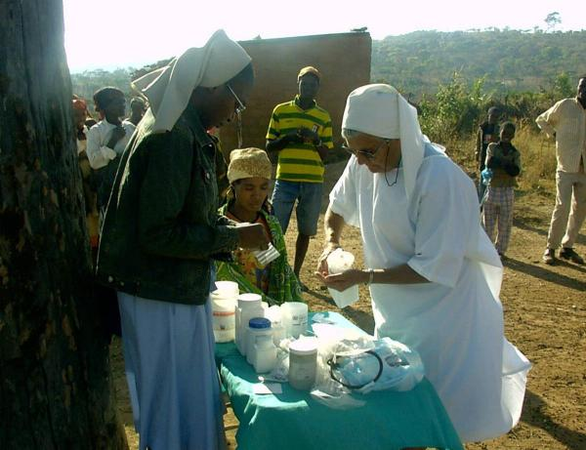
Service of the poor
GENEROSITY OF SPIRIT, ESPECIALLY FOR PERSONS MOST IN NEED

Slide 16
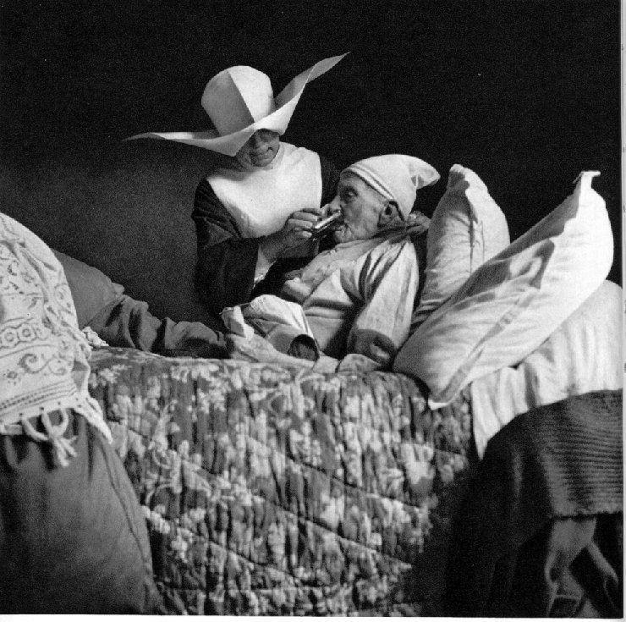
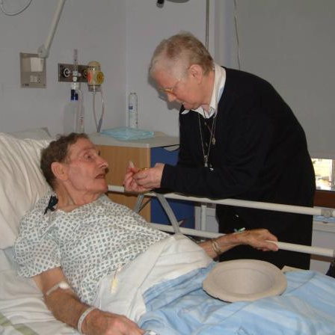
reverence
RESPECT AND COMPASSION FOR THE DIGNITY AND DIVERSITY OF LIFE

Slide 17
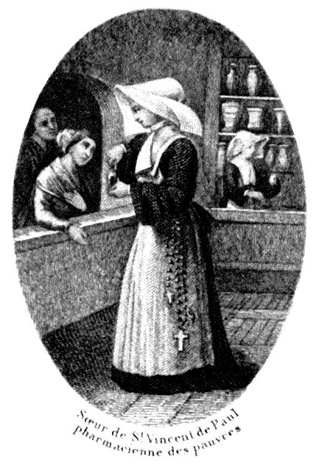
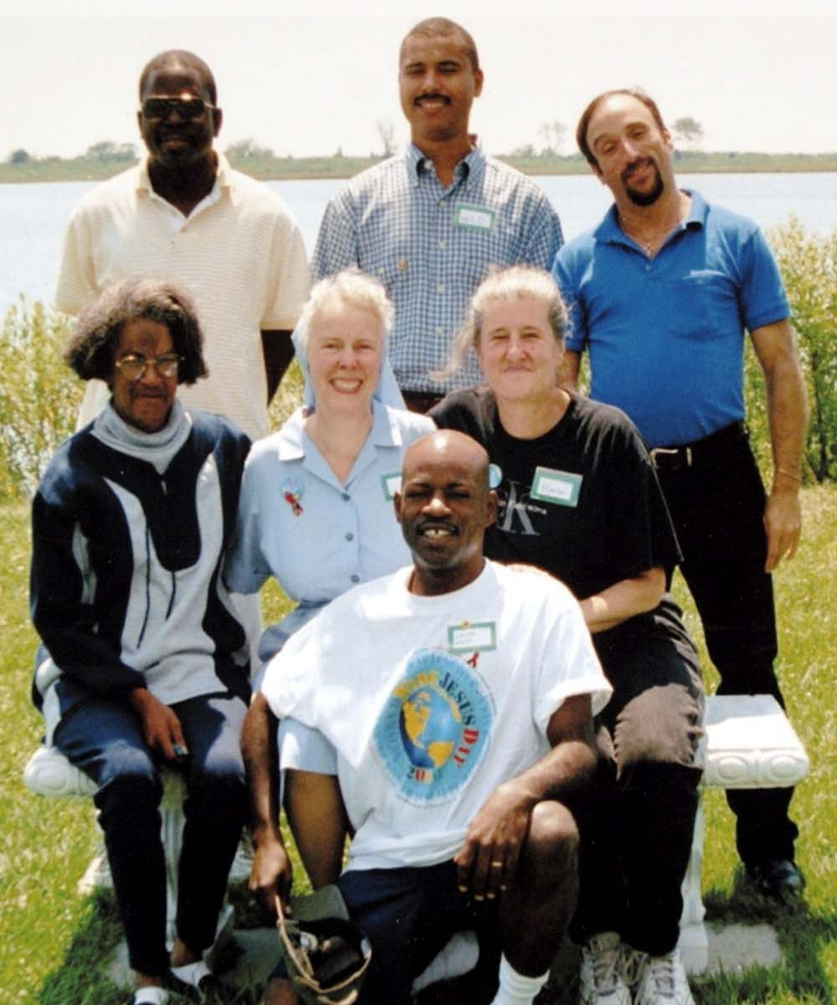
integrity
INSPIRING TRUST THROUGH
PERSONAL LEADERSHIP

Slide 18
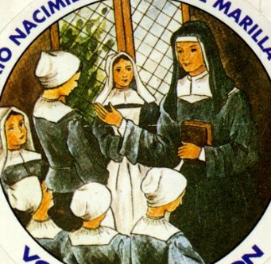
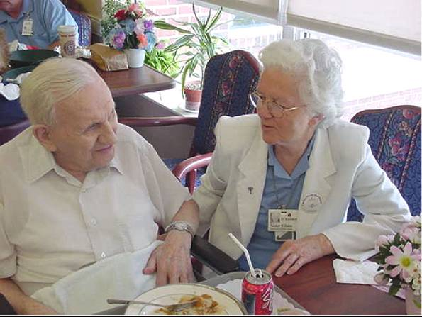
wisdom
INTEGRATING EXCELLENCE
AND STEWARDSHIP

Slide 19
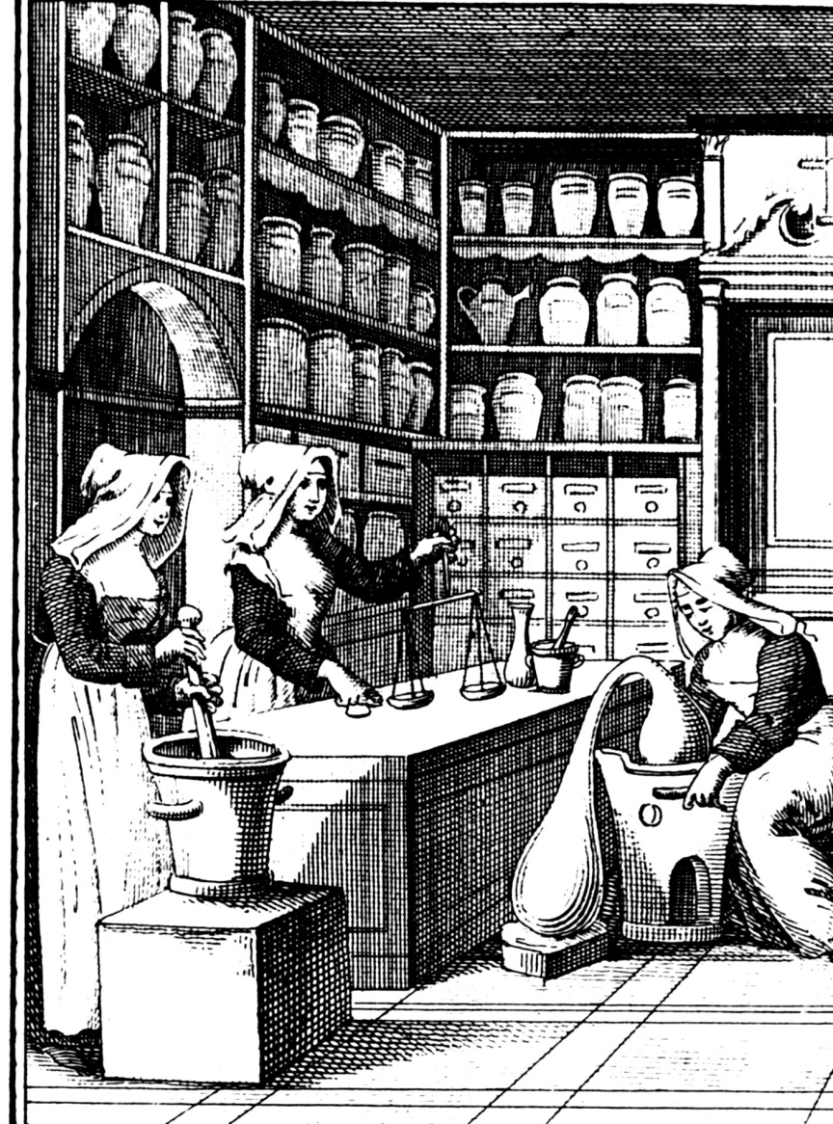
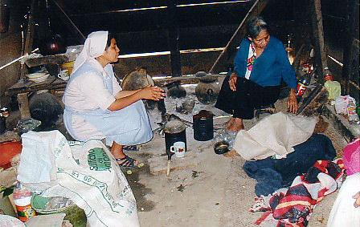
Creativity
COURAGEOUS INNOVATION

Slide 20
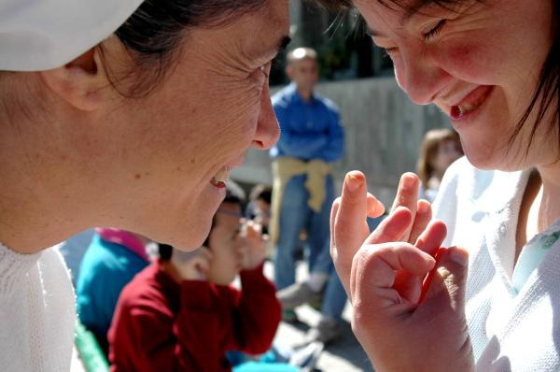
Dedication
AFFIRMING THE JOY AND HOPE
OF OUR MINISTRY

Slide 21
St. Louise - healer, sister, friend
Shared by Sister Nancy Murphy, DC

