Slide 1
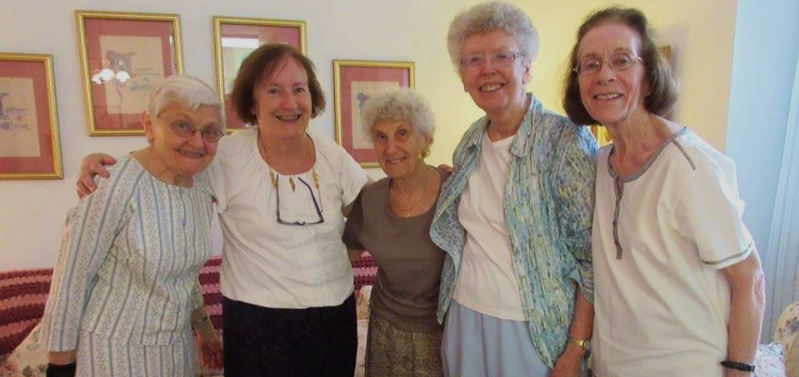
Around December 8 each year, in these or similar words, each professed Sister of Charity recalls the meaning of the vows she made:

Slide 2
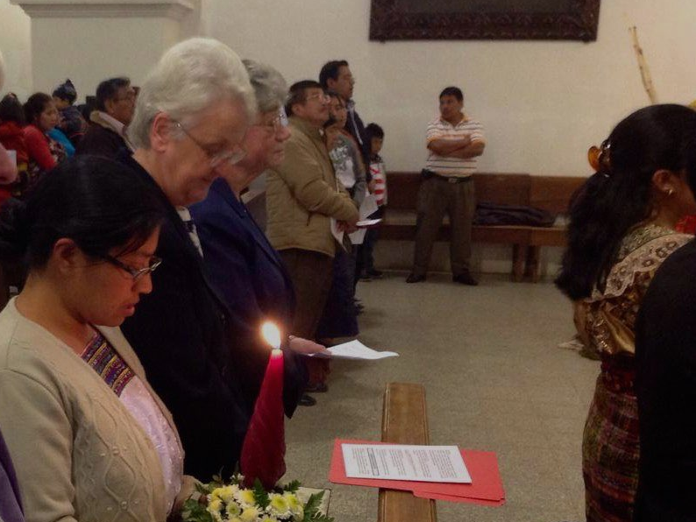
I renew my vow of poverty, seeking to live simply,
to be satisfied with what is enough,
recognizing that all I have is gift,
sharing responsibility for the resources of the Congregation,
in a spirit of interdependence.

Slide 3
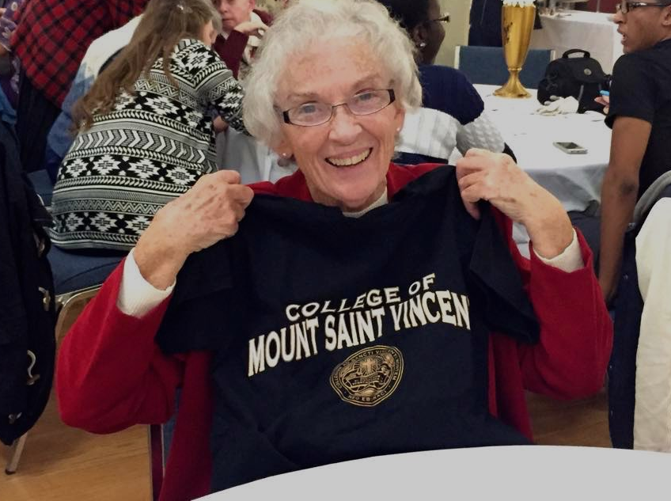
I renew my vow of celibate chastity,
seeking to deepen my capacity to love freely and widely,
to give and receive reverently in a relationship of mutuality,
to foster community and communion
for the sake of the mission.

Slide 4
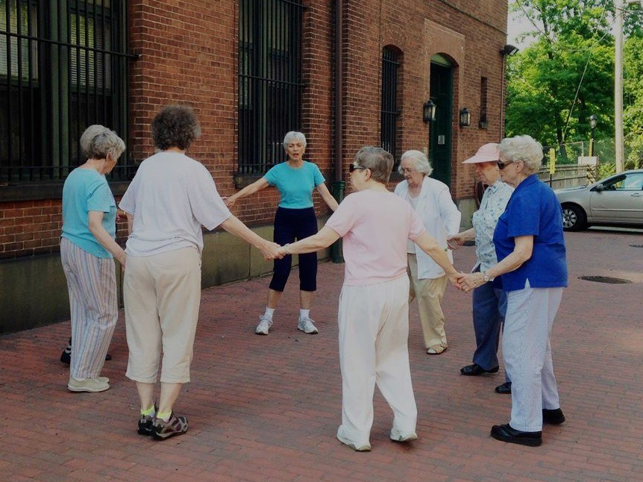
I renew my vow of obedience, seeking to listen attentively
to God’s revelation in each person and event of life,
to attend to those entrusted with authority,
to discern the truth in responsible dialogue
and to respond in fidelity to the Spirit.

Slide 5
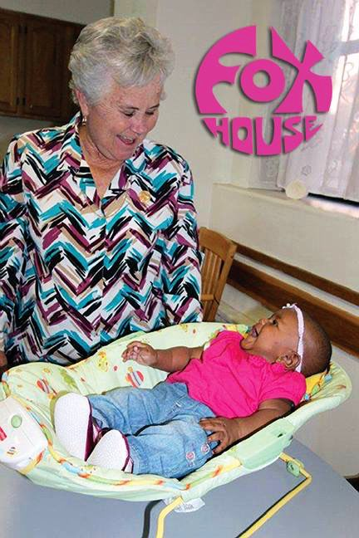
I renew these vows,
desiring with all my heart
to embody Charity
with perseverance and passion.

Slide 6
All photos:
facebook.com/SistersOfCharityNY

