Slide 1
Sign of the Sacred: the Poor as Sacrament
the mystical parallel between Christ's presence in the Eucharist and Christ's presence in the poor and oppressed

Slide 2
Sacrament
St. Augustine defined sacrament as “the visible form of an invisible grace” or “a sign of a sacred thing”.

Slide 3
Sign of the sacred
“It is to be strongly held that there is a relationship between the real presence of Christ in the Eucharist and His social presence in the poor; the poor are the sacrament of Christ.”
(J. Sobrino, The True Church, 125-159.)
from The Relationship between the Eucharistic Liturgy, the Interior Life and the Social Witness of the Church according to Joseph Cardinal Parecattil by Jacob Nangelimalil, Roma 1996.

Slide 4
Sign of the sacred
“The real presence of Christ, which is hidden in the bread and wine, is visibly manifested in his social presence in the poor who are the sign and image of His ongoing passion in the world.”
(Paul VI, Insegnamenti, VI, 377; P.J. Rosato, Cena del Signore e amore sociale, 83.)

Slide 5
Places of God's real presence in the world:
in the encounter of God and man in the Eucharist
and in the care for the poor and those who are hard-pressed by plights of all kinds
image: facebook/FatherPedroOpeka

Slide 6
Ways that Christ is present in the Church
“[The poor are] “sacramentum magnum, dico, in Christo et in ecclesia" ("the great sacrament, I say, in Christ and in the Church”)."
— from a speech given by Cardinal Giacomo Lercaro of Bologna during the first session of the Second Vatican Council
He immediately explains what that means: The Church knew three "truths of the mystery of Christ in the Church" - namely,
His presence in the leadership of the Church
His presence in the Eucharist
In the history of the Church both of the above had been thoroughly thought over, whereas the third presence of Christ in the Church must be dealt with more in detail: Christ's presence in the poor
from The Poor as Christ's Sacrament by Bernhard Bleyer
image: facebook/DaughtersOfCharityInternationalProjectServices

Slide 7
Pope Paul VI Sermon
“On the day between his visit to the Eucharistic World Congress and the opening of the General Assembly of the episcopacy, [Pope Blessed Paul VI] on 23 August 1968 travelled to a place called San Jose de Mosquera, about 25 km outside Bogotá, hardly known even to Colombians. Never before had a pope said Mass in a tropical landscape, on Latin American soil and, on top of that, in the presence of thousands of people who belong to the poorest of the poor of the country visited.” [200,000 campesinos, farm workers and day-laborers]
from The Poor as Christ's Sacrament by Bernhard Bleyer
U.N. photo

Slide 8
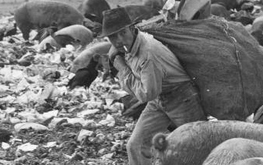
Christ's Real Presence in the Poor - Analogous to the Eucharist
[There] “the Pope unfolds an amazing theology in the interpretation of the speech of the Last Judgment (Mt 25:31-46). He addresses the farm-hands and day-laborers with the words:
‘You are a sign, a likeness, a mystery of Christ's presence. The sacrament of the Eucharist offers us his hidden presence, living and real; you too are a sacrament, i.e. a holy image of the Lord in the world, a reflection which is a representation and does not hide his human and divine face ... The whole tradition of the Church recognizes in the poor the sacrament of Christ, which certainly was not simply to be equated with the reality of the Eucharist, but was in a completely analogous and mystical correspondence with it.’”
from The Poor as Christ's Sacrament by Bernhard Bleyer
photo: a farm worker in Colombia (free embed from Getty images/Timothy Ross)

Slide 9
“You are Christ for us”
“Directly addressing his audience the Pope continues:
‘Beloved sons, you are Christ for us. We, who have the extraordinary luck to be his deputy in the teaching authority of the truth revealed by him and in the pastoral service of the entire Catholic Church, want to discover the risen and suffering Christ in you. We have not come to get your devoted applause, which is always pleasant and moving, but to honor the Lord in your persons, in order to bow accordingly before them and to tell them that we show that love ... to Him in you, in you yourselves.’”
from The Poor as Christ's Sacrament by Bernhard Bleyer
photo by Ambrosius007 at English Wikipedia, CC BY-SA 3.0

Slide 10
Highest dignity
By those words Paul VI gives the human and social service of Christian charity […] that place and status in the church, which the Church has always given the celebration of the sacrament of the Eucharist.
[These] belong together, due to their highest dignity in theology and salvation history.
from The Poor as Christ's Sacrament by Bernhard Bleyer
image: facebook/DaughtersOfCharityInternationalProjectServices

Slide 11
A place where we can meet Him
“Jesus Christ made himself in history forever accessible […] he announced a place where we can meet him in a dense and explicit way: in existentially threatened needy people. Just there, where the loving care for him in the humiliated becomes practice is the place of Christ's presence. It is a preferred Christian place, the place of the present Gospel: in the way that he promised to be with those to whom he preached the Good News of God's coming kingdom: the marginalized people of society.”
from The Poor as Christ's Sacrament by Bernhard Bleyer

Slide 12
Two foundations on which the Church builds its legitimacy
We can say…
The Church exists to witness Christ's life, cross and resurrection in the world
The Church does that in the highest form by celebrating the Eucharist and by serving the poor and distressed
from The Poor as Christ's Sacrament by Bernhard Bleyer
Image: Dawn of Hope Day Care Center, Ethiopia
facebook/VincentianSolidarityOffice

Slide 13
"We must get to know man, in order to recognize God." {22}
– Pope Paul VI, after starting from Mt 25:31-46, in his sermon on the occasion of the conclusion of the Second Vatican Council,
7 December 1965

Slide 14
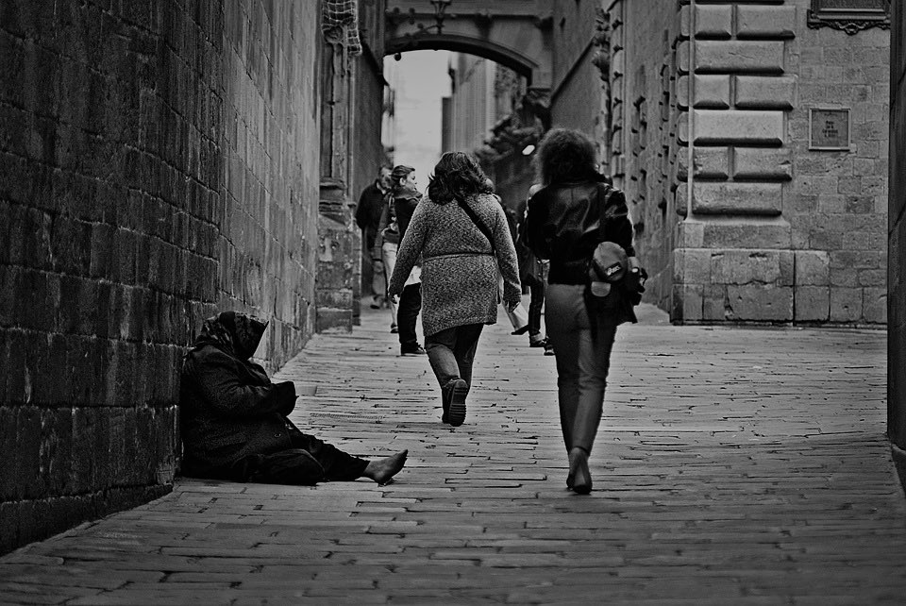
[The poor are] "a sacred image of the Lord in the world (una imagen sagrada del Señor en el mundo) ... You are Christ for us (vosotros sois Cristo para Nos)" {36}.
– Pope Paul VI

Slide 15
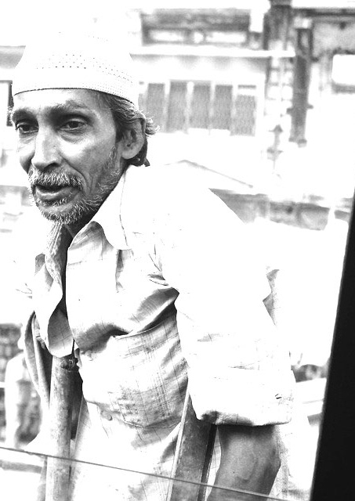
“We should kneel at the feet of the poor and, with the Apostle, say to them
‘You are our masters, we shall be your servants; you are the visible image of God whom we do not see, but whom we love in loving you.’”
–Frederic Ozanam

Slide 16
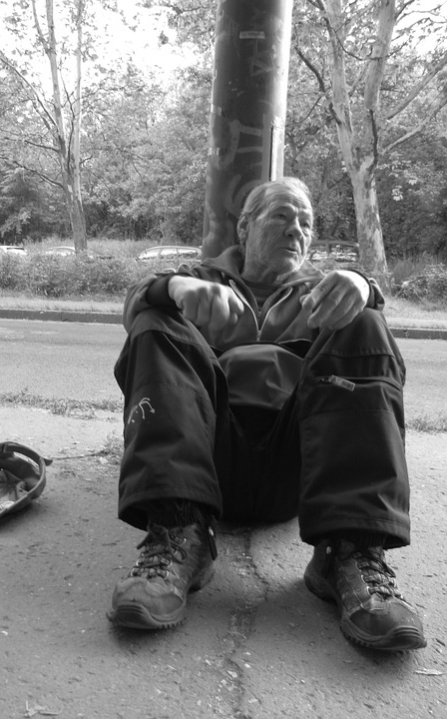
"In our contacts with people we meet the Lord, especially in contacts with those whose human faces have been disfigured by oppression, exploitation and alienation ... The salvation of mankind comes through them ... Our attitude towards them or— better— our commitment to them decides whether our existence is conformed to the will of the Father. That is the content of the revelation Christ gives us, identifying himself with the poor of Matthew's text."
— Gustavo Gutiérrez, OP
quoted in The Poor as Christ's Sacrament by Bernhard Bleyer

Slide 17
“How beautiful it is to see poor people if we consider them in God and with the esteem in which Jesus Christ held them.”
–St. Vincent de Paul (XI:26)

Slide 18
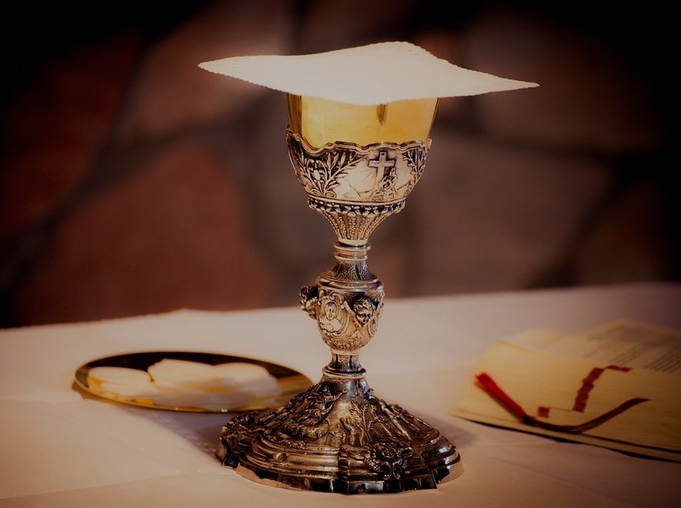
“Feeding on the Eucharist, Christians nourish their soul and become the soul which sustains the world, thus giving a Christian meaning to life, which is the meaning of the Sacrament. The Sacrament brings the gift of charity and solidarity, because the Sacrament of the Altar is inseparable from the new commandment of mutual love.”
from The Social Meaning of the Eucharist, vatican.va/roman_curia/synod/documents
[So also the poor nourish our souls as we walk with them…] “The world’s impoverished live day after day sensing the closeness of God’s presence. God is near, familiar, someone who can be counted on … These are people who, in the most difficult of situations, know how to understand the other, put themselves in the other’s place … They live simply and it is this simplicity that fills their relationships with the other person and with God … economically poor but rich in generosity, who give the little they have … The joy of small gestures, their sense of the little things evangelizes us … their ability to relativize their own crosses, to live their own lives in the joy of being saved, all of this reminds us of our attitudes when facing our crosses and we are enlightened.”
Villar, Eva (2002) "Being Evangelized by the Poor," Vincentiana: Vol. 46: No. 4, Article 11.

Slide 19
“God loves the poor, consequently, He loves those who love the poor; for, when we truly love someone, we have an affection for his friends and for his servants. Now, the Little Company of the Mission strives to devote itself ardently to serve persons who are poor, the well-beloved of God; in this way, we have good reason to hope that, for love of them, God will love us.”
–St. Vincent de Paul (XI:349)

