Slide 1
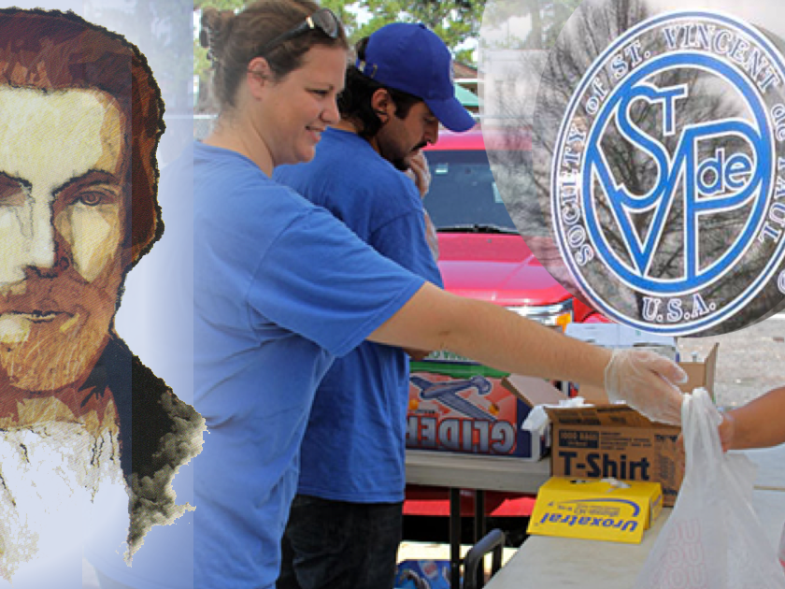
An Examination of Conscience
for Vincentians
(adapted from “Prayerbook, SSVP Council of Scotland”)

Slide 2
Why am I a member of
Society of Saint Vincent de Paul?
First and foremost, my membership of the Society is to make me a better person – to deepen my
relationship with Our Lord. If I am not striving after this, then my being a SSVP member is useless, despite the would-be good works I am doing.
photo: (CNS/Catholic New World/Karen Callaway)

Slide 3
Am I trying hard enough to become a better person through the Society?
This will involve my fidelity to the Mass and Sacraments, to prayer and my love for people who need me. Then I must go further: I must strive to be aware of the presence of God all around me, in creation and in creatures.
photo: svp.ie

Slide 4
Do I see in even the most unworthy of people the face of Christ?
We cannot pick and choose the people we have to help. We accept each person who comes our way. Even if our help is squandered and misused, we have done our part.
photo: svdpstlouis.org

Slide 5
Is my conference meeting such that it enriches my faith?
If it is not, then there is something wrong with it, and it has maybe developed into a mere discussion of “cases”. It must be no ordinary meeting, but a holy encounter between people who are striving after a closer encounter with Our Lord.
photo: svdpBoston.com

Slide 6
Am I unobtrusive enough in my membership in the Society?
To work silently, with no wish for recognition or reward has always been a characteristic of the Society of Saint Vincent de Paul. Do I like the sound of my own voice? Do I try to force my opinions on others or grumble about others’ methods?
photo: svdpla.org

Slide 7
Am I gentle enough in my dealings with Vincentians and with those I help?
Our Lord was meek, gentle, understanding and courteous. We must strive to be Jesus to one another, to the poor and even to the toughest and roughest people we meet. We show to them the same courtesy Our Lord Himself would show.
photo: svdphouston.org

Slide 8
Am I an example to others?
photo: archindy.org
I must be a genuine example to others of living in the faith of Christ. I must be strong in principle, gentle in its application. But above all, I must practice what I preach and preach what I stand for.

Slide 9
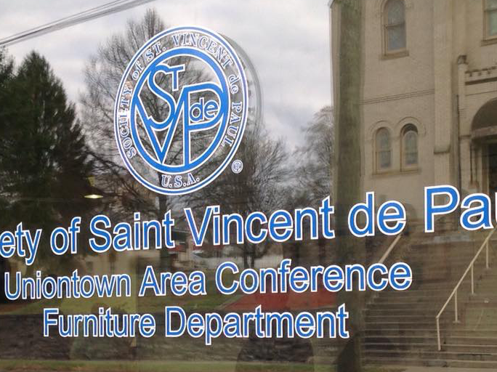
WORK HARD AT HOLINESS,
AND YOUR WORKS WILL TAKE CARE
OF THEMSELVES.
photo: stvincentdepauluniontown.org

