Slide 1
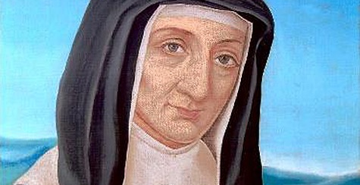
The Heart of Jesus In the Spirituality of Louise de Marillac
by Robert P. Maloney C.M.

Slide 2

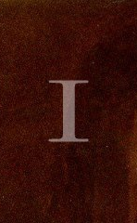
One New Testament text speaks explicitly of Jesus’ heart. In Matthew’s gospel, Jesus himself tells his followers:
“Learn from me, for I am gentle and humble of heart.”
It was a text that Louise and Vincent loved to quote.

Slide 3
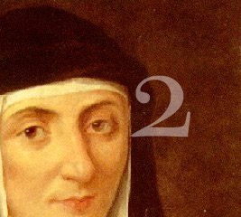
Jesus’ gentleness of heart has stood as a challenge for all Christians: we are to be in control of our anger, peace-makers, warm, receptive, aware of our limitations, grateful for God’s gifts.

Slide 4
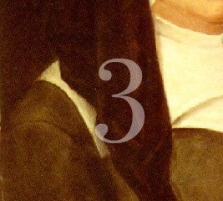
Louise made many references to the heart of Jesus. Not only do we read of it in her writings, we see it in the paintings which, she told the sisters, were her devotion and amusement.
She painted both small and large images of Jesus’ heart.

Slide 5
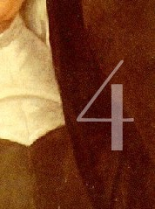
A large painting depicting the “Lord of Charity” hangs above a landing on a staircase near the Superior
General’s room at the Motherhouse of the Daughters in Paris. The heart of Jesus is exposed as he looks out at the viewer.

Slide 6

Louise uses “heart” with great frequency. She urges the Company to be of “one heart” and one mind or will, and encourages sisters to have “a loving heart for works of charity.”
She is aware of her own “hardness of heart”; she desires things “with all my heart”; and advises that “God wants only our hearts.” She frequently ends letters “in the love of the heart of Jesus Crucified.”

Slide 7

As early as 1622, when writing about her desire to give herself to God, she focuses explicitly on the heart of Jesus:
“As I meditated on the Gospel of the Sower, I realized that there was no good soil in me. Therefore I desired to sow, in the heart of Jesus, all the actions of my heart and soul in order that they may grow by sharing in His merits. Henceforth, I shall exist only through Him and in Him since He has willed to lower Himself to assume human nature.”

Slide 8
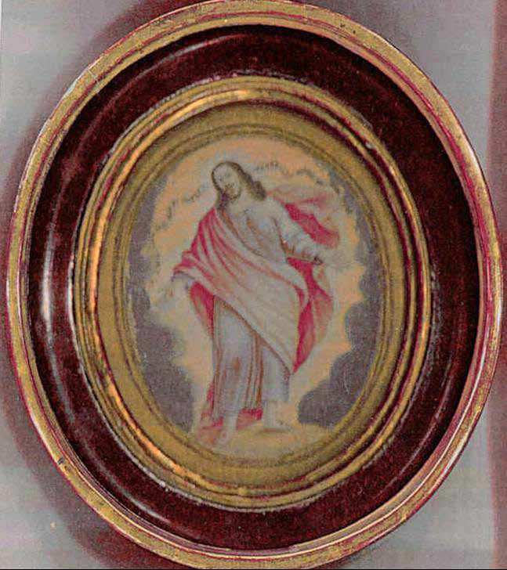
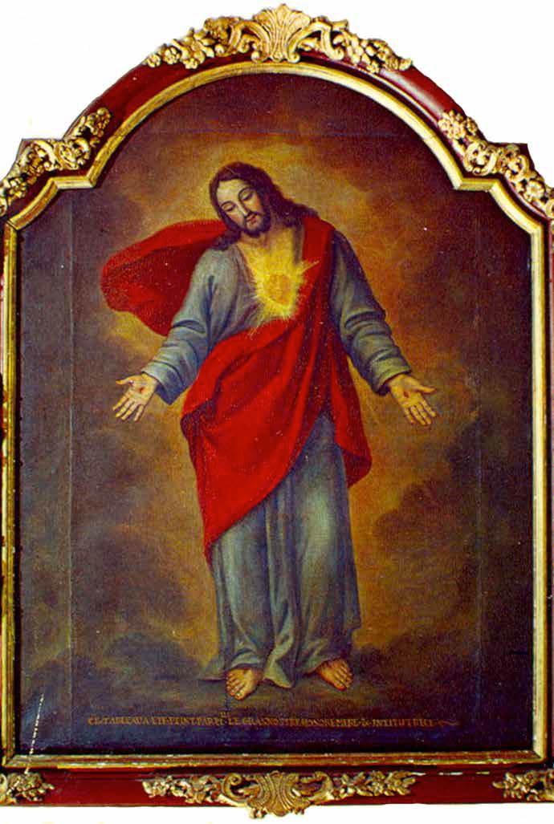
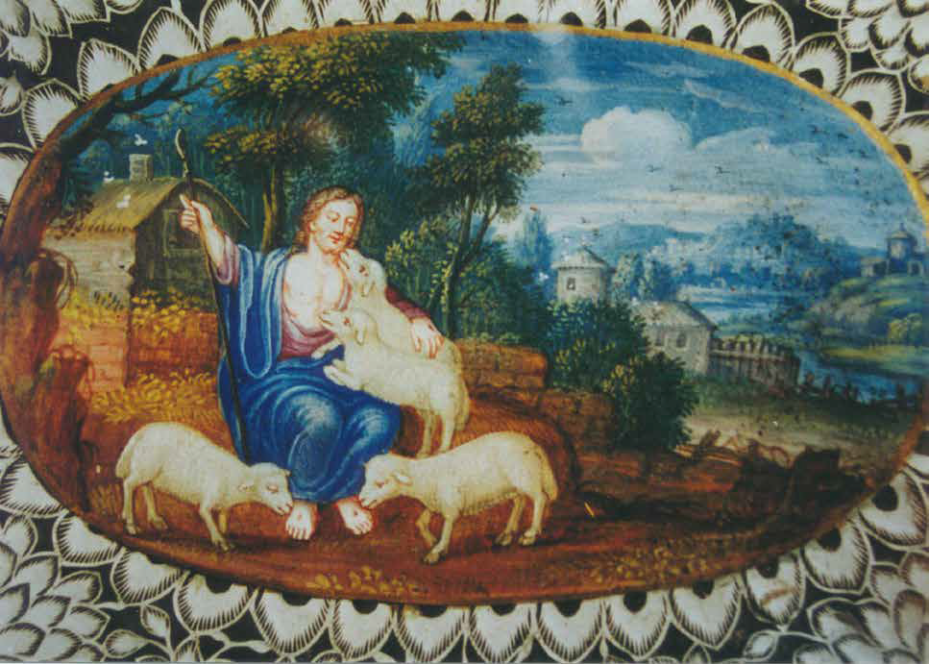
It is surprising that so little has been written about Louise as a painter, surely a very interesting facet of her personality. Vincent refers to her paintings as early as 1630. We still have a number of them and know that there were many more.

Slide 9
Louise called them “the little occasions for amusement that I find in holy cards and other devotions.”

Slide 10
Close photographic analysis of a small medallion, painted by Louise, reveals a heart which the naked eye can barely see, and was unnoticed for years. On the right-hand banner, near the head of Christ, are the words, “Learn from me that I am gentle…”, and on the left-hand banner, “Come, blessed of my Father…”

Slide 11
This large painting is currently housed on the staircase near the office of the Superior General in the Maison-Mère of the Daughters of Charity, rue du Bac. At the bottom of the painting someone has written in capital letters: “Ce tableau a été peint par Mlle. Le Gras notre mère et institutrice [This tableau was done by Mademoiselle Le Gras, our mother and founder].”

Slide 12
In 1891 this painting was noticed in a chapel annexed to the cathedral of Cahors, where a house of the Daughters of Charity had been established in the time of Vincent
and Louise. It is likely that this house, like many others, received a “Lord of Charity” from Louise. Such paintings were probably also placed in the room or chapel where the
Confraternities of the Ladies of Charity met, so that the members might have an image of the Lord, their patron.

Slide 13
The work pictures Jesus, almost life-size, with open arms, his head inclined and his eyes lowered as if he were speaking to someone who is imploring him. He is standing on a globe to signify that he is both its creator and its savior. His feet and hands reveal his wounds. His heart radiates light. It is a remarkable image, particularly if one considers that it was created decades before Saint Margaret Mary’s visions of the Sacred Heart. It is one of the first such representations of the heart of Jesus that we know of.

Slide 14
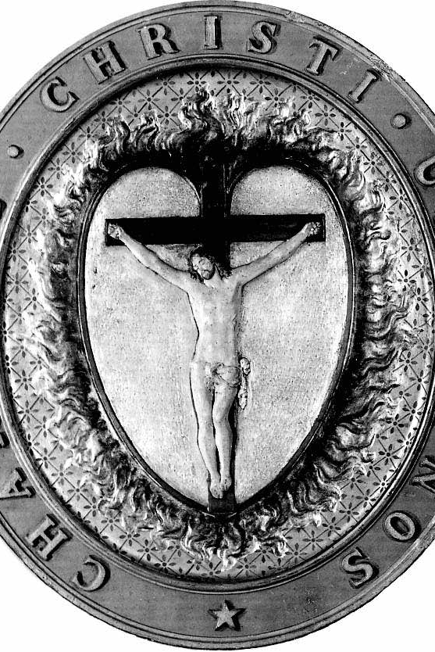
In the Daughters’ emblem, seen here, a burning heart is surmounted by the crucified Lord, and surrounded by “Charitas christi urget nos.” It is clear that this emblem aims to signify that the heart of the crucified Lord is the font of the Company’s works of love.

Slide 15
For Vincent, the heart of Jesus was the source of missionary zeal. For Louise, it was the font of a burning charity that was both affective and effective. Hence, “Mission et
Charité” have had a central role in the lives of their followers, with different accents, in the Congregation of the Mission and the Daughters of Charity.

Slide 16
The two founders’ focus on the heart of Jesus, and the extraordinary impact of Jesus’ heart on their own hearts, moved them toward missionary zeal and toward affective and effective charity.

Slide 17
Points to ponder

Slide 18
Focus on the heart of Jesus heightens our awareness of the limitless love of God

Slide 19
Focus on the heart of Jesus summons us to learn to be gentle and humble

Slide 20
Focus on the heart of Jesus draws us to be vulnerable

Slide 21
Focus on the heart of Jesus offers us an often unused road toward wisdom and discernment (There is a wisdom which goes beyond human knowledge and that flows from the
heart.)

Slide 22
Focus on the heart of Jesus moves us to have a love that is expansive (mission) and that is both
affective and effective (charité)
The expansive love of Jesus’ heart,
his zeal, mirrored in our hearts, is a love that burns with compassion for those around us and drives us out to serve them.

Slide 23

Source:
The Heart of Jesus In the Spirituality of Vincent de Paul and Louise de Marillac
by Robert P. Maloney C.M.
Vincentian Heritage Journal,
Spring 3-6-2014

