Slide 1
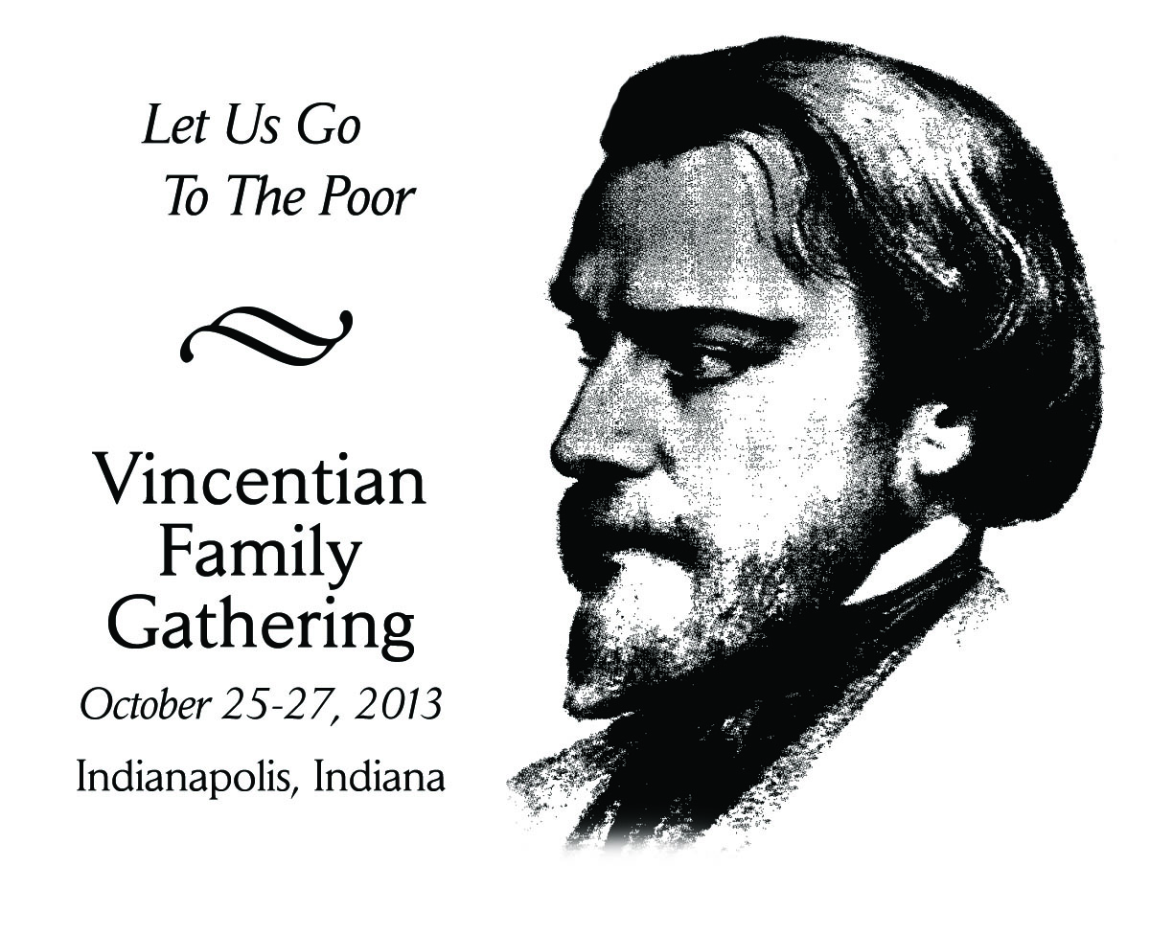
Morning Prayer
Sunday, October 27, 2013

Slide 2
Call to Prayer: Jeremiah 6:16
Leader:
Yahweh says this: “Stand at the crossroads and look. Enquire about the ancient paths: which was the good way? Take it and you shall find provisions for the poor.”

Slide 3
Left:
Lord, as we discuss the Spirituality of Systemic Change, we recall your promise to be present where two or three are gathered in your name. We know that without you here among us, and within us, we will labor in vain.
All:
Lord, in your Wisdom help us to make Systemic Change a living reality.

Slide 4
Right:
We rejoice that we are blessed and called together as Vincentians to work in your name. We pray that we will respond generously to this opportunity to bring about something new for those we serve.
All:
Lord, in your Wisdom help us to make Systemic Change a living reality.

Slide 5
Left:
Inspire us with your Spirit of wisdom; plant seeds of your vision in our hearts and minds;
give us humor and give us humility as we work with one another to transform our service into something new for those living in poverty.
All:
Lord, in your Wisdom help us to make Systemic Change a living reality.

Slide 6
Leader:
Antiphon: “May the radiance of your charity be a beaming light. “ St. Vincent de Paul
Left:
We bless You and thank You as well for that which is stable and unchanging, for the ancient and traditional Word of God that gives meaning to the new.

Slide 7
Right:
We thank you, Lord of all good things, for change in our lives.
Left:
We are grateful, for those among us who, through their gifts of excitement and adventure, have taught us not to fear change, nor to resist the new.

Slide 8
Right:
We are thankful for Your Son, Your Sacred Word, who spoke to us of new wine for new wine skins and who calls us daily to a new kingdom and to a new covenant.
Left:
May our hearts be ever-changing, ever growing, as we journey to You, our Mysterious Source, You who are forever fresh and new yet forever the same.

Slide 9
Leader:
Reading: Isaiah 43: 16-19
Thus says the Lord, who opens a way in the sea, a path in the mighty waters, who leads out chariots and horsemen, a powerful army. Till they lie down, never, never to rise again. Remember not the events of the past, the things of long ago consider not; See I am doing something new! Now it springs forth, do you not perceive it?

Slide 10
Response: All
LEFT: To be a Christian is to believe in the new.
RIGHT: To be a Christian is to believe in a God of newness.
LEFT: To be a Christian is to dare to attempt to see as God sees.
RIGHT: To be Vincentian is to believe in our call to change people’s lives.

Slide 11
Closing Prayer:
Leader: Loving God, we thank You especially now for the gift of change, that gift of newness that opens doors closed by habit and routine.
Leader: We dare to pray:: All: God, let the world be changed, for we long to see the end of poverty.
Leader: We dare to pray: All: God, let the rules be changed, for we long to see our economic structures bring justice to those who are poor.

Slide 12
Leader: We dare to pray:
All: God let our lives be changed, for we long to bring hope where the Good News is needed.
Leader: With the strength of your spirit and inspired by your compassion, we dare to make this promise to work for systemic change.
All: United with our Vincentian brothers and sisters, we will go to the poor with loving compassion and a holistic approach. We ask this in Jesus Name. Amen.

Slide 13
Sing: Find us Faithful
We’re pilgrims on the journey of the narrow road
And those who’ve gone before us line the way
Cheering on the faithful, encouraging the weary
Their lives a stirring testament to God’s sustaining grace.
Surrounded by so great a cloud of witnesses Let us run the race not only for the prize But as those who’ve gone before us,
Let us leave to those behind us the heritage of faithfulness
Passed on through Godly lives.

Slide 14
Refrain:
May all who come behind us find us faithful
May the fire of our devotion light their way
May the footprints that we leave, lead them to believe
And the lives we live inspire them to obey
May all who come behind us find us faithful.

Slide 15
After all our hopes and dreams have come and gone
And our children sift through all we’ve left behind
May the clues that they discover and the memories they uncover
Become the light that leads them to the road we each must find.

Slide 16
Refrain:
May all who come behind us find us faithful
May the fire of our devotion light their way
May the footprints that we leave, lead them to believe
And the lives we live inspire them to obey
May all who come behind us find us faithful.
People Need the Lord by Steve Green
The Sparrow Corporation

