Slide 1

A Vincentian Focus on Health Care in the USA
Sr. Carol Keehan, DC
President and Chief Executive Officer
September 15, 2012
Ladies of Charity of the USA National Assembly

Slide 2
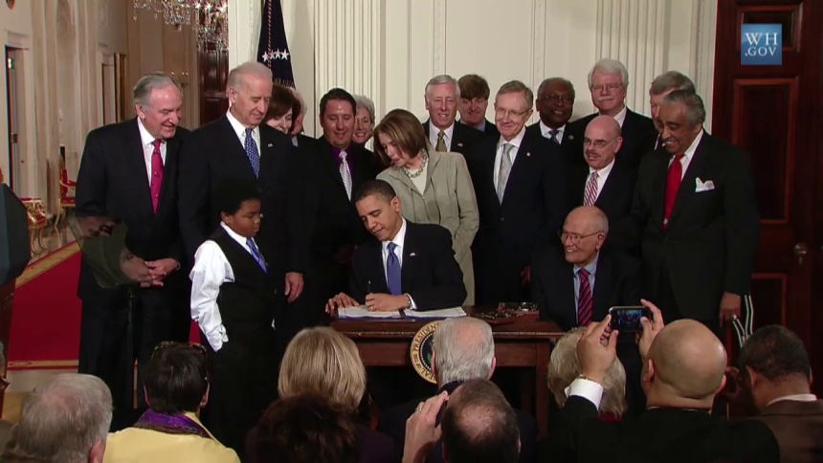
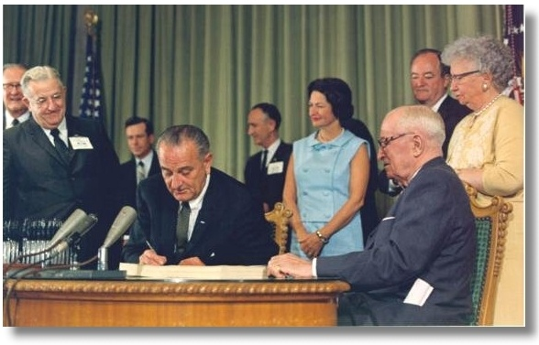
National Health Reform
Historic Health Reform Signed into Law – March 23, 2010
As significant as the 1965 signing of the Medicare and Medicaid law
Photo Credits: www.ssa.gov Courtesy LBJ Presidential Library / WH.GOV

Slide 3
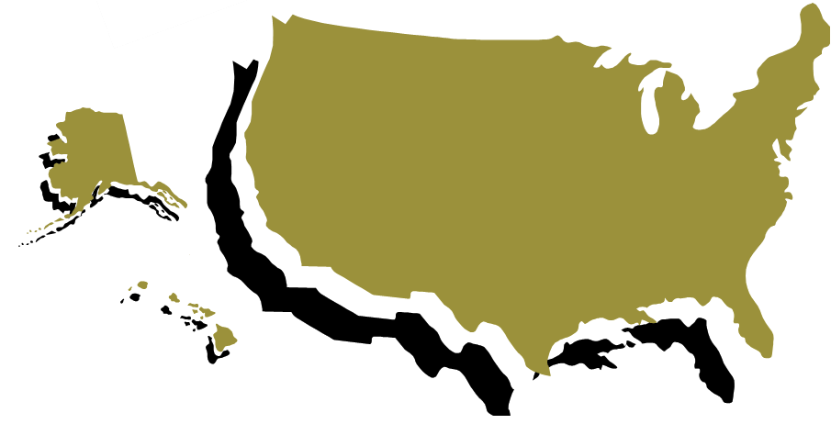

National Health Reform
The overall U.S. health care system was:
  Unsustainable
  Unfair
  Inefficient
No question it had many pockets of excellence

Slide 4
Health Care in the U.S.
The need in the USA for improving our system
  Approximately 50 million uninsured
  Millions more underinsured
  18,000 preventable deaths/year due to lack of access
  Elderly choosing between food and medicine
  Over 9 million children uninsured

Slide 5
Health Care in the U.S.
The need in the USA for improving our system (continued)
  Over 50% of personal bankruptcies due to health expenses
  National abortion rate ⬇ 8%
    Abortion rate among low-income women ⬆ 18%
  Most vulnerable with serious illnesses lose coverage when limit is hit or cannot get insurance at all

Slide 6
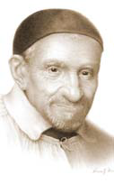
How Would St. Vincent Respond
To This?
“The father of the poor”
“The universal patron of charity”
  Wonderful at making the plight and suffering of the poor real to those in power
  Often, but not always, successful
  Often was only able to make minimal progress
  Often denounced and/or ridiculed
  Never stopped trying and never attacked those who opposed him

Slide 7
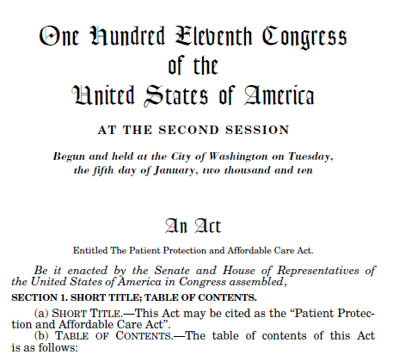
The Patient Protection and Affordable Care Act
  The health reform law is not the perfect solution
  It does have great potential to help the American people, especially the working families and the poor
  We have to start the journey to full coverage for all
  We see the consequences of this as well as the suffering on a daily basis
  We cannot ignore that and wait for a perfect solution

Slide 8
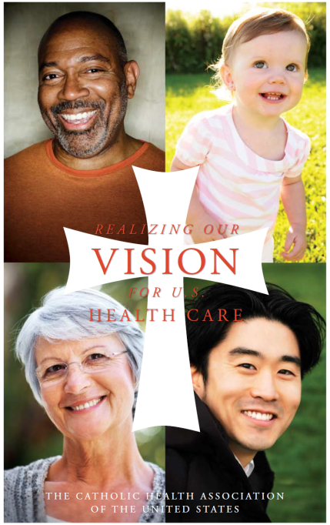
The Patient Protection and Affordable Care Act
CHA said we would compromise our preferences but not our principles

Slide 9
The Patient Protection and Affordable Care Act
What’s Working for the American People Already?
  Adult children up to 26 can stay on their parents’ policy
  Pre-existing conditions in children cannot be denied coverage
  No lifetime limit on benefits
  Companies must prove fraud to cancel a policy
  Must allow an appeal before denying a claim

Slide 10
The Patient Protection and Affordable Care Act
What’s Working for the American People Already? (continued)
  Preventive services must be available without a co-pay for Medicare and private insurance
  Free choice of a primary care M.D., including OB-GYN and pediatrician, must be allowed
  Closing the “donut hole” for Medicare recipients
  Insurance companies must spend 80 to 85 percent of the insurance dollars for medical care and quality
  Monitoring of rate increases

Slide 11
The Patient Protection and Affordable Care Act
What’s Going to Work in the Future for the American People?
  New coverage for working uninsured is projected to be 30-32 million
  Medicaid eligibility will increase and is 100 percent federally funded
  Multi-state health plans

Slide 12
The Patient Protection and Affordable Care Act
What’s Going to Work in the Future for the American People? (continued)
  Health insurance exchanges
    Estimated that 16 million small business employees will qualify
    Federal subsidies employer tax credits and employee contributions
    Decreased expense due to volume purchasing
  More quality data available for providers and consumers
  Clinical effectiveness/innovation studies

Slide 13
The Patient Protection and Affordable Care Act
What is working in the U.S.A.

Slide 14
The Patient Protection and Affordable Care Act
What’s working for Americans?
  32.5 million Americans on Medicare have already received preventive services without cost
  3.6 million Americans on Medicare received $250 rebate for “the donut hole”
  Pre-existing condition insurance plans run through the states or the U.S. Department of Health and Human Services
  Small businesses are eligible for a tax credit up to 35% of premium cost

Slide 15
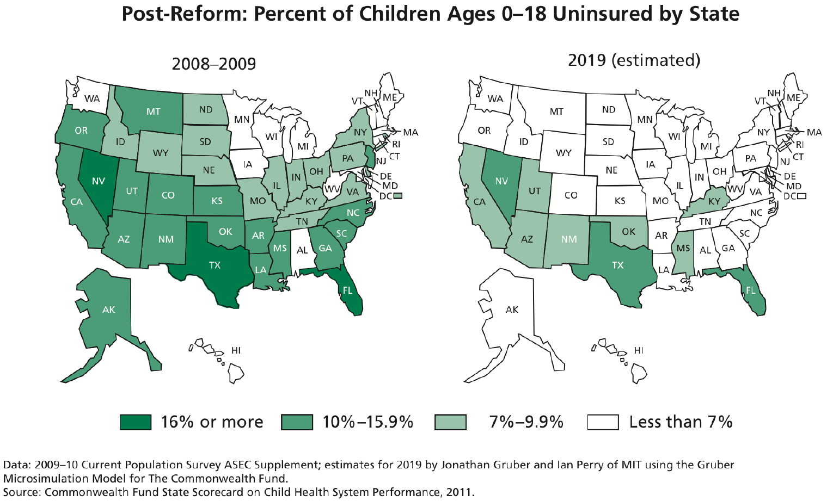

Health Care in the U.S.

Slide 16
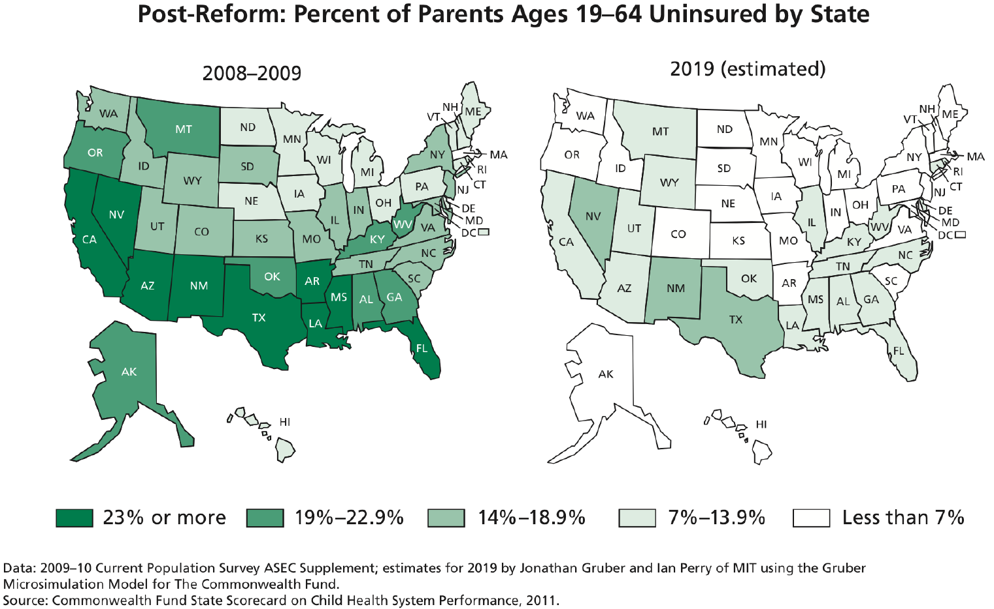
Health Care in the U.S.

Slide 17
The Patient Protection and Affordable Care Act
Life Issues
  A critical CHA principle
  No federal funding of abortion in ACA
  Two federal judges (Ohio and Virginia) have ruled that there is no federal funding of abortion
  In the exchanges – must buy a separate plan to get abortion coverage
  May not discriminate against handicapped in any coverage or medical decision
  May not require any provider to participate in euthanasia or abortion to be in a plan

Slide 18
The Patient Protection and Affordable Care Act
Religious Freedom Issue
  New definition of Religious Employer
  Force religious employers to buy contraception and sterilization
  Current situation:
    Waiting on final regulations
    One year waiver – dialogue
    Will not have to buy, refer or negotiate for coverage but employees will get it separately
    Working to improve

Slide 19

Suggestions for a Vincentian Response
  Know the facts
  Know the need
  Work to improve religious employer definition
  Advocate for good exchanges and expansion of Medicaid
  Advocate for simple, easily accessed enrollment procedures
  Help people know and access their benefits
Help our nation know, respect and love our brothers and sisters who are poor

Slide 20
A Vincentian Focus on Health Care in the USA
Sr. Carol Keehan, DC
President and Chief Executive Officer
September 15, 2012
Ladies of Charity of the USA National Assembly

