Slide 1
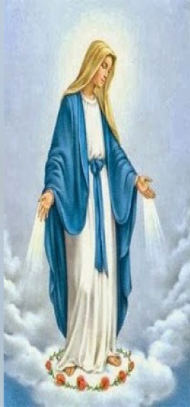
VINCENTIAN FAMILY
COLÓN - 2015

Slide 2
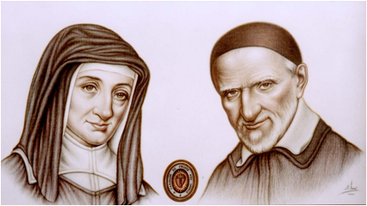
Vincentian Family
Web page
www.famvin.org
OUR FOUNDERS
St. Vincent de Paul
September 27, 1660
St. Louise de Marillac
March 15, 1660

Slide 3
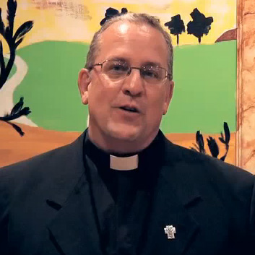
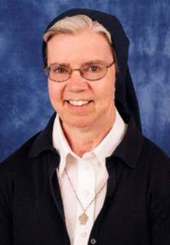
Vincentian Family
Web page
www.famvin.org
Successors of Vincent and Louise
Father General
Gregory Gay
Mother General
Kathleen Appler

Slide 4
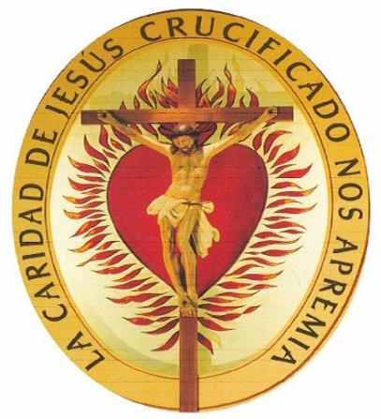
Branches of the Vincentian Family
In Colon
International Association
Of Charity
Congregation
of theMission
Daughters of Charity
Vincentian Marian
Youth
Vincent de Paul
Society

Slide 6
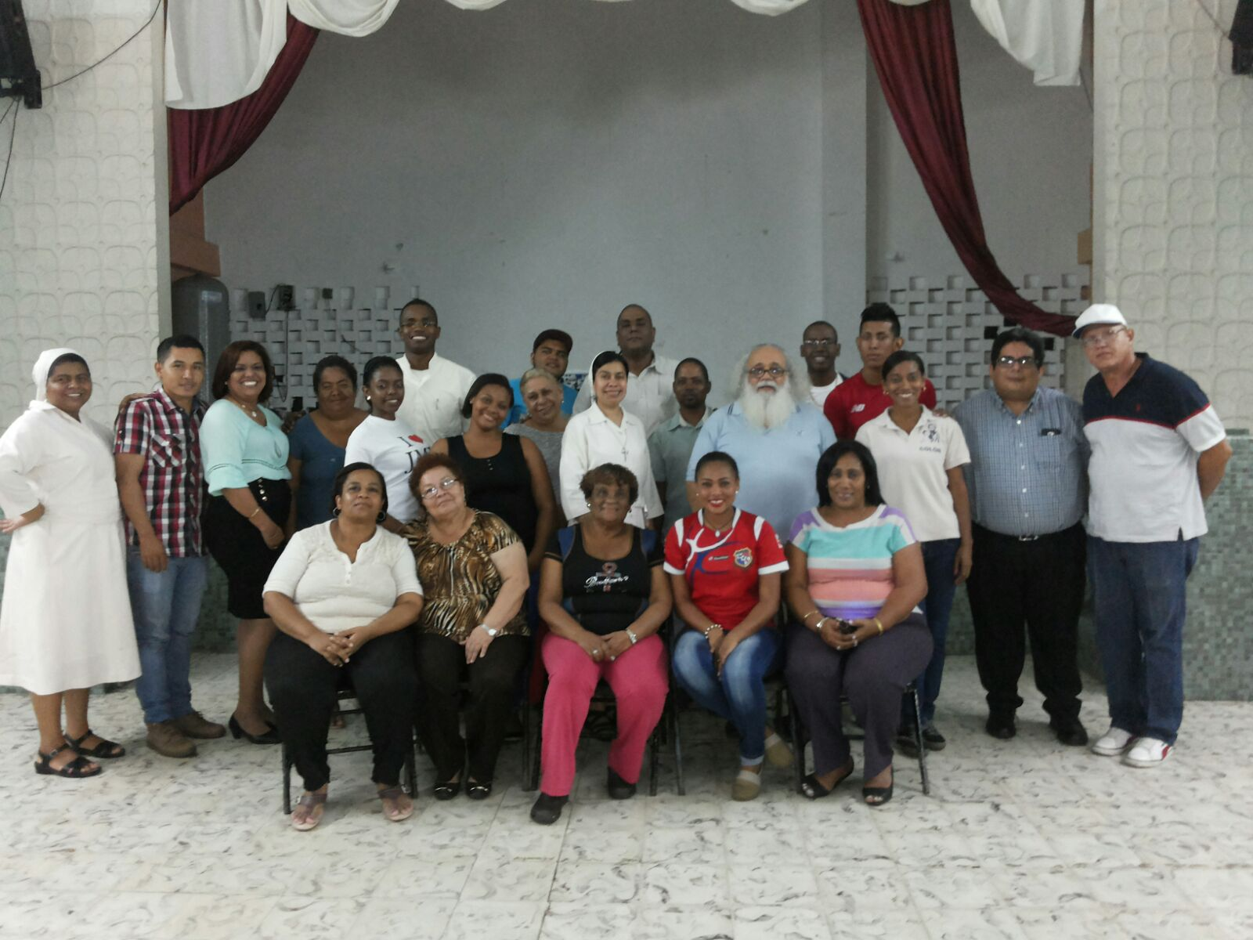
VINCENTIAN FAMILY COLON

Slide 7
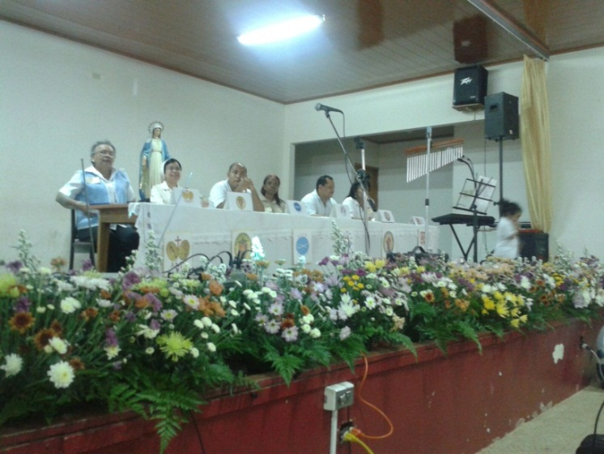
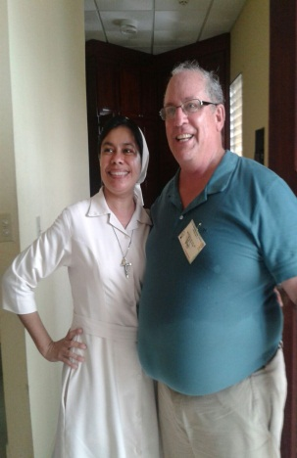
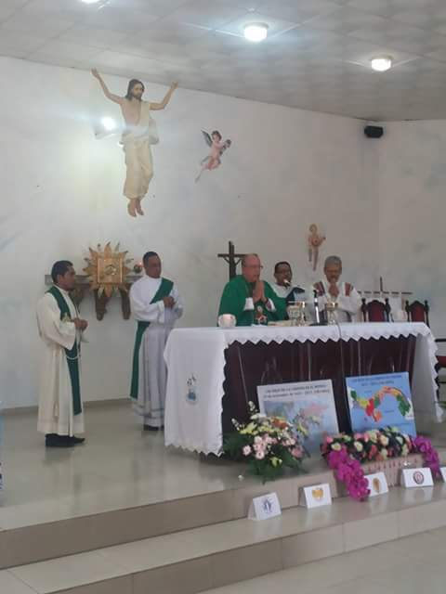
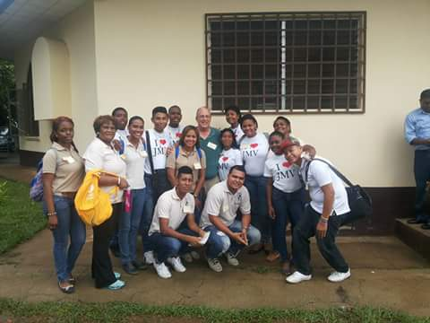
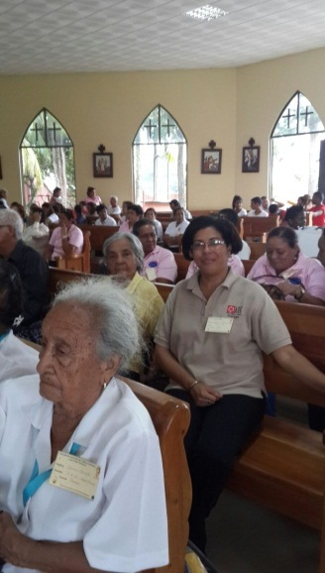
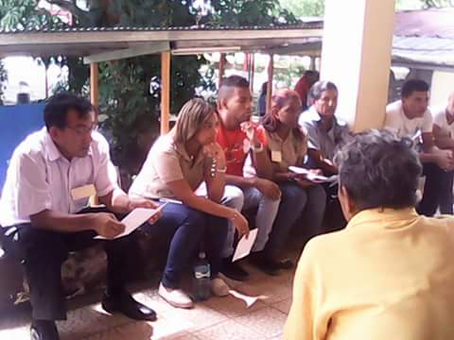
Participating in the National Encounter of the Vincentian Family
Santiago de Veraguas
September 5, 2015

Slide 8
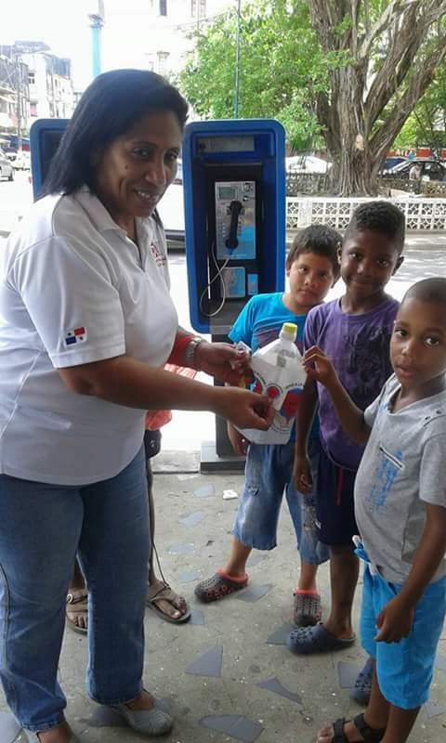
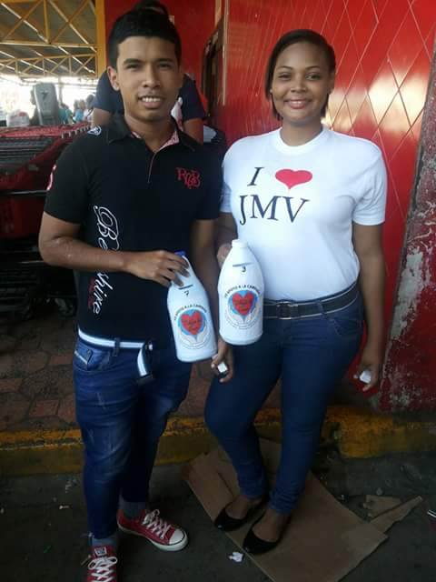
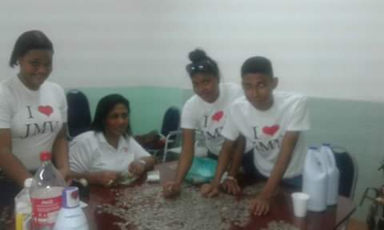
PROJECT:
BLANKETS OF LOVE
September 19
With joy we go out into the streets in order to collect funds

Slide 9
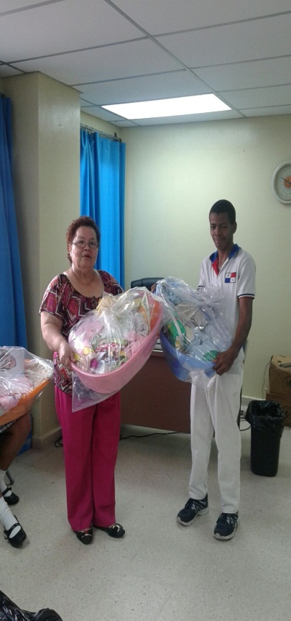
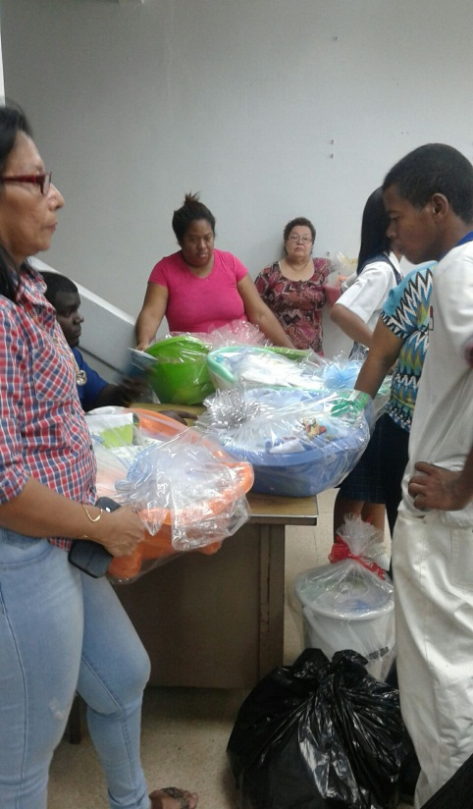
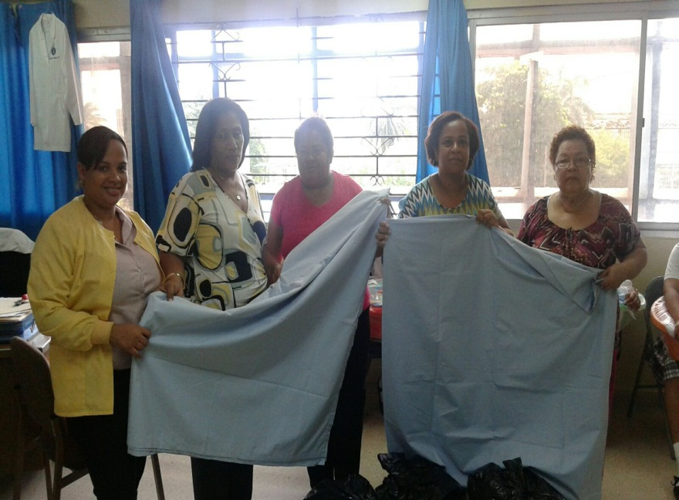
PROYECTO
COBIJAS DE AMOR
27 de noviembre
Vincentian Family
Bringing blankets
Hospital Manuel Amador Guerrero

Slide 10
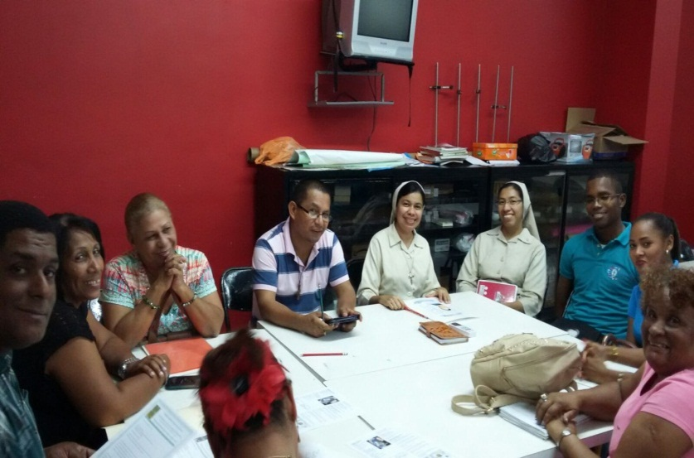
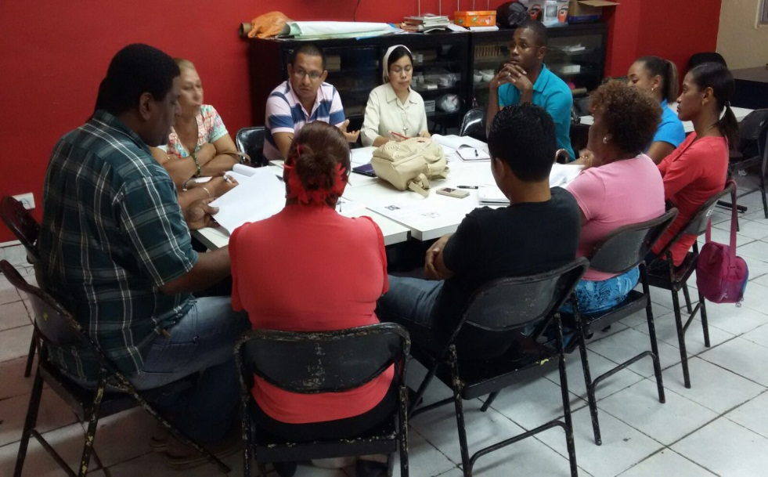
Leadership Board
of the Vincentian Family in Colon
October 28th
ORGANIZING
UNITED AND WITH JOY WE SHARE THE CHARISM

Slide 11
VINCENTIAN FAMILY
COLON
Leadership
Board
President
Amparo de Caro
AIC
Vice president
Candy Aizpurrúa
VMY
Secretary
Roxana Rountree
SSVP
Treasurer
Juan Pretto
SSVP
Press
Aracely Aizpurrúa
VMY
Spiritual Formation
Fr. Norberto Abrego
CM
Advisor
Sr. Carolina Solórzano
DC

Slide 12
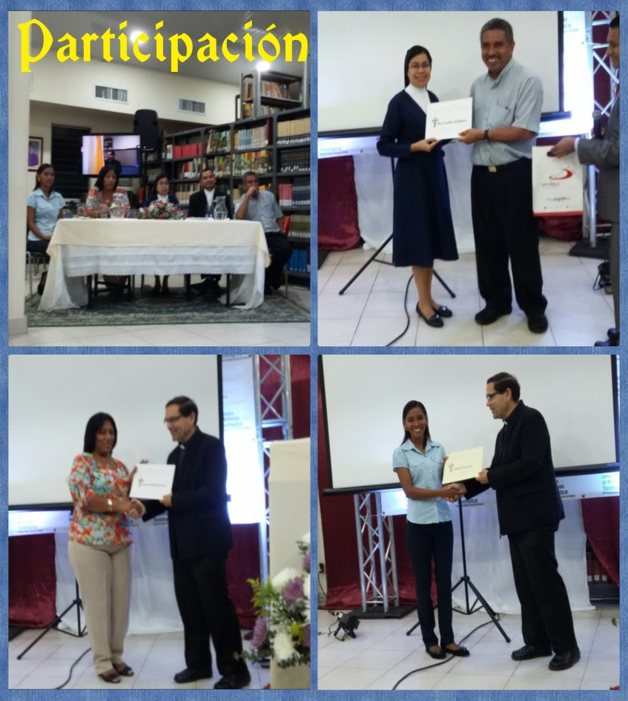
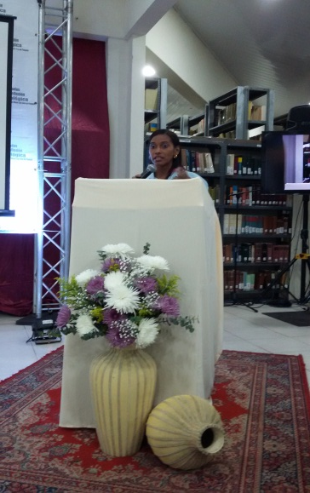
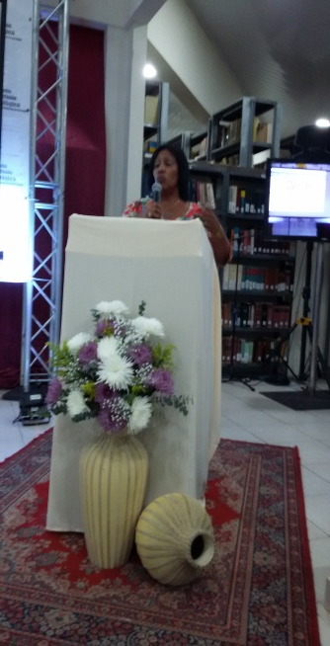
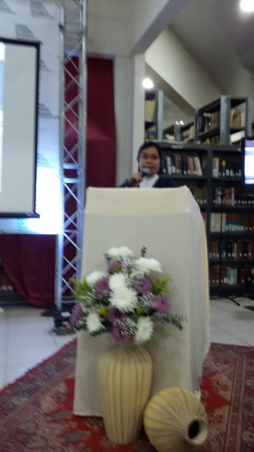
Sharing Formation Themes
November 16
VMY
AIC
DC
Collaborating in the Diocesan Major Seminary, San Jose, Panama.

Slide 13
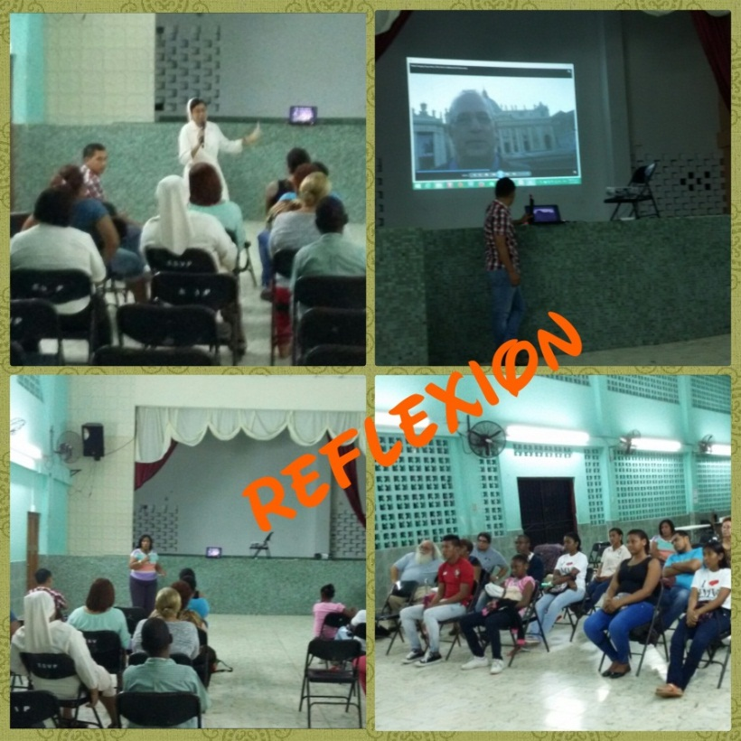
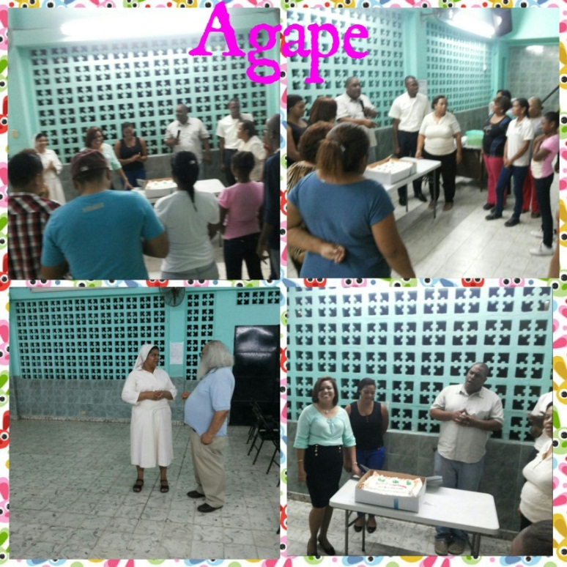
VINCENTIAN FAMILY ENCOUNTER COLON
November 17th
Team
Work
Fraternity

Slide 14
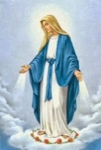
Vincentian Family Project:
Musical Palace
Miraculous Medal

Slide 15
MUSICAL PALACE
Centers of Cultural Formation
which services children and teenagers residing in Colon and the surrounding áreas.

Slide 16
MUSICAL PALACE
Instruments are available
Volunteers/Instructors

Slide 17
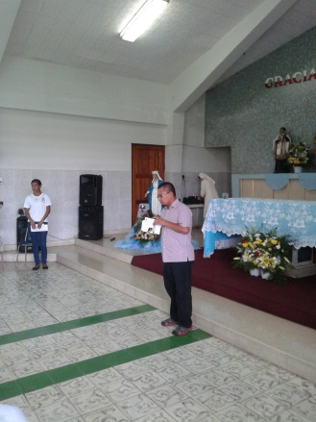
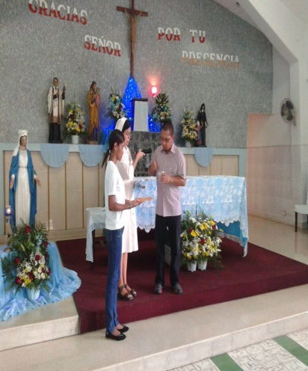
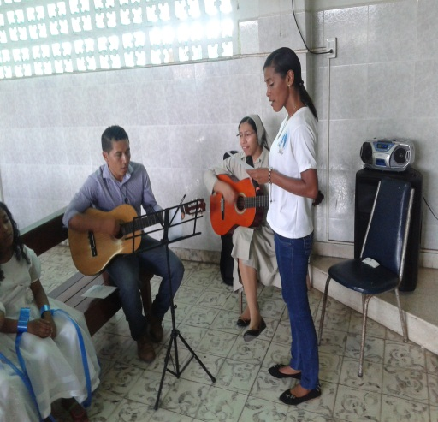
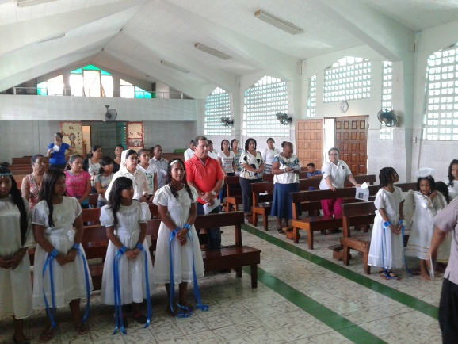
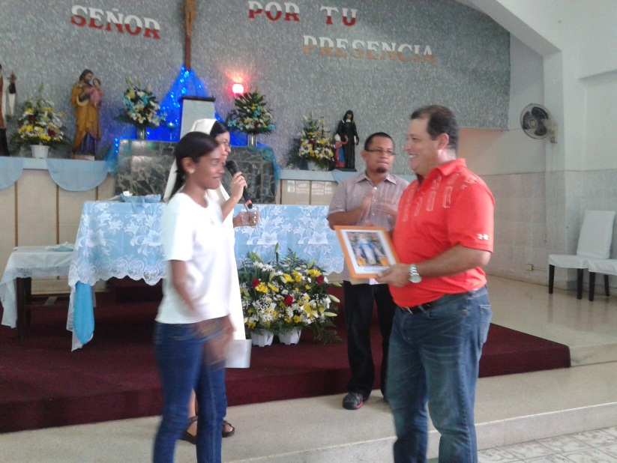
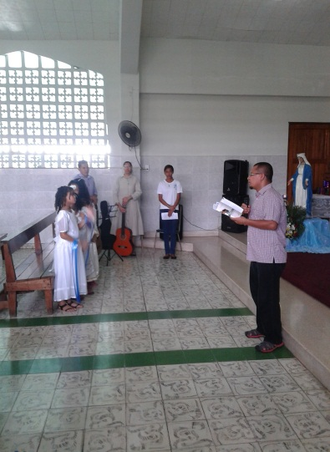
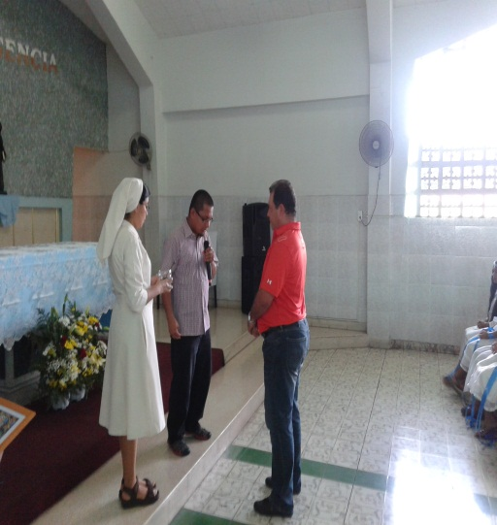
INAUGURATION
MUSICAL PALACE
November 27
Religious Invocation

Slide 18
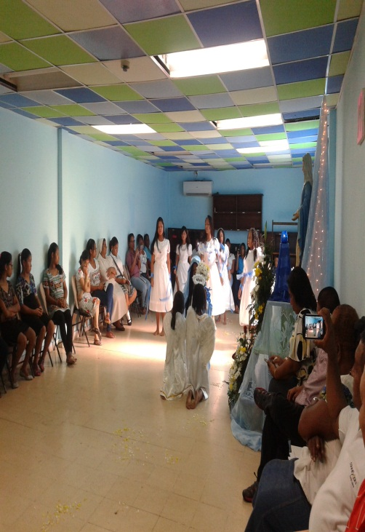
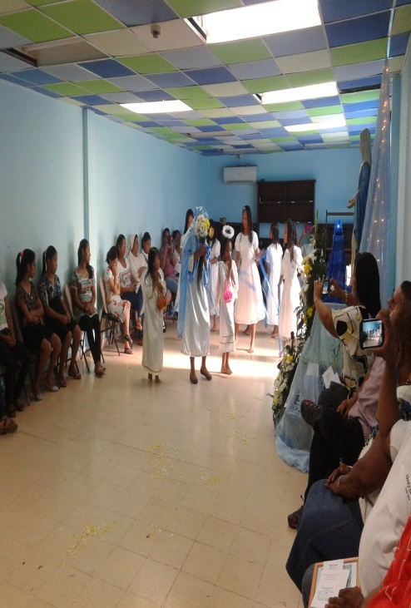
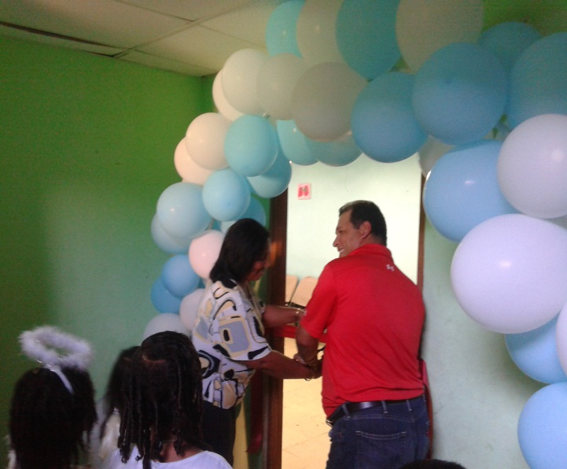
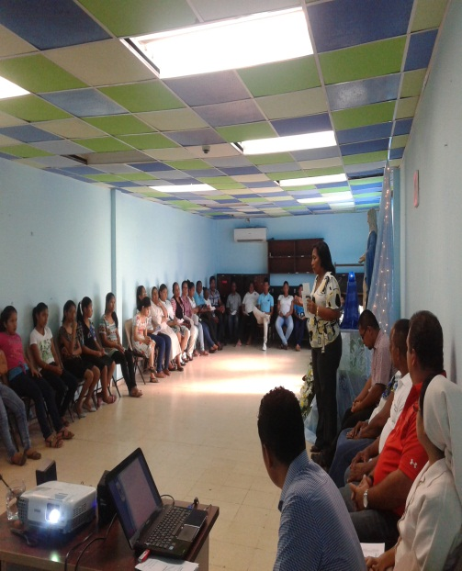
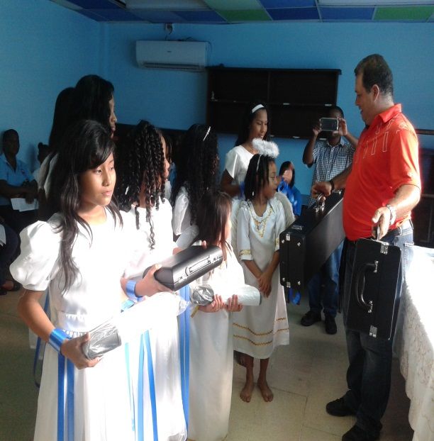
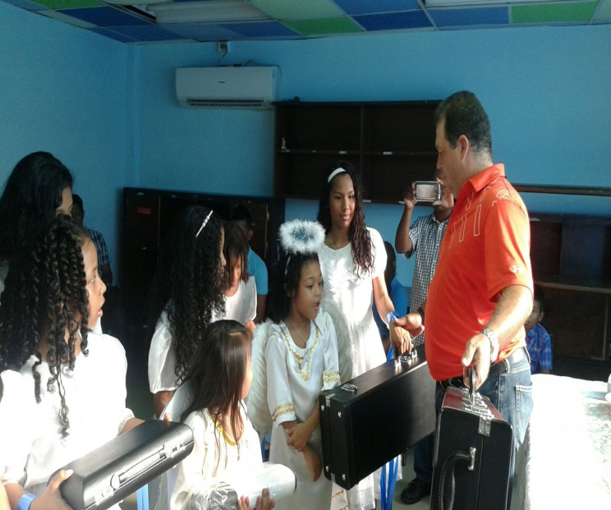
INAUGURATION
MUSICAL PALACE
Noviembre 27
Marian dance
Ribbon cutting
Distribution of instruments
Words of encouragement

